Slide 1

Why Use LEGO®
in Research?
Thinking with our hands: A creative and participatory research method
Olalekan Adisa (PhD)
MAKE • SHARE • INTERPRET
Notes:
Timing: 0–3 minutes.
Welcome participants and frame the session as an introduction to defensible research use — not a certification course. Ask participants to keep their bricks untouched until the skills-build instruction on slide 6.
Trademark note: LEGO® and LEGO® SERIOUS PLAY® are trademarks of the LEGO Group. This independent CPD resource is not endorsed by the LEGO Group.

Slide 2

CONTENTS
What we will cover.
1
Why it works, and where it fits
Where building sits in the research process
The core facilitation cycle
Where it has been applied
2
Now build something
Skills: build, make, then explain
Research simulation: adding a barrier
3
Evaluate the evidence
What counts as data
Limitations

Slide 3

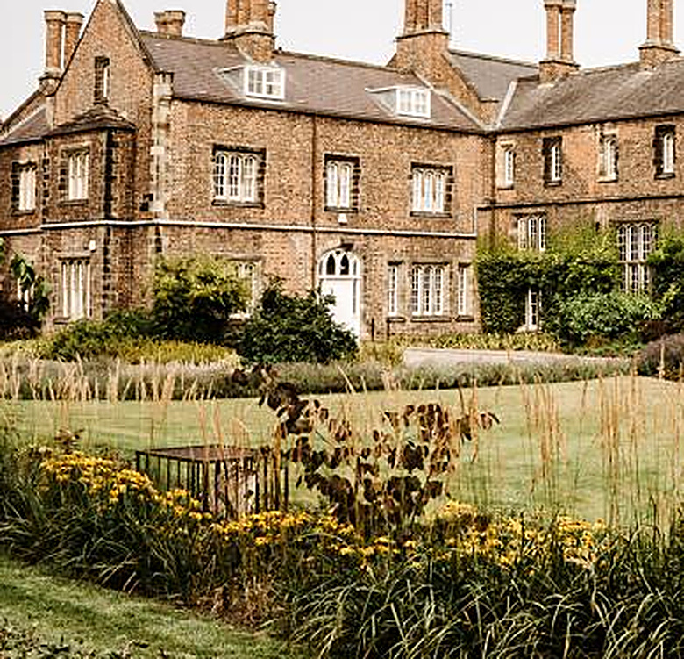
01 · WHY IT WORKS
Some knowledge could be hard to explain
through words alone.
Making and metaphor help participants externalise tacit, emotional, relational and spatial experience — and then explain it in their own terms.
1
2
3
4
5
Makes the abstract visible
Surfaces tacit knowledge
Provide another mean for expression
Exposes divergent perspectives
Converges perspectives
Leadership, identity, culture and power become objects that can be pointed at and questioned.
Building can articulate experiential knowledge that direct questioning rarely reaches.
Everyone builds and everyone speaks, reducing domination by the most senior or confident.
Several people building the same issue makes similarity and disagreement visible at once.
Partcipants identifying patterns together
FRAMING QUESTION Where might conventional interviews or focus groups limit expression? Value comes from the participant's explanation, not from the researcher 'reading' the model.
Notes:
Timing: 4 minutes (3–7).
Invite two or three quick responses to the framing question. Emphasise that construction can slow thinking, make relationships visible and provide a shared object for dialogue. Do not claim LEGO is universally suitable — appropriateness depends on question, participants, access and ethics.
[Sources]
- Gauntlett, D. (2007) Creative Explorations. London: Routledge.
- Papert, S. & Harel, I. (1991) 'Situating constructionism', in Constructionism. Norwood, NJ: Ablex, pp. 1–11.
- Lakoff, G. & Johnson, M. (2003) Metaphors We Live By. 2nd edn. Chicago: University of Chicago Press.
- McCusker, S. (2020) IJRME, 43(2), pp. 146–162.

Slide 4

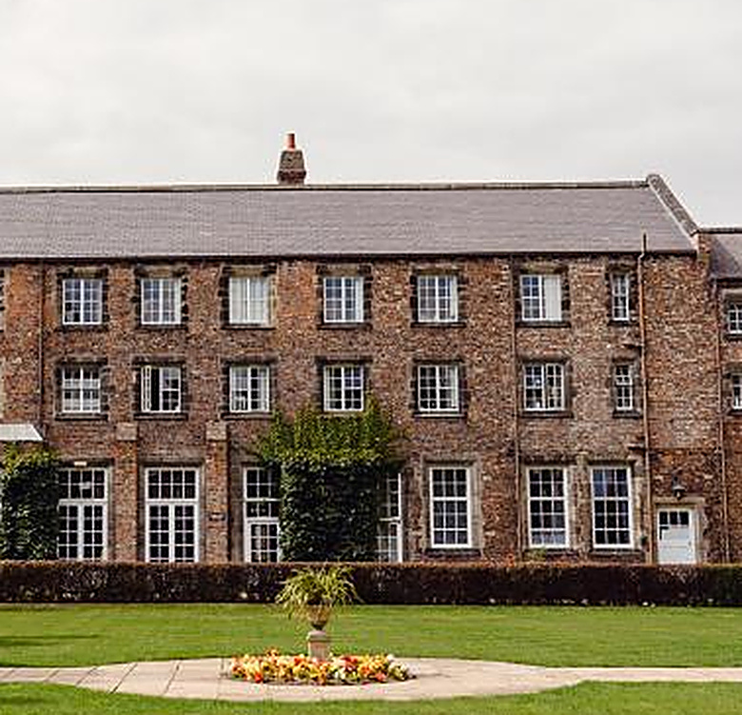
02 · THE SEQUENCE
Where building sits in the research process.
Building is a stage inside the design, not an activity bolted alongside it. Each stage produces something the next stage depends on.
1
›
2
›
3
›
4
›
5
›
6
Research question
Individual build
Participant narration
Group discussion
Shared meaning
Researcher interpretation
A focused inquiry that construction can plausibly serve.
Each participant makes a model. No technical skill judged.
The builder explains what the model represents.
Others ask clarifying questions. No interpretation imposed.
Agreement, patterns, tension and interdependence surface.
Coding and thematic analysis, grounded in the narration.
Decide at design stage which of these stages generate data, which support the research team's thinking, and which do both.
Notes:
Timing: 2 minutes (7–9).
This sequence is the spine of the session — everything that follows maps onto one of these six stages. Stress that the researcher's interpretation is the LAST stage, not the second. A common failure is jumping from the model straight to interpretation, skipping the participant's own account.
[Sources]
- Kristiansen, P. & Rasmussen, R. (2014) Building a Better Business Using the LEGO® Serious Play® Method.
- Henderson, H., Shipway, R. & Jones, I. (2025) Qualitative Inquiry.

Slide 5

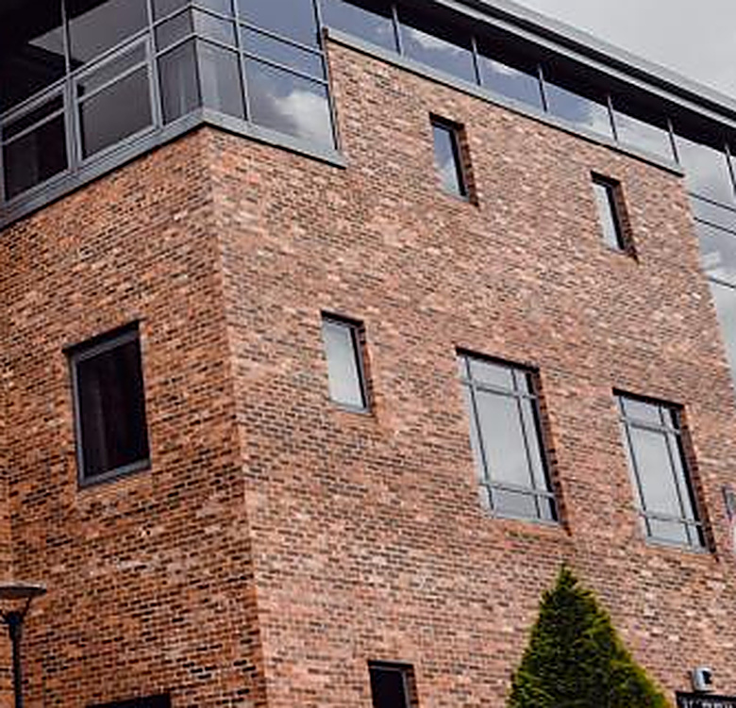
03 · PURPOSE
Three defensible research uses.
Ask first: what role will building play in this study?
01
02
03
Research elicitation
Participatory research
Research development
Participants build and narrate experiences, identities, barriers or imagined futures. The narration is the data.
Groups compare perspectives, negotiate meaning and co-design responses to a shared problem.
Researchers model their own questions, concepts, systems or projects to sharpen a design.
GENERATES RESEARCH DATA
GENERATES RESEARCH DATA
SUPPORTS RESEARCH THINKING
WHERE IT HAS BEEN APPLIED
Management & organisations
Higher education
Nursing & health
Tourism & geography
Notes:
Timing: 4 minutes (9–13).
Distinguish data generation from researcher development. A model used to clarify the research team's thinking is useful, but it is not participant data unless it was designed and consented as such. Peabody & Noyes is the reference to reach for if someone asks about LSP used purely for reflection or teaching.
[Sources]
- Hickman Dunne, J. & Pimlott-Wilson, H. (2021) in Creative Methods for Human Geographers. London: SAGE.
- Kriszan, A. & Nienaber, B. (2024) Societies, 14(2), Article 15.
- Warburton, T., Brown, J. & Sandars, J. (2022) Nurse Education Today, 118, Article 105528.
- Wengel, Y. (2020) IJCHM, 32(4), pp. 1605–1623.
- Peabody, M.A. & Noyes, S. (2017) Reflective Practice, 18(2), pp. 232–243.
- Chew, R.S.Y. et al. (2025) IJLTER.

Slide 6
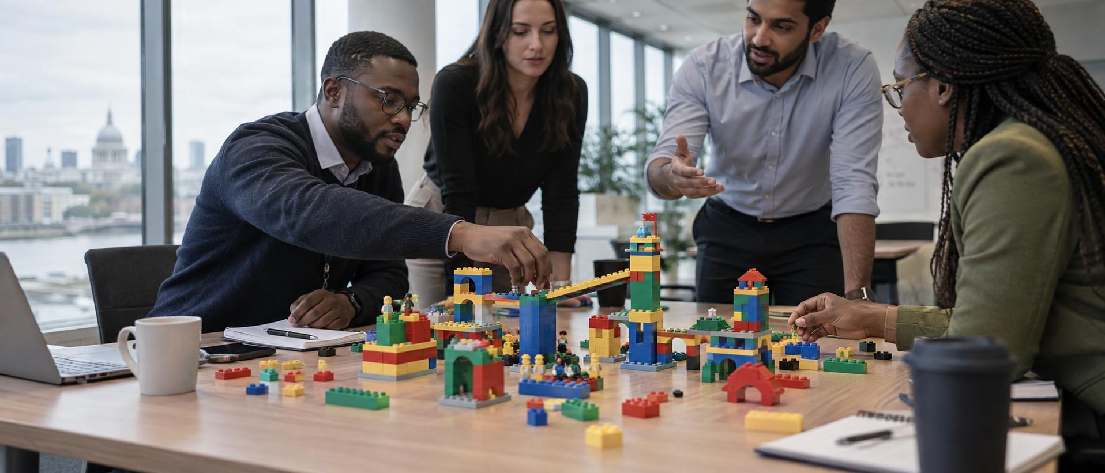
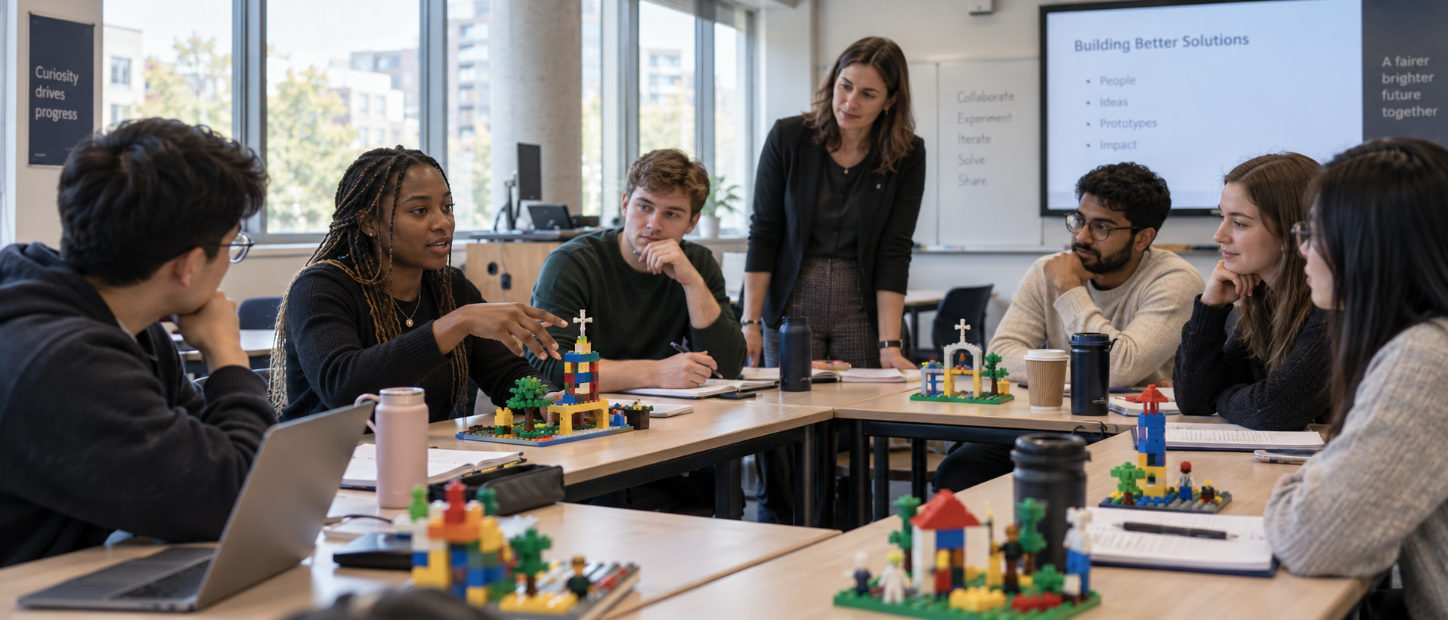
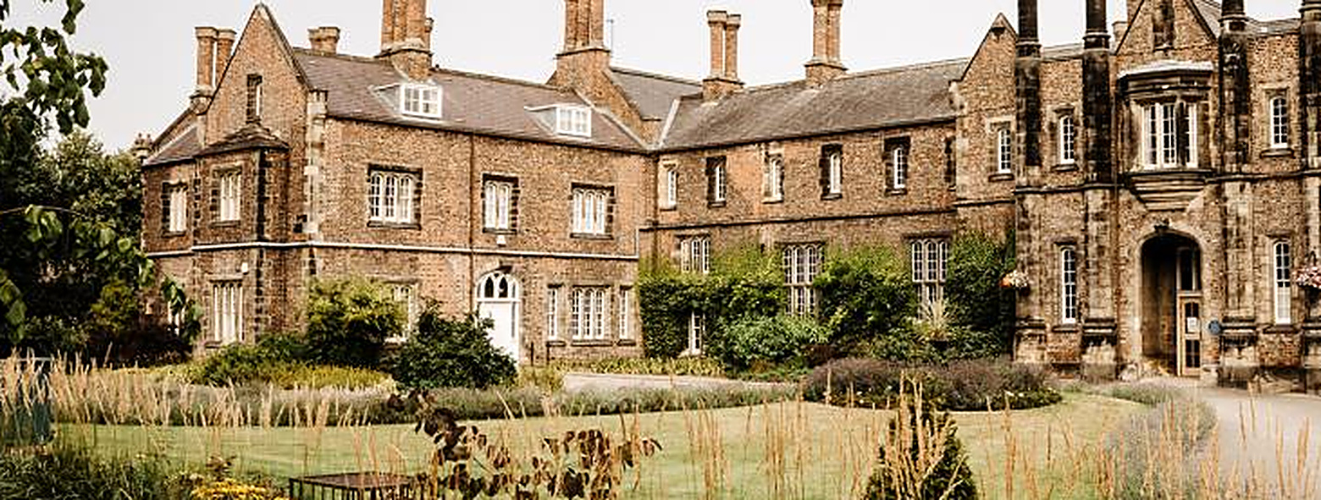

03 · APPLIED
In organisations and classrooms
Management and organisations
Teaching and learning
Making organisational complexity visible
Supporting active, collaborative and reflective learning
Strategy
Active engagement
Stakeholder relationships
Critical and creative thinking
Risks
Group Engagement
Barriers
Visible understanding
Notes:
Applications, part one.
These two slides sit inside section 03 and answer the obvious question after 'three defensible uses': who is actually doing this?
The photographs are placeholders — right-click, Change Picture, and swap in images relevant to the field or to your own institution.

Slide 7

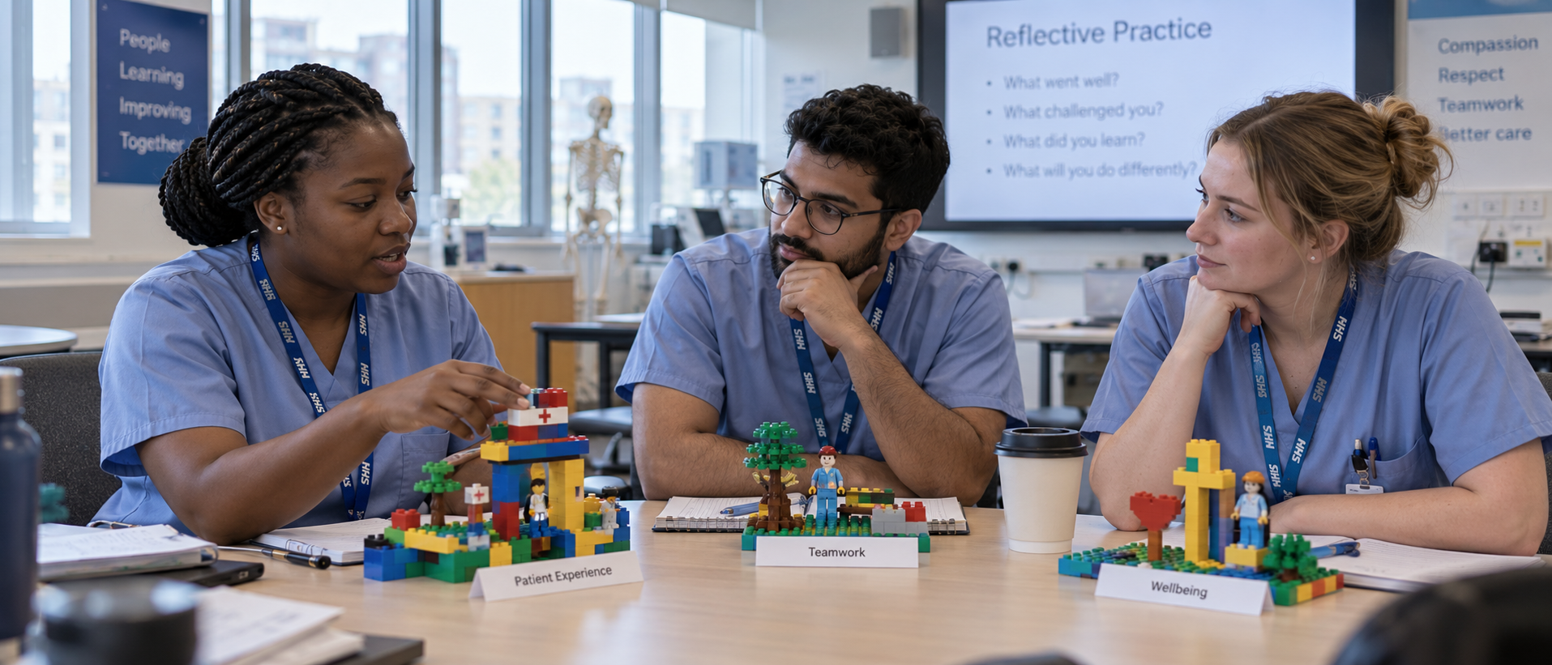
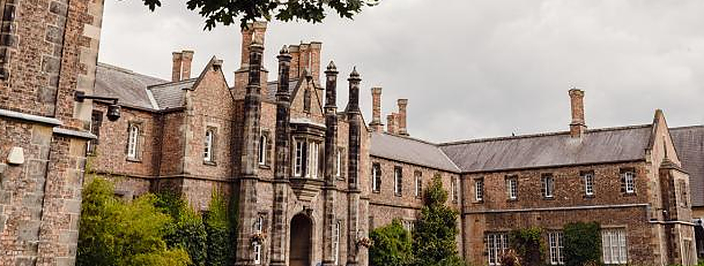
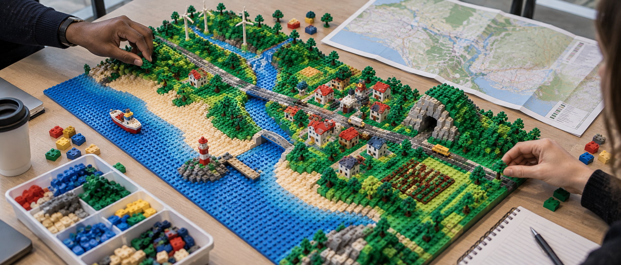
03 · APPLIED
In health and Tourism
Where experience is personal and situated, building offers a second route into accounts that are difficult to give directly.
Nursing and health
Tourism and geography
Supporting reflection in professional practice
Experience, place and sustainable futures
Nursing values
Host–guest experiences
Professional practice
Sustainable futures
Patient-care experiences
Landscapes and mobility
Notes:
Applications, part two.
Nursing is the best-evidenced of the four (Warburton, Brown and Sandars, 2022, is a scoping review). Tourism and geography is where the sharpest methodological critique comes from (Wengel, McIntosh and Cockburn-Wootten, 2021).
The photographs are placeholders — right-click, Change Picture, to swap them.

Slide 8


04 · FACILITATION
The core facilitation cycle.
Five stages, every time. Everyone builds, and everyone shares: equal participation is the rule, not the aspiration.
1
2
3
4
5
›
›
›
›
POSE
BUILD
SHARE
SYNTHESISE
REFLECT
One focused challenge, stated once and left visible.
Individual meaning-making. No technical skill is judged.
The builder explains their model and answers questions about what elements represent.
Participants identify patterns and connections across models.
Connect the account back to the inquiry.
The model is not the finding. Meaning comes from the participant's explanation and transparent analysis, not from the researcher decoding colour, height, or distance.
Notes:
Timing: 4 minutes (13–17).
Walk through the five stages. Stress equal participation. Clarifying questions should invite elaboration — 'What does this element represent?' — rather than impose interpretation. Model a bad clarifying question ('So the red brick means anger?') and ask the room what is wrong with it.
[Sources]
- Kristiansen, P. & Rasmussen, R. (2014) Building a Better Business Using the LEGO® Serious Play® Method.
- Henderson, H., Shipway, R. & Jones, I. (2025) Qualitative Inquiry.
- McCusker, S. (2020) IJRME, 43(2), pp. 146–162.

Slide 9

PART TWO
Now, let’s build
something.

Slide 10
05 · YOUR TURN
Skills build:
make, then explain.
YOUR CHALLENGE
Build a model showing what good research feels like.
Six minutes, two moves. This is the smallest complete version of the cycle on the previous slide — pose, build, share, clarify.
1
3 MIN · Build individually
Work alone. No technical skill is judged and there is no wrong model.
2
3 MIN · Share with others
DEBRIEF
The builder owns the meaning.
What did the brick let you say that words alone would not have?
Clarify — do not interpret: “What does that piece represent for you?”
Notes:
Timing: 6 minutes (17–23).
Give exactly three minutes to build and three to share. If bricks are scarce, use pairs but ask each person to add one element and explain it. Debrief briefly: what changed when you had an object to think with? Keep the debrief to 60 seconds — the substantive discussion belongs on slide 7.
[Sources]
- Gauntlett, D. (2007) Creative Explorations. London: Routledge.
- Kristiansen, P. & Rasmussen, R. (2014) Building a Better Business Using the LEGO® Serious Play® Method.

Slide 11
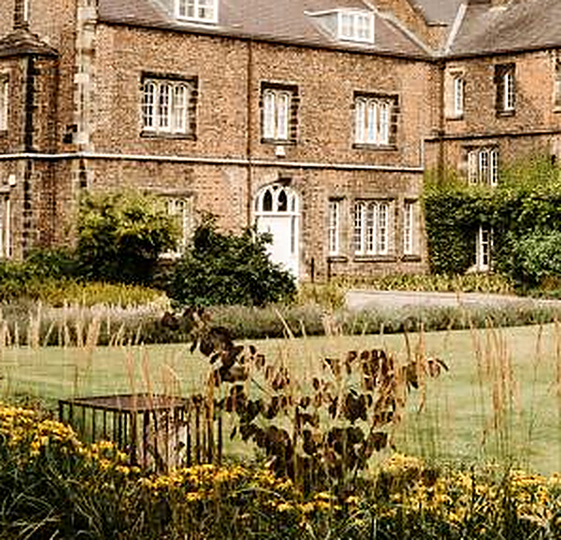

06 · RESEARCH SIMULATION
Add an element representing one barrier to meaningful participation in higher education research.
1
ADD
4
SHARE
3
SYNTHESISE
3
REFLECT
minutes
minutes
minutes
minutes · or modify
SHARING PROMPTS
FACILITATOR WATCH
What does this element represent?
What is the added value?
Who or what is missing?
What change would make the greatest difference?
Listen for metaphor, relationships, sequence, distance and participant-defined meaning. Prohibit evaluative feedback and researcher-led interpretation during clarification.
Notes:
Timing: 13 minutes (23–36).
Keep time tightly: 4 build, 4 share, 3 clarify, 2–3 reflect or modify. Participants build individually and share in groups of three. During clarification, prohibit evaluative feedback and researcher-led interpretation. During reflection, ask whether modifying the model changed the participant's account — that is the methodological point of this exercise.
[Sources]
- Rose, S. & Furness, P.J. (2024) Qualitative Research in Psychology, 21(4), pp. 578–609.
- McCusker, S. (2020) IJRME, 43(2), pp. 146–162.
- Medupin, C., Regalado, C. & Burrows, M. (2025) Education Sciences, 15(6), Article 663.

Slide 12

PART THREE
Evaluate
the evidence.
What counts as data, and when not to use the method at all.

Slide 13
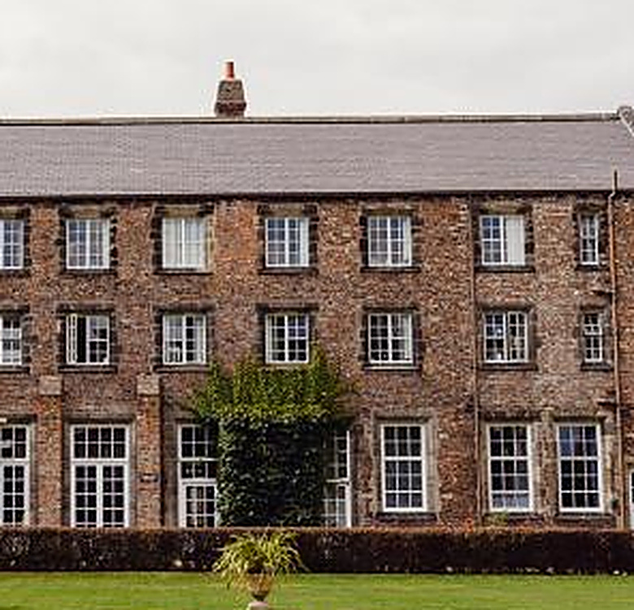
07 · DATA
What counts as data?
Decide before fieldwork what will be captured, transcribed, stored and analysed — and write it into the protocol and the consent form.
PRIMARY
CONTEXT
DIALOGUE
PROCESS
REFLEXIVE
Participant narrative
Model or photograph
Clarification exchange
Shared build
Researcher fieldnotes
The narrated meaning is normally the primary interpretive source.
Preserves configuration — but may identify people or organisations.
What was asked, and how the builder elaborated in response.
Synthesise, negotiation, pattern identification, revision and who shaped the collective model.
Your own observations, decisions and positionality.
DO NOT treat the image as self-explanatory. Do not infer fixed meanings from colour, shape, distance or height without the participant's account.
!
Notes:
Timing: 5 minutes (36–41).
Explain that the participant's narrated meaning is normally the primary interpretive source. Photographs preserve configuration but may identify participants or reveal sensitive information. Make capture decisions explicit in the protocol and consent process. Ask the room: in your own study, which of these five would you actually analyse — and which would you only use as a prompt?
[Sources]
- Hickman Dunne, J. & Pimlott-Wilson, H. (2021) in Creative Methods for Human Geographers. London: SAGE.
- Prosser, J. & Loxley, A. (2008) Introducing Visual Methods. NCRM/010.
- Ganiyu, I.O. et al. (2025) Humanities and Social Sciences Communications, 12, Article 223.

Slide 14
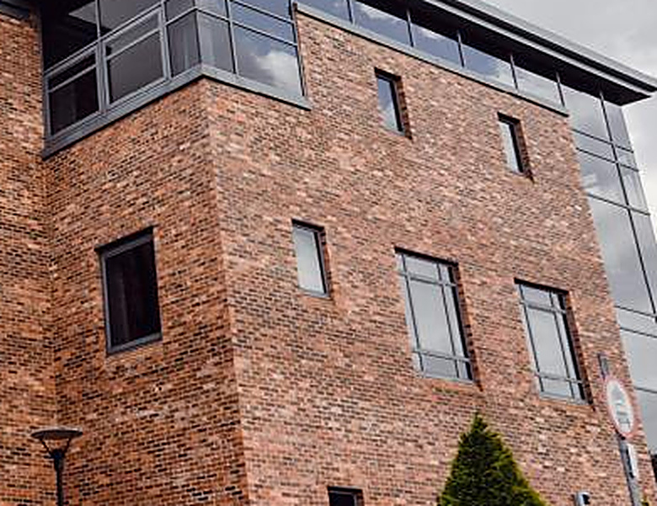
08 · LIMITATIONS
Use the method selectively.
LEGO®-based research can open expression, but it also introduces methodological and practical constraints. Treat these as design considerations, not reasons to reject the method.
01
Fit
02
Accessibility
03
Framing
04
Influence
Not every question or participant benefits from construction and metaphor.
Manual, visual or sensory demands may exclude or fatigue some participants.
Playfulness may distract, feel culturally unfamiliar or trivialise sensitive topics.
Group dynamics and unequal confidence shape whose account dominates.
05
Resources
06
Interpretation
07
Claims
08
Justification
Bricks, room set-up, facilitation skill and sufficient time are all required.
Models are ambiguous without narration; multimodal data are demanding to analyse.
Small purposive samples limit generalisability; exact reproduction is difficult.
Novelty is not a rationale. Be able to say why not an interview.
Mitigate through piloting, accessible alternatives, skilled facilitation and participant-led interpretation, and choose another method when the question, participants or context make construction unsuitable.
Notes:
Timing: 5 minutes (47–52).
This slide is the credibility test with a research-literate audience — do not rush it. Ask participants which limitation is most consequential in their setting and what mitigation would be proportionate. Wengel, McIntosh & Cockburn-Wootten (2021) is the strongest single critique: facilitator dependency, novelty effect and the researcher's interpretive footprint. Emphasise that an alternative method should be chosen when the research question, participant needs or context make construction unsuitable.
[Sources]
- Wengel, Y., McIntosh, A. & Cockburn-Wootten, C. (2021) Tourism Geographies, 23(1–2), pp. 162–184.
- Chew, R.S.Y. et al. (2025) IJLTER.
- Wayland, S. & Watharow, A. (2025) IJQM, 24.
- Hickman Dunne, J. & Pimlott-Wilson, H. (2021) in Creative Methods for Human Geographers.

Slide 15
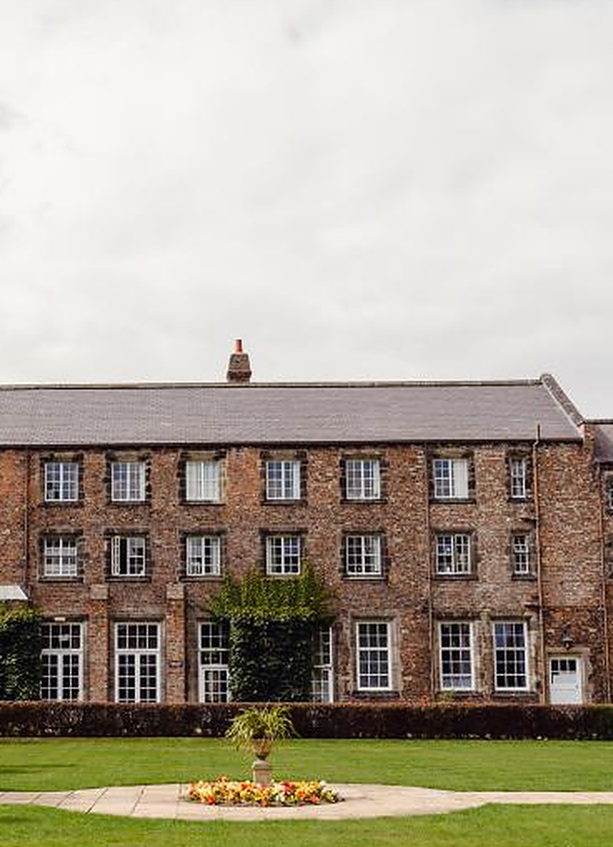
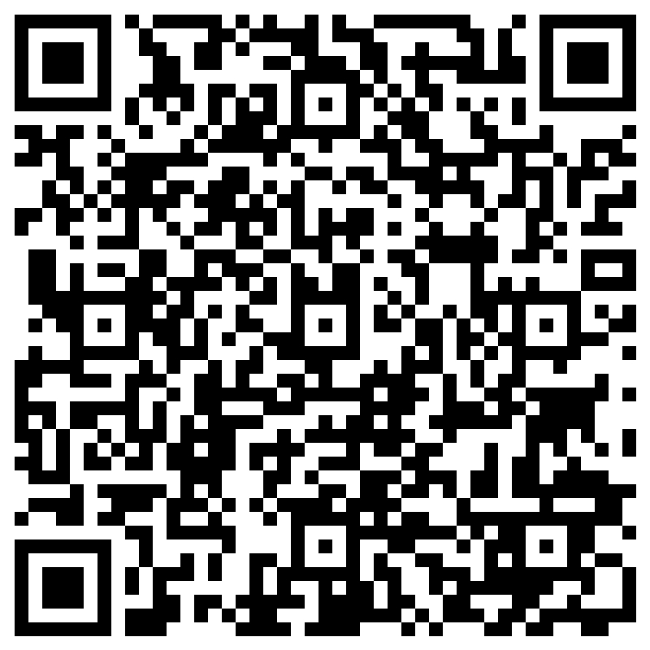

Slide 16
APPENDIX
References
Braun, V. & Clarke, V. (2021) 'One size fits all? What counts as quality practice in (reflexive) thematic analysis?', Qualitative Research in Psychology, 18(3), pp. 328–352.
Chew, R.S.Y. et al. (2025) 'LEGO® Serious Play® research: A bibliometric mapping of themes, trajectories and frontiers (2015–2025)', International Journal of Learning, Teaching and Educational Research.
Ganiyu, I.O., Plotka, G., Seuwou, P. & Ige-Olaobaju, A. (2025) 'Examining the use of LEGO Serious Play to enhance postgraduate research capacity', Humanities and Social Sciences Communications, 12, Article 223.
Gauntlett, D. (2007) Creative Explorations: New Approaches to Identities and Audiences. London: Routledge.
Hannes, K. & Parylo, O. (2014) 'Let's play it safe: Ethical considerations from participants in a photovoice research project', International Journal of Qualitative Methods, 13(1), pp. 255–274.
Henderson, H., Shipway, R. & Jones, I. (2025) 'Constructing insights: Exploring the position of LEGO® Serious Play® within the landscape of creative and participatory research methodologies', Qualitative Inquiry.
Hickman Dunne, J. & Pimlott-Wilson, H. (2021) 'Moodboards and LEGO: Principles and practice in social research', in Creative Methods for Human Geographers. London: SAGE.
Kristiansen, P. & Rasmussen, R. (2014) Building a Better Business Using the LEGO® Serious Play® Method. Hoboken, NJ: Wiley.
Kriszan, A. & Nienaber, B. (2024) 'Researching playfully? Assessing the applicability of LEGO® Serious Play® for researching vulnerable groups', Societies, 14(2), Article 15.
Lakoff, G. & Johnson, M. (2003) Metaphors We Live By. 2nd edn. Chicago: University of Chicago Press.
McCusker, S. (2020) 'Everybody's monkey is important: LEGO® Serious Play® as a methodology for enabling equality of voice within diverse groups', International Journal of Research & Method in Education, 43(2), pp. 146–162.
Medupin, C., Regalado, C. & Burrows, M. (2025) 'Creating an innovative approach to engagement, connectivity, and problem-solving in higher education institutions using LEGO® Serious Play®', Education Sciences, 15(6), Article 663.
Papert, S. & Harel, I. (1991) 'Situating constructionism', in Constructionism. Norwood, NJ: Ablex, pp. 1–11.
Peabody, M.A. & Noyes, S. (2017) 'Reflective boot camp: adapting LEGO® SERIOUS PLAY® in higher education', Reflective Practice, 18(2), pp. 232–243.
Prosser, J. & Loxley, A. (2008) Introducing Visual Methods. NCRM Methods Review Paper NCRM/010. Southampton: ESRC NCRM.
Rose, S. & Furness, P.J. (2024) 'LEGO Serious Play in psychology: Exploring its use in qualitative interviews', Qualitative Research in Psychology, 21(4), pp. 578–609.
Warburton, T., Brown, J. & Sandars, J. (2022) 'The use of LEGO® Serious Play® within nurse education: A scoping review', Nurse Education Today, 118, Article 105528.
Watharow, A. & Wayland, S. (2022) 'Making qualitative research inclusive: Methodological insights in disability research', International Journal of Qualitative Methods, 21.
Wayland, S. & Watharow, A. (2025) 'Reflecting on “doing better”: Inclusive and accessible qualitative research methods', International Journal of Qualitative Methods, 24.
Wengel, Y. (2020) 'LEGO® Serious Play® in multi-method tourism research', International Journal of Contemporary Hospitality Management, 32(4), pp. 1605–1623.
Wengel, Y., McIntosh, A. & Cockburn-Wootten, C. (2021) 'A critical consideration of LEGO® SERIOUS PLAY® methodology for tourism studies', Tourism Geographies, 23(1–2), pp. 162–184.
Wiles, R., Prosser, J., Bagnoli, A., Clark, A., Davies, K., Holland, S. & Renold, E. (2008) Visual Ethics: Ethical Issues in Visual Research. NCRM/011. Southampton: ESRC NCRM.
Notes:
Appendix slide — delete before presenting if you are circulating the separate reference document instead. 22 references: 8 from the original deck (with authorship corrected) plus 14 added.

