Slide 1


Reading media: Developing critical media literacies with KS3 students and educators
Dr Brian Rock and Dr Emma Walker (York St John University)

Slide 2
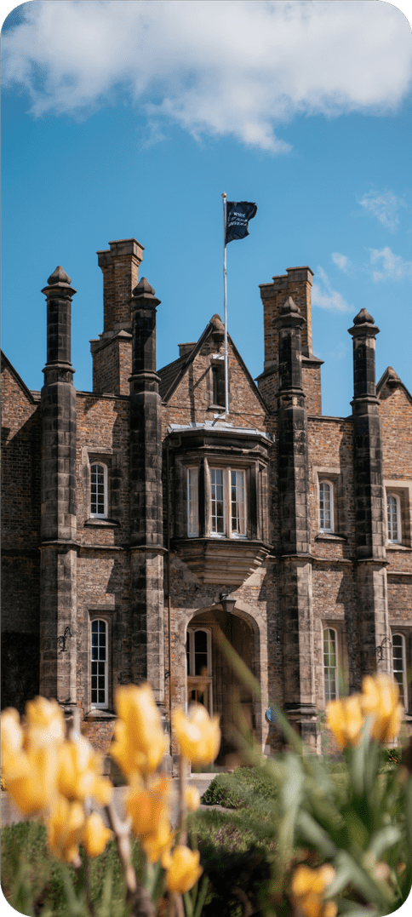
Our Research
Context
Rising concerns about misinformation, disinformation, political polarisation, and GenAI-generated content.
Growing policy emphasis on critical literacy, media literacy, and democratic participation.
The Project
UKLA-funded research project exploring critical media literacy with KS3 students.
Collaborative school-university partnership.
Co-design approach recognising teachers as curriculum makers and agents of change.
Curriculum Intervention Global Perspectives (Year 9, North of England secondary school)
Students explored:
Artificial Intelligence (AI); Populism; Fossil Fuels; Maritime Trading
Critical Literacy Development Students were supported to:
Evaluate evidence and sources
Question assumptions and dominant narratives
Consider multiple perspectives
Analyse media representations and power relations
Qualitative survey
How do students perceive the development of their critical literacy skills?
What pedagogical supports and curriculum structures enable effective critical literacy teaching?
Notes:
This study forms part of a UKLA-funded research project exploring how critical media literacy can be developed with Key Stage 3 students through school-university partnerships. The project responds to growing concerns about misinformation, disinformation, political polarisation, and the rapid growth of digital and AI-generated content. These developments are creating new challenges for democratic participation and increasing demands on young people to critically evaluate the information they encounter online and offline.
While policymakers, researchers, and organisations such as UNESCO increasingly emphasise the importance of critical literacy and media literacy, there is still limited evidence about how these approaches can be meaningfully embedded within secondary school curricula and how students themselves experience this learning. Our project seeks to address this gap.
The research adopts a collaborative co-design approach, recognising teachers as curriculum makers and agents of change. Working in partnership with a secondary school in the North of England, we co-developed a Year 9 scheme of learning called Global Perspectives. The curriculum was informed by critical literacy and multiliteracies frameworks and focused on contemporary issues including artificial intelligence, populism, fossil fuels, and maritime trading.
Throughout the programme, students were encouraged to evaluate evidence, question assumptions, examine multiple viewpoints, and analyse media representations of complex global issues. This paper reports findings from the first case study in the wider project, focusing on how students perceived their development of critical literacy skills and what they identified as the pedagogical supports needed for success.
Ultimately, the project aims to generate learner-informed and evidence-informed approaches to curriculum design that help schools prepare young people to participate critically, confidently, and responsibly in an increasingly complex digitally mediated world.

Slide 3
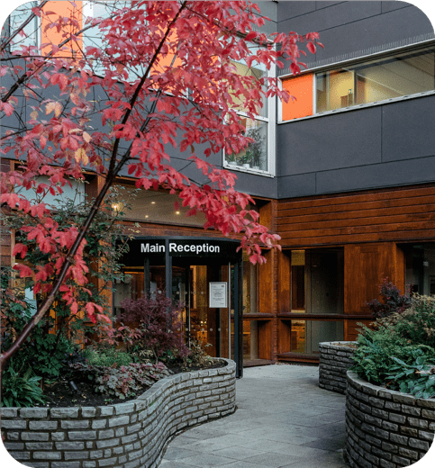
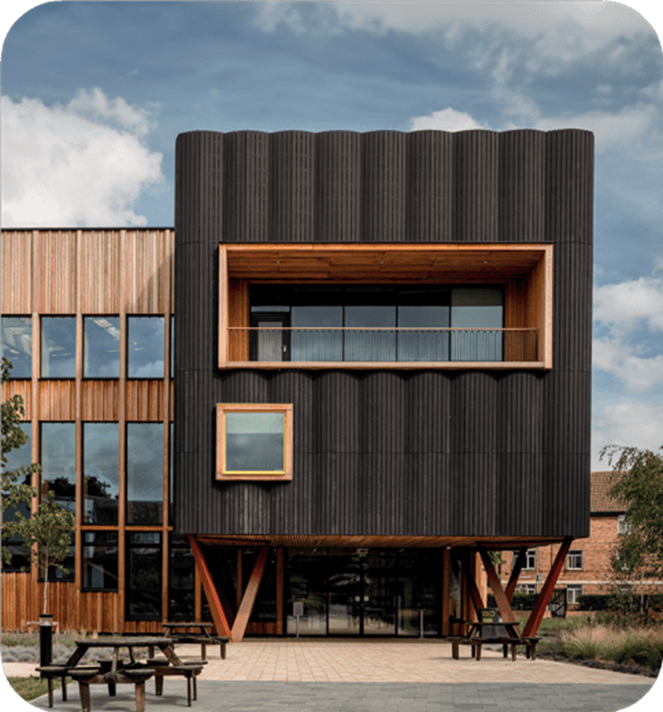
Research Findings and Implications for Practice
Main Findings
Critical engagement depends on prior knowledge
Students construct relevance through personal and future lenses
Pedagogy matters
Implications for Practice
Build on students' existing knowledge to develop critical analysis.
Explicitly connect local experiences to global issues and interdependence.
Create structured opportunities for dialogue and respectful disagreement.
Position students as active contributors to curriculum development.
Project Impact and Next Steps
UKLA funding enabled school-university collaboration and teacher release time for curriculum co-design.
Findings will inform the next phase of participatory action research. Revised curriculum to be co-developed with teachers and students.
Notes:
Our findings suggest that students generally viewed the Global Perspectives curriculum positively and identified gains in their ability to evaluate information, consider different viewpoints, and engage with contemporary issues. However, three key themes emerged.
First, students' access to critical engagement was strongly influenced by prior knowledge. Familiar topics such as AI and fossil fuels were easier to engage with because students encountered them elsewhere in the curriculum and in everyday life. More unfamiliar topics, such as populism, were often perceived as more challenging. This suggests that critical literacy curricula need to build deliberate bridges between what students already know and the critical analysis we want them to develop.
Second, students tended to construct relevance through personal, local, and future-oriented lenses. They were most engaged when they could see a direct connection to their lives, communities, or future careers. While this offers a useful starting point, it also highlights the need for curriculum designs that help students connect local experiences to broader global systems and questions of power, inequality, and democratic participation.
Thirdly, pedagogy was crucial. Students repeatedly identified teachers as the key factor in making complex topics accessible and facilitating discussion. At the same time, some students expressed concerns about being judged by peers or causing offence when discussing controversial issues. This highlights the importance of creating safe spaces for dialogue and teaching students how to engage in respectful disagreement.
A particular strength of this project was the support provided through UKLA funding, which enabled meaningful school-university partnership working, including teacher release time to collaborate in curriculum design, implementation, and evaluation. This has allowed us to build a sustainable research-practice partnership rather than simply delivering a one-off intervention.
Looking ahead, these findings will directly inform the next stage of our participatory action research cycle, where the curriculum will be revised alongside teachers and students. We are also currently developing a full paper based on these findings for submission to the London Review of Education.

