Slide 1
‘Critical moments’: A sociological examination of the transitions through a professional football academy
Nicola hague
pgr 1st year, School of science, technology and health (sport)

Slide 2
Overview of the PhD
RESEARCH QUESTIONS/ STATEMENTS:
Explore the Youth Academy environment to identify ‘critical moments’ and players experiences of these during a two-year football apprenticeship.
How does participation within an Academy influence Youth Academy players perceptions and understandings of and towards mental health and wellbeing?
One study over the duration of the full-time PhD; qualitative methodology.
Interviews with one intake of U18 male academy players at one Category 1, Premier League football club.
Figurational sociology as the analytical tool for exploring players experiences.

Slide 3
Aims and Rationales
AIMS
To explore the experiences of Youth Academy footballers throughout their two-year apprenticeship.
Explore prevalent subcultures within the football environment.
Analyse ‘critical moments’ or transitions that may or may not influence the individual’s identity and/or habitus.
Use a sociological framework to aid with analysis of the data.
RATIONALES
Research in professional football environments is gaining momentum; however, access to clubs is notoriously difficult, particularly at prestige clubs.
The success rate of becoming a professional footballer is 0.012% (BT Sport 2018).
Failure to succeed can negatively influence individual identity and thus future work opportunities.
This project could aid academy clubs in creating nuanced programmes of support for their players.

Slide 4
Literature- what do we know?
Of the limited number of sociological studies that have been able to gain access to football clubs, many have focused on first team players (McGillivray, Fearn and McIntosh 2005; Roderick 2006a; 2006b; Kelly and Waddington 2006; Hickey and Kelly 2008).
An academy is designed to educate and prepare young players for a career in the game or to be sold to generate income (Manley, Roderick and Parker 2016).
Participation within a football club often involves the internalisation of a set of norms regarding behaviour and practices that are commonplace within the football environment.
Dominating behaviours include: hegemonic masculinity; obedience; normalising strict authoritarianism; completing jobs and chores without question (Parker 1996; Roderick 2006a; Platts 2012).
Pressure to conform to such behaviours such as gambling and conspicuous consumption (Law 2018) can lead to mental health issues for these young players.

Slide 5
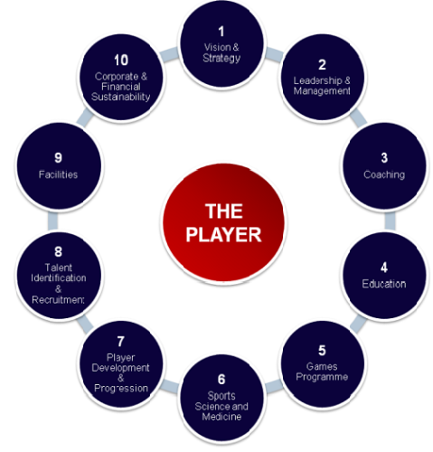
The Football Club
Academies are divided into 4 categories and these are awarded based on 10 audit traits such as productivity rates, training facilities, welfare and education provision. It is extremely difficult to obtain category 1 status.
The award of a category determines the level and amount of funding awarded to the club from the FA.
The categorising of clubs in line with the Elite Player Performance Plan (EPPP) that was introduced by the Premier League in 2012 has been both welcomed and met with scepticism.
The main purpose of the EPPP is to increase the number of ‘home grown’ players who are successful in obtaining a professional contract.

Slide 6
Proposed Methodology
Qualitative study
Semi-structured interviews with the U18 team at one football club
Interview players up to 7/8 times throughout their apprenticeship to identify their experiences
Use NVivo 12 to manage the potentially large amounts of data
Six stages of thematic analysis will be used to analyse the data (Braun and Clarke 2006)
One report written to present the findings

Slide 7
Work to date
Ethical approval granted in March 2020
Contact made with Premier League Academy club and structure of interviews agreed
Interview guide for first round of interviews created
Meeting of players placed on hold due to Covid 19
All necessary documentation- i.e. participant information and consent forms completed and sent to club
First draft chapter of Literature Review completed
First draft chapter of Figurational Sociology completed
Methods chapter planned
6 month review completed

Slide 8
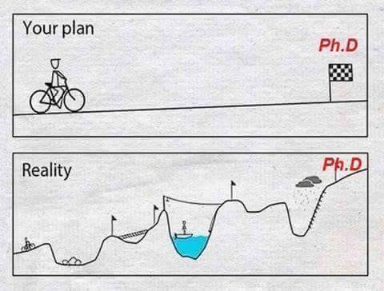
Moving forward
Begin writing the introduction chapter
Agree with football club to begin interviews via Zoom
Review feedback from supervisor for Literature Review and Theory chapters
Prepare for 12-month review
Ensure interview guides are up to date and ready

Slide 9
Any questions please?

Slide 10
References
Braun, V. and Clarke, V. (2006) Using thematic analysis in psychology. Qualitative Research in Psychology [Internet], 3 (2), pp.77-102, Available from: http://www-tandfonline-com.yorksj.idm.oclc.org/doi/abs/10.1191/1478088706qp063oa [Accessed 10/03/2020].
Hickey, C. and Kelly, P. (2008) Preparing to not be a footballer: higher education and professional sport. Sport, Education and Society, 13 (4), pp.477-494.
Kelly, S., and Waddington, I. (2006) Abuse, Intimidation and Violence as Aspects of Managerial Control in Professional Soccer in Britain and Ireland. International Review for the Sociology of Sport, 41 (2), pp.147–164.
Law, G. (2018) A sociological analysis of the monetisation of social relations within the working lives of professional footballers. PhD thesis, University of Chester.
Manley, A., Roderick, M. and Parker, A. (2016) Disciplinary mechanisms and the discourse of identity: The creation of ‘silence’ in an elite sports academy. Culture and Organisation, 22 (3), pp.221-244.
McGillivray, D., Fearn, R. and McIntosh, A. (2005) Caught Up In and By the Beautiful Game: A Case Study of Scottish Professional Footballers. Journal of Sport and Social Issues, 29 (1), pp.102-123.
No Hunger in Paradise (2018) London, BT Sport, 18th January.
Parker, A. (1996) Chasing the ‘Big-Time’: football apprenticeship in the 1990s. PhD thesis, University of Warwick.
Platts, C. (2012) Education and welfare in professional football academies and centres of excellence: A sociological study. PhD thesis. University of Chester.
Roderick, M. (2006a) A Very Precarious Profession: Uncertainty in the Working Lives of Professional Footballers. Work, Employment and Society, 20 (2), pp. 245–265.
Roderick, M. (2006b) The Work of Professional Football: A Labour of Love? London, Routledge.

