Slide 1
How can Augmented Reality make an impact on Chemistry Education?

Slide 2
Virtual Environments & Simulations

Slide 3
(Herga. N., Cagran. B & Dinevski D 2016) raise their own points over the advantages a virtual laboratory can bring:
Dangerous experiments can be performed without concerns over health and safety issues being implicated
Simulations are affordable, given once they have been created they can be delivered without any further additional costs.
A virtual laboratory allows for independent or collaborative work
- The use of virtual laboratories in chemistry classes help to present teaching matter at the microscopic, symbolic and sub-microscopic levels.

Slide 4
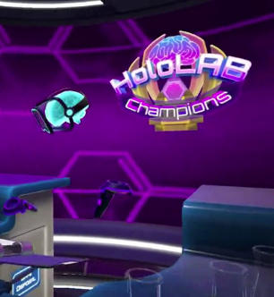
Notes:
Hololab / Mel Science / Labster

Slide 5
What is Augmented Reality?

Slide 6
A VR users’ experience is completely tied to a virtual world, whereas in AR user’s experience is still connected and centred around the real world, but with virtual objects superimposed so that both real and virtual objects coexist in the same space (Azuma, 1997).

Slide 8
There are a variety of devices that uses AR technologies. These can be divided into three categories:
1) wearable,
2) handheld, and 3) fixed.
Wearable AR technologies generally include head-mounted displays, smart glasses, and gesture-recognition devices.
Handheld AR devices are characteristically operated using mobile tablets or smartphones, whilst fixed AR projects content onto a surface or is a screen-based application.

Slide 9
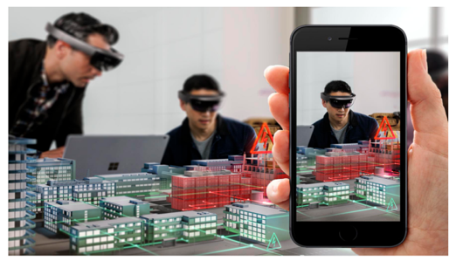
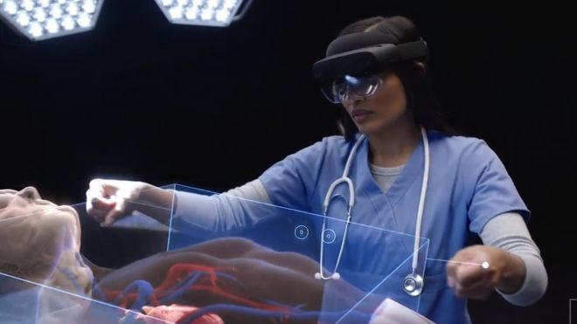
Notes:
Wearable Technology
Microsoft Hololens
ZAPBox

Slide 10
Handheld
Marker Based AR
Marker- Less AR

Slide 11
