Slide 1
Immersive Experiences in Education and Training ___________________________ Yorkshire & Humber Institute of Technology Warren Fearn York St John University

Slide 2
History of Technology What is XR? VR Experiences AR / MR Experiences Geolocation Training Future

Slide 3
A bit of history.

Slide 4
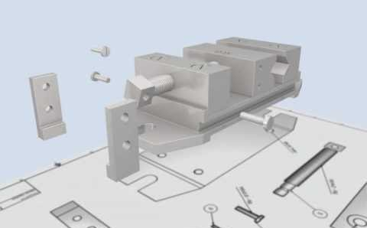
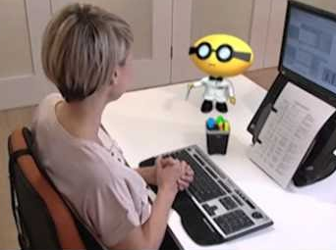
Who am I?
SGI (Alias Wavefront)
BBC Virtual Reality / BBC 3D-Motion
Creative Director (8 years)
Autodesk (Secondary Education Board)
Undertaking a PhD (Augmented Realty for Primary Science Education), York University
Emmy Award / Promax Awards
Programme Leader: Postgraduate (MA Virtual & Augmented Reality, MSc 3D Design & Technologies, MA Visual Communication)

Slide 5
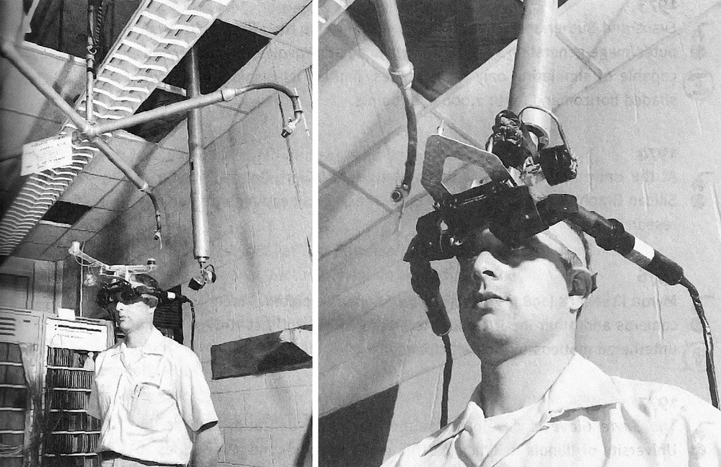
1968.
The Sword of Damocles
(Ivan Sutherland, Bob Sproull, Danny Cohen)
The Ultimate Display – University of Utah
First experiments with head-mounted displays of different kinds.
Motion tracking and computer connectivity

Slide 6
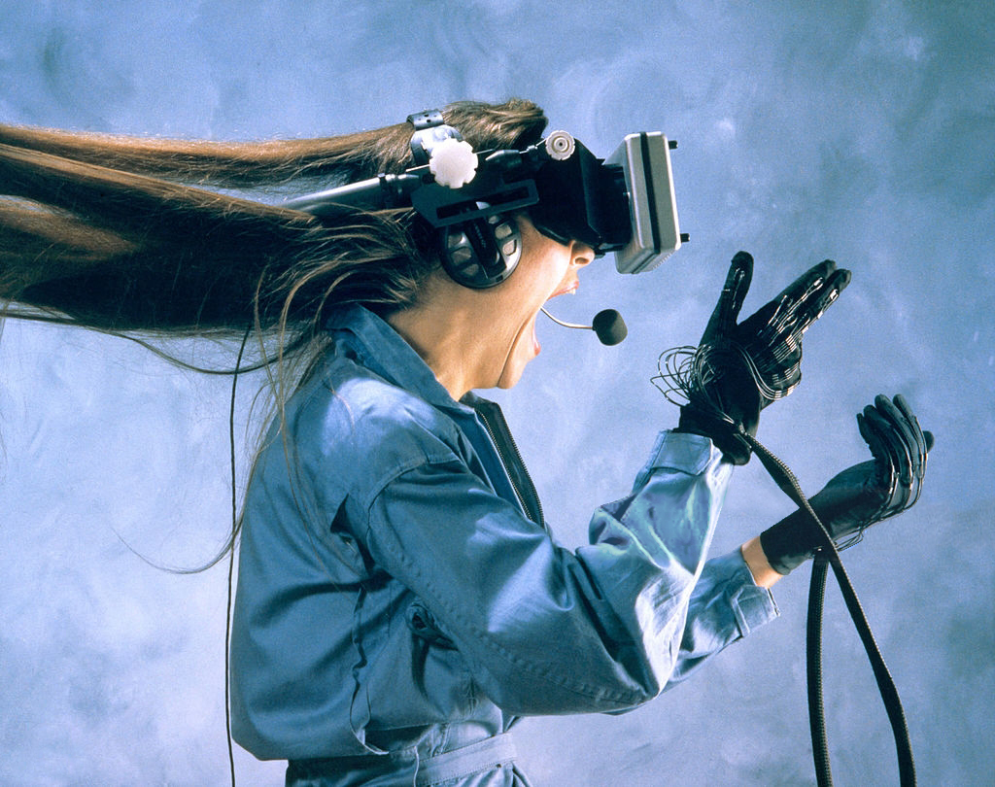
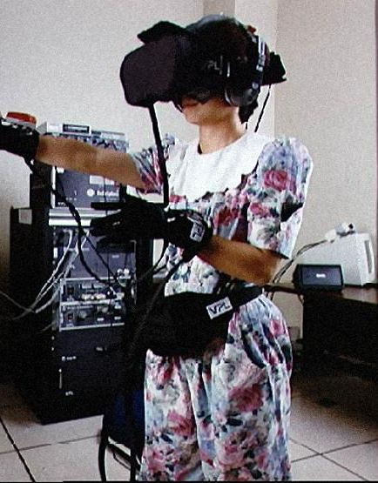

Slide 7
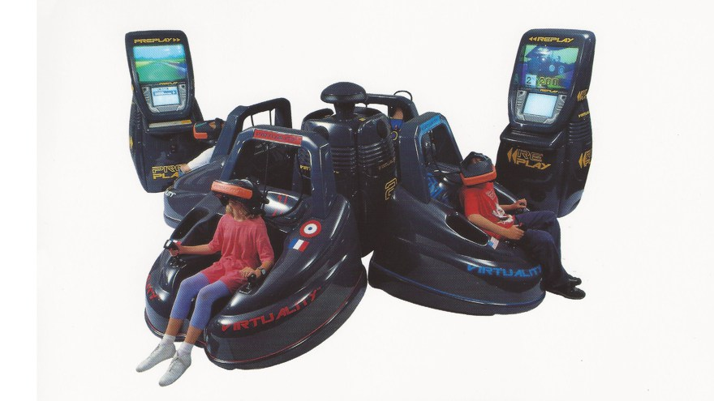
Notes:
EARLY 1990s - VR charge into arcades was Virtuality, founded by Jonathan Waldern, a Ph.D. graduate from the Loughborough University of Technology. VR technology

Slide 8
1994.
Virtuality Continuum (Milgram and Kishino)
An early diagram ‘Virtuality Continuum’ (Milgram, P., Kishino, F., 1994) describes any combination of virtual and physical objects (mixed reality) between the extremes of reality and virtual reality.

Slide 9
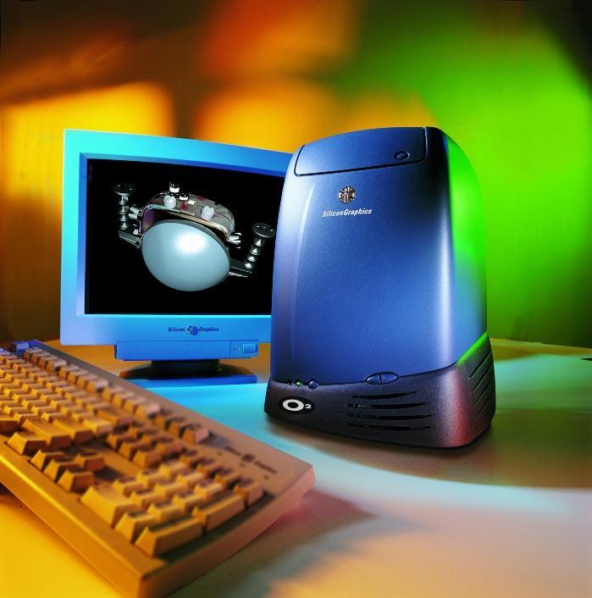
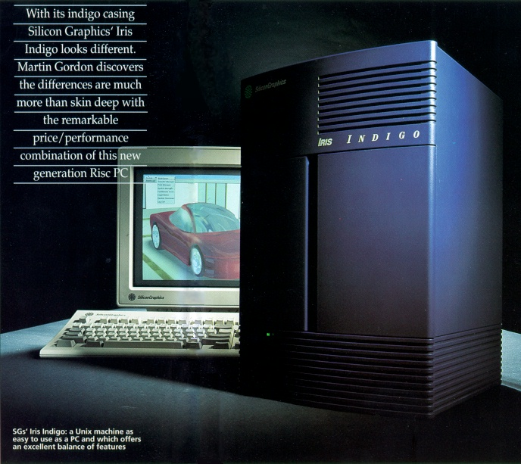
Notes:
Memory Capacity 512 RAM
CD ROMS / Disk Drives

Slide 10
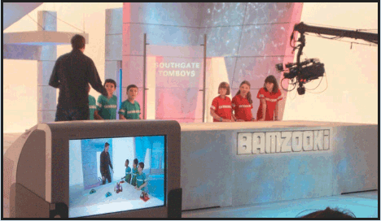
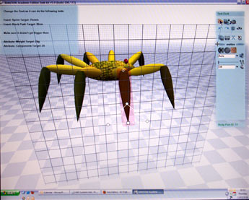
1998.
Notes:
Worked alongside BBC Producers and Dr Richard Hawkes from Hewlett Packard / Professor Graham Thomas

Slide 11
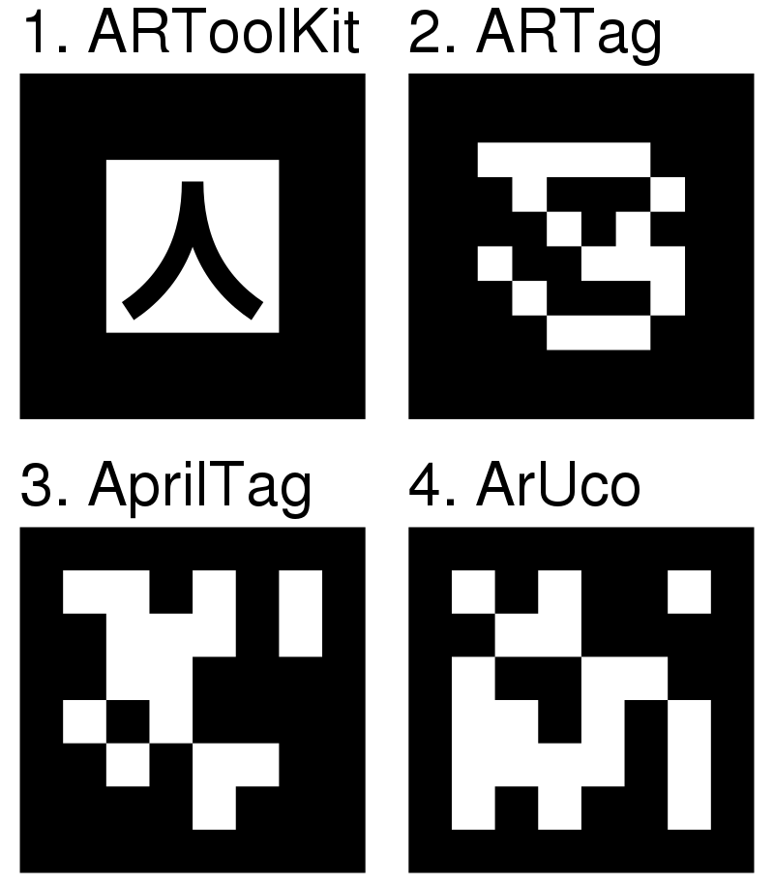
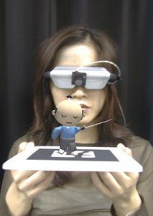
1999.
AR Tool Kit (Kato.H, Billinghurst. M, Poupyrev.I)
Single camera position/orientation tracking.
Tracking code that uses simple black squares.
The ability to use any square marker patterns.
Easy camera calibration code.
Fast enough for real time AR applications.
SGI IRIX, Linux, MacOS and Windows OS distributions.
Distributed with complete source code
ARToolKit was originally developed by Dr. Hirokazu Kato, and ongoing development was supported by the Human Interface Technology Laboratory (HIT Lab) at the University of Washington, HIT Lab NZ at the University of Canterbury, New Zealand, and ARToolworks, Inc, Seattle

Slide 12
2011.

Slide 13
2014.

Slide 15
Virtual Reality VR
Mixed Reality MR
Augmented Reality AR
2020.

Slide 16
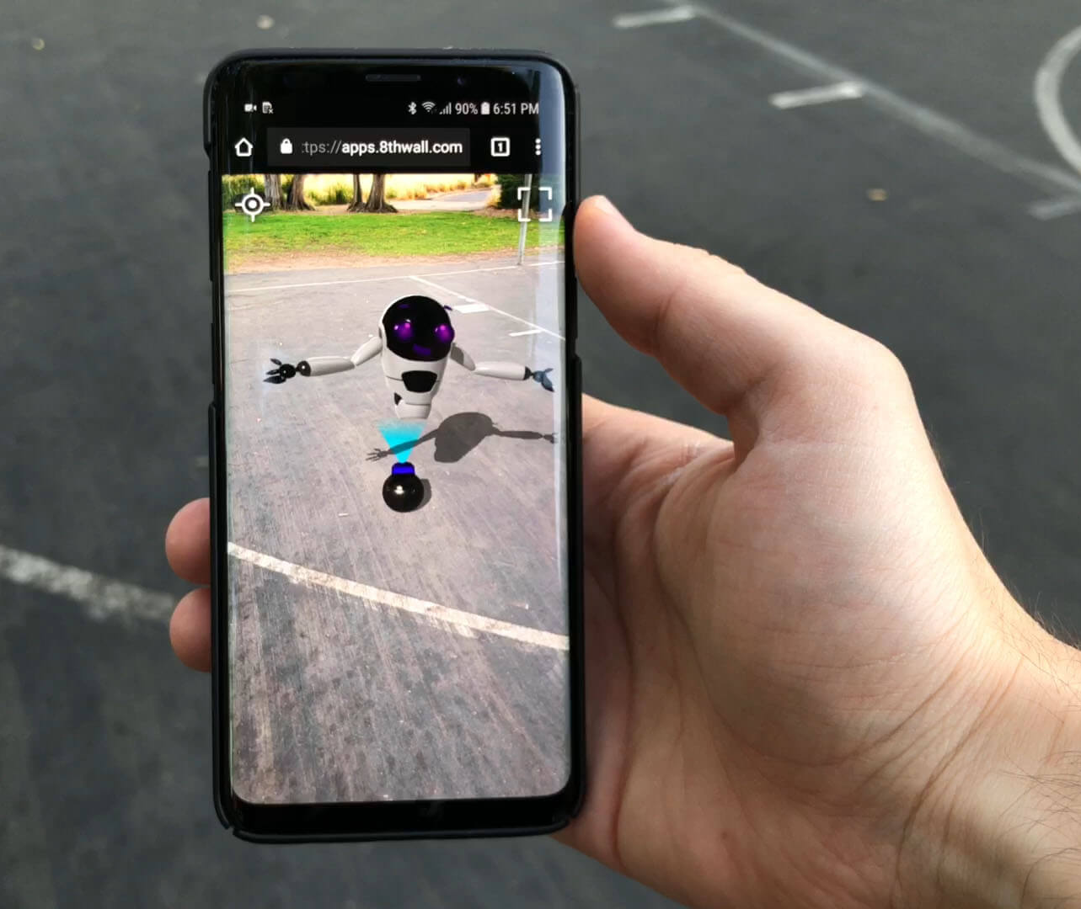
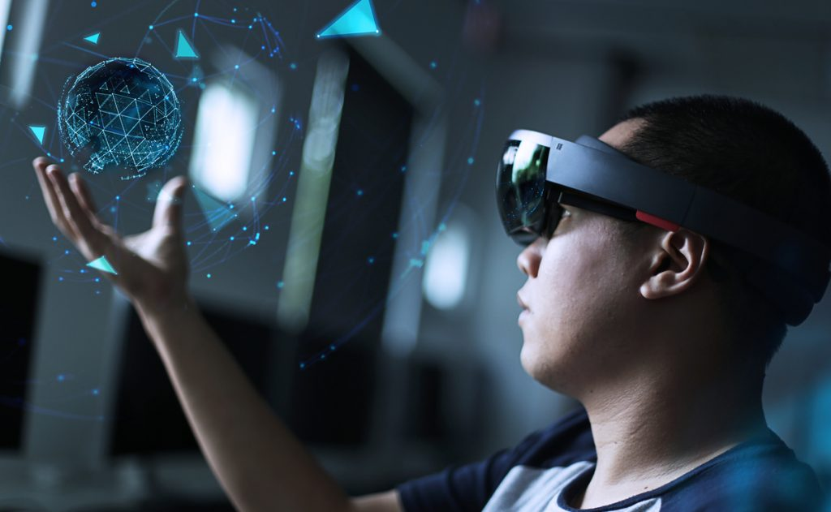
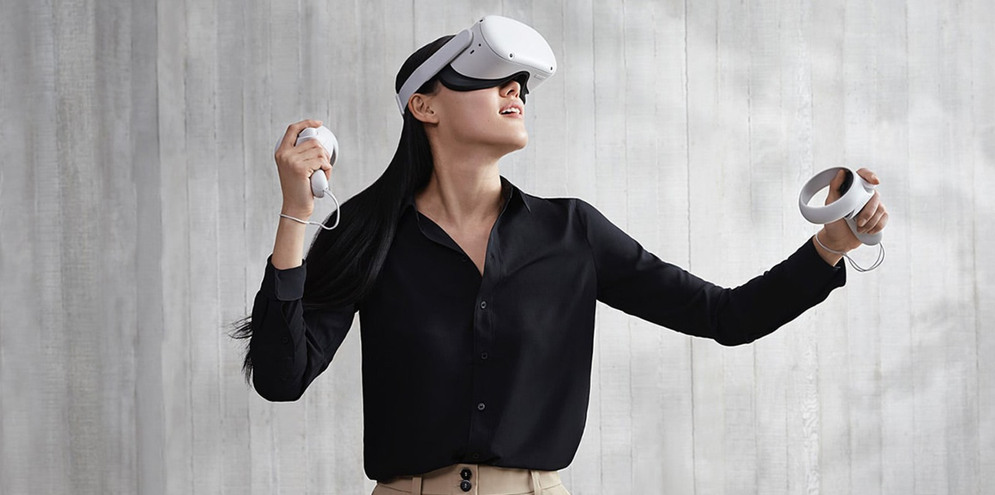
MOBILE.
(MAR)
WEARABLE.
(WAR)

Slide 17
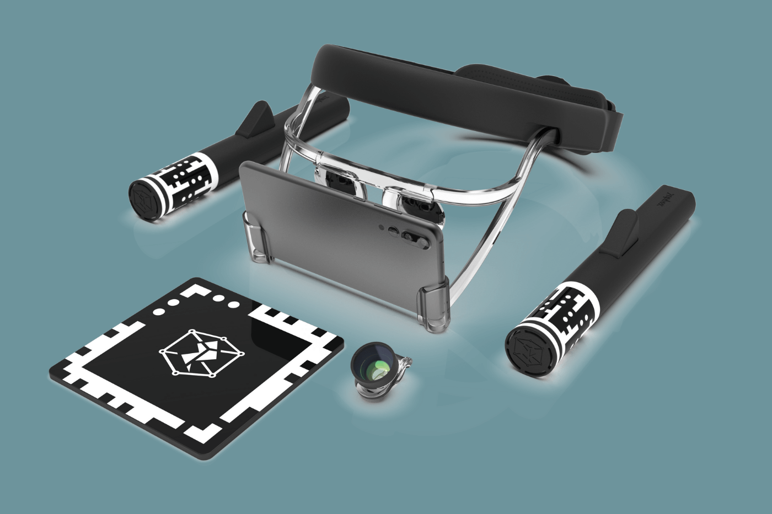
Handheld AR can be classified into various categories such as:
1) Marker based,
2) Marker-less,
3) Projection Mapping and
4) Superimposition.

Slide 18
What does this mean for Education?

Slide 19
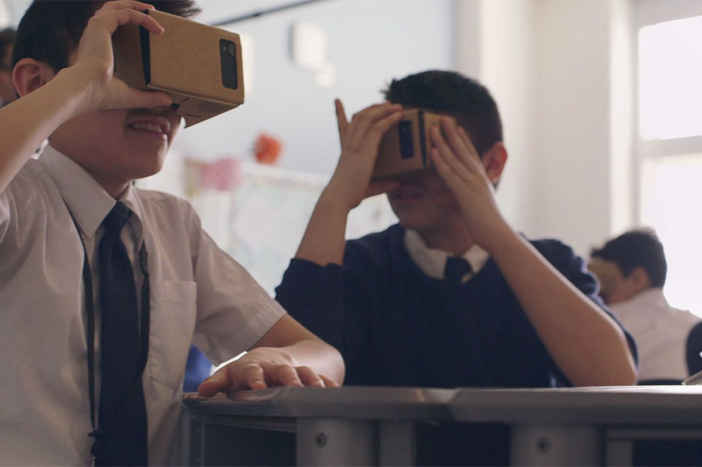
Google Expeditions
VR Tours / Field Trips
Explore without leaving the classroom
2021 – Migrating to Arts & Culture App

Slide 20
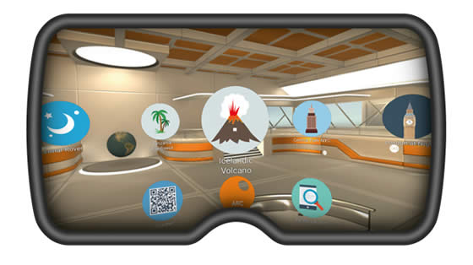
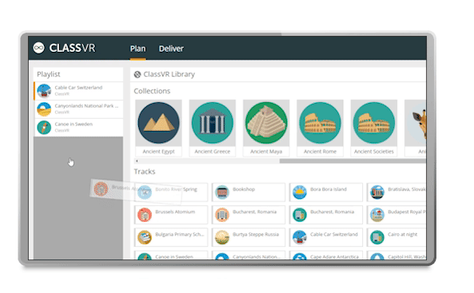
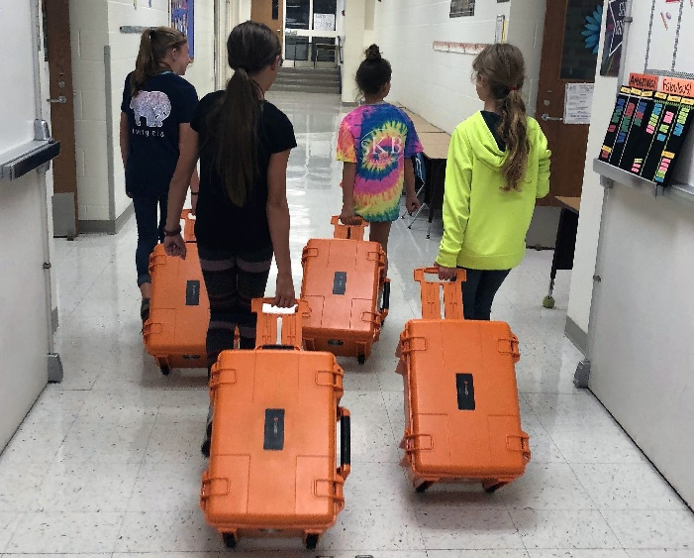
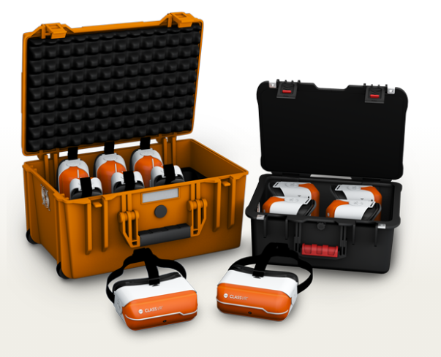
Class VR
VR / AR Headsets
Planning Sessions
Topic Delivery
Both the ClassVR4 – (8 portable sets, ruggedized storage and charging cases, making sure all your headsets are safe, secure and fully charged, ready for students to use at any time.

Slide 21
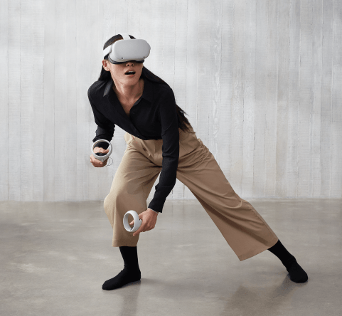
VR COLLABORATION
OCULUS QUEST 2
Untethered
Freedom of Movement
Better Performance

Slide 22
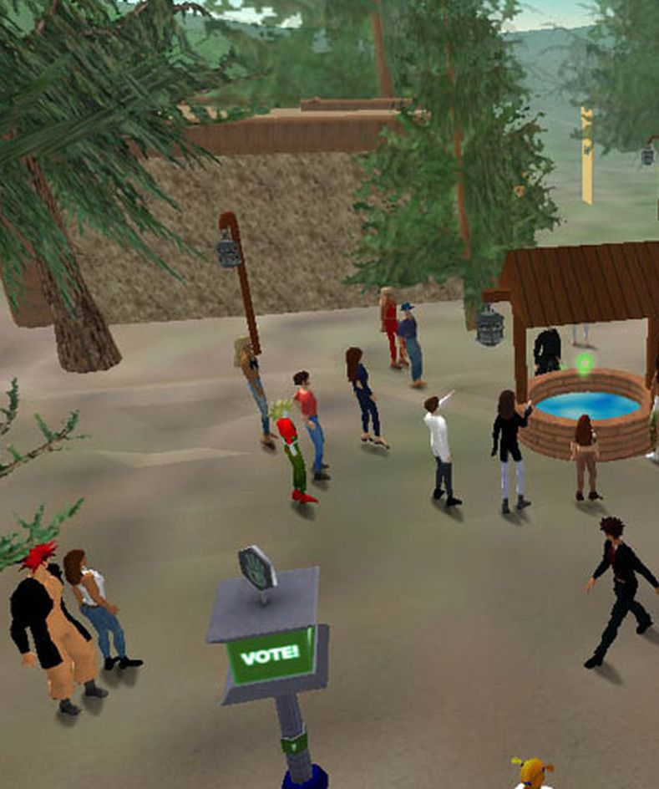
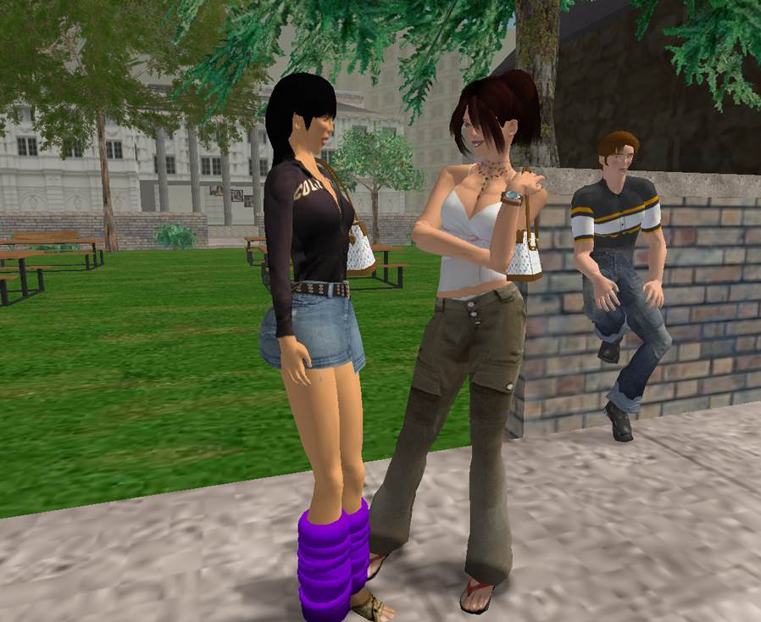
SECOND LIFE.
Who remembers?

Slide 23
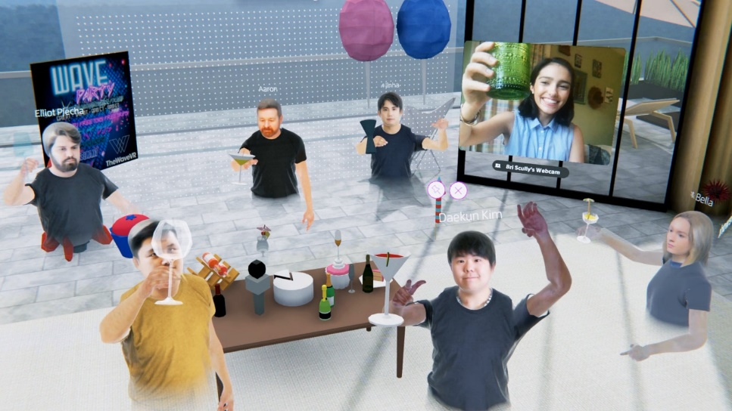
VR SPATIAL
Oculus Quest / Interact through VR / Remote Learning / Collaborate

Slide 24
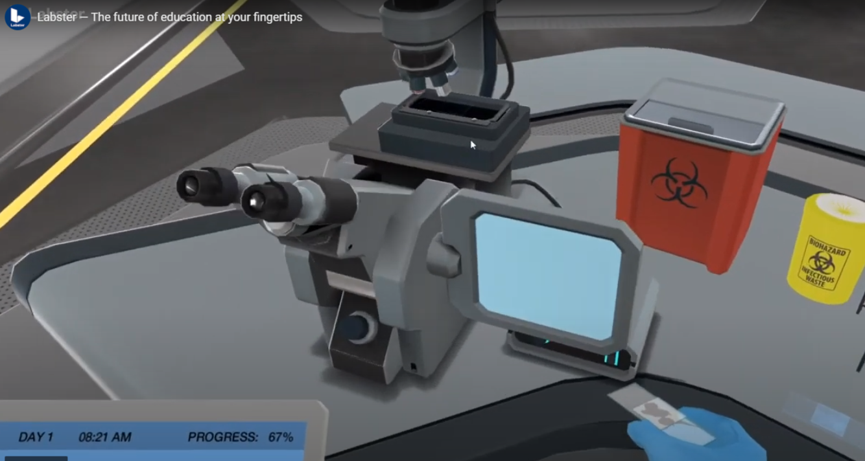
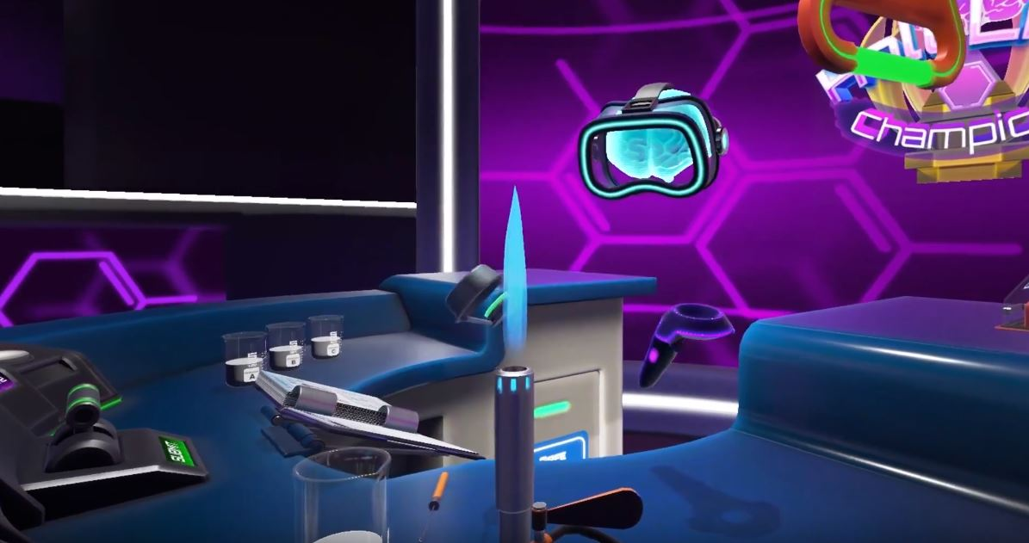
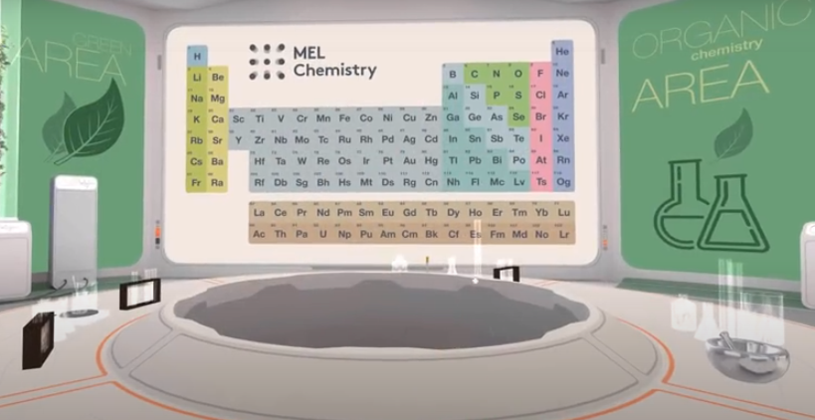
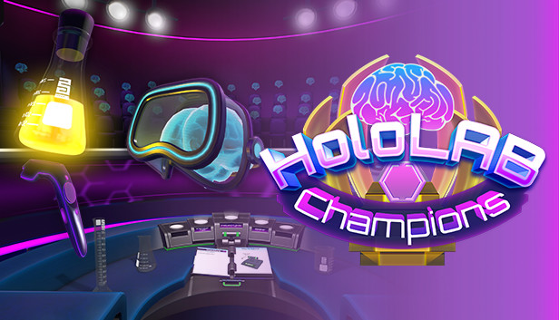
VR – LAB
HOLOLAB
MEL SCIENCE LABSTER
(Dalgarno.B et. al. 2003) reinforces this in reference to virtual environments allow students to explore an environment, collect and assemble apparatus before undertaking their first laboratory session.
Virtual laboratory technology is becoming more manipulative, interactive and ‘real’ as time goes on, and the future of these types of technologies will only develop quicker. (Brinson. J 2015).

Slide 25
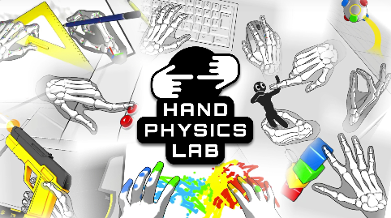
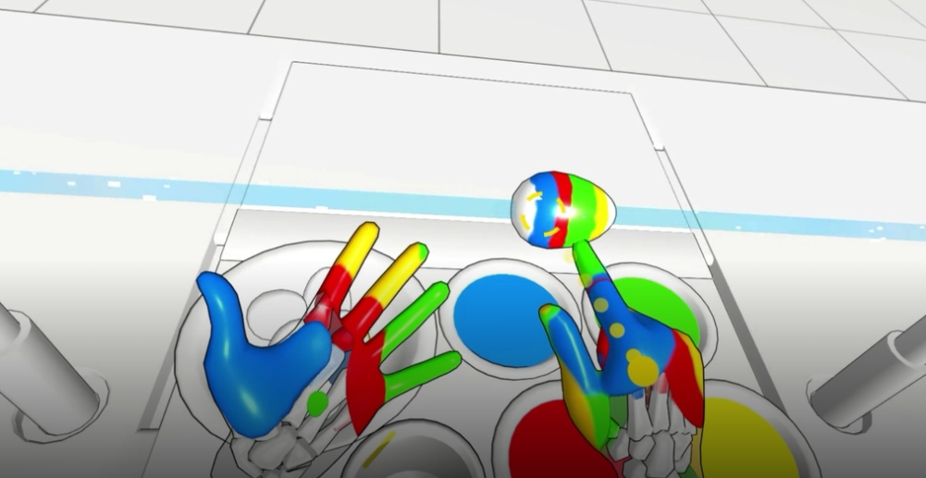
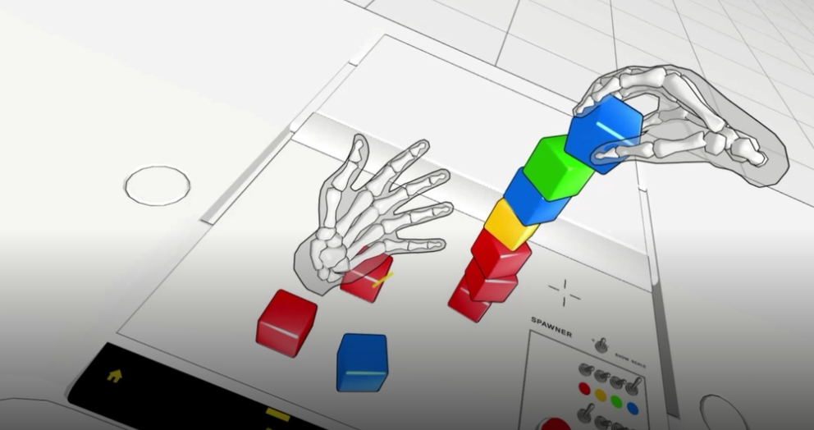
VR – HAND PHYSICS LAB
Hand Physics Lab is an experimental project created by Dennys Kuhnert and forged at the Holonautic Studio.
Experiment in the Chemistry Lab with Lasers and Acid

Slide 26
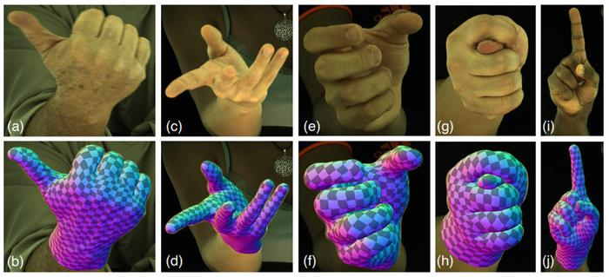
VR – FACEBOOK REALITY LABS
Constraining Dense Hand Surface Tracking with Elasticity
(Breannan Smith, Chenglei Wu, He Wen, Patrick Peluse, Yaser Sheikh, Jessica Hodgins, Takaaki Shiratori, 2020)

Slide 27
Merge Cube (AR)
Tangible AR
STEM programs can expand beyond the classroom, and schools can introduce powerful new educational technology.
The use of mobile devices such as smartphones and tablets, all have built-in cameras, This presents new opportunities to move away from lecture-style teaching and use AR in educational environments to create practical and highly interactive visual forms of learning (Huang et el., 2016).
By integrating the digital information with real-world assets simultaneously, AR helps to concretize abstract concepts, enables the use of all senses, and enhances the sense of reality, which in turn is a huge contribution to learning” (Ozdemir, 2017a).

Slide 28
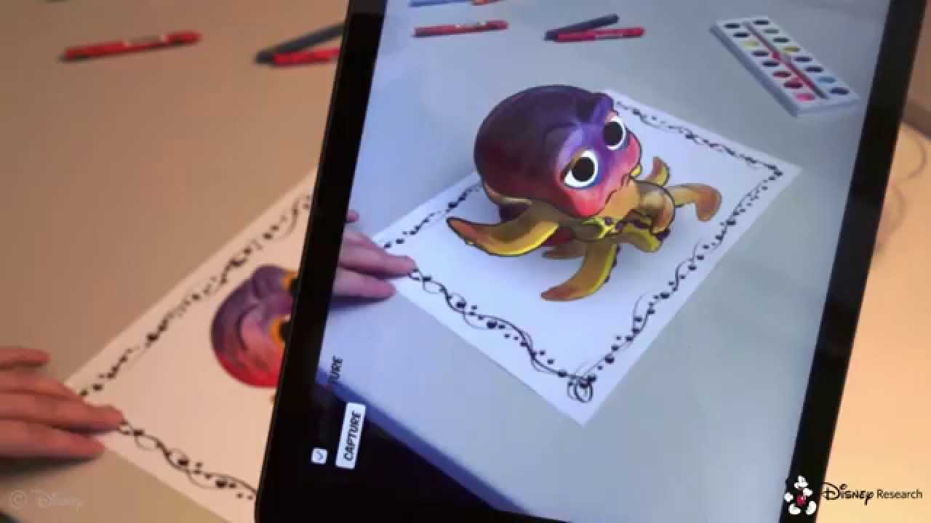
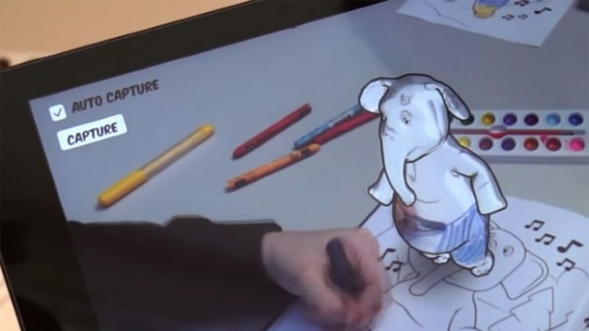
Augmented Creativity
Dr Rob Sumners, Disney Research
Interactive UV Texture Maps to change colours in real time
Marker AR – Triggering Colouring Book
Compose music experiments with styles, melodies etc.

Slide 29
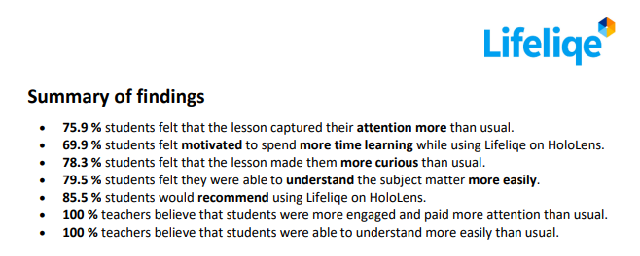
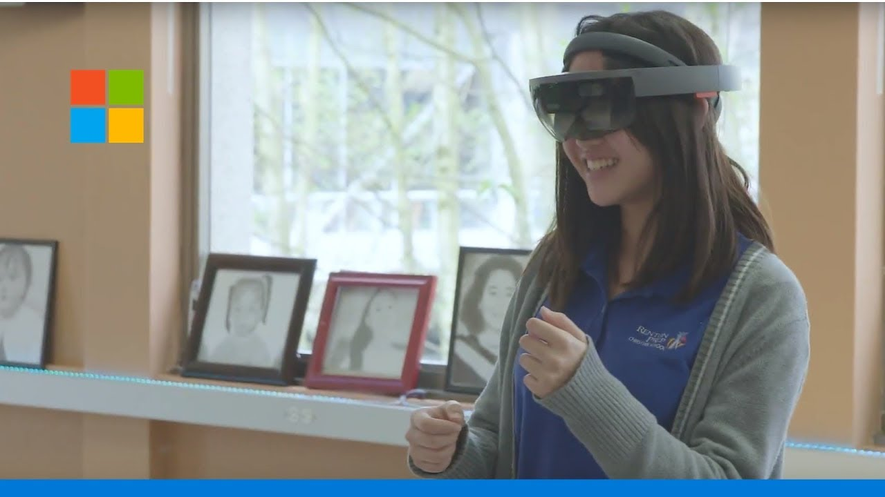
Lifeliqe - Hololens
Pilot Report:
180 Students & 5 Teachers - K-12 Curriculum
30 Students & 2 Teachers - Prep School

Slide 30
Cognitive Process
Emotional Learning
Behaviour
Embodied Cognition: Digitally immersive experience
Enable students to practice and
perfect skills in a safe and accurate learning environment.
Inclusive: As costs decrease, immersive Technologies can become a democratizing force in education.
Simulations: Simulations allow learners to recreate and practice situations and immerse themselves in situations.
Focused: Evidence shows that test scores among students using Immersive Technology improved by 22%
Collaboration: Mixed Reality provides settings in which students can work in collaboration and have access to more personalized knowledge.
Identity: Students working with immersive content report a higher level of engagement with issue such as homelessness, environment etc.
Cognitive Load: Mixed Reality reduces information bottlenecks and increases performance on skills-based tasks.
Diversity: Immersive Technologies allow you to experience life from the perspective from others.
Situated Learning: Immersive Technologies can increase rates of skills transfer, enabling students to apply theoretical concepts learned to real world scenarios.
Microsoft: Immersive Experiences in Education New Places and Spaces for Learning (Bonasio.A)

Slide 31
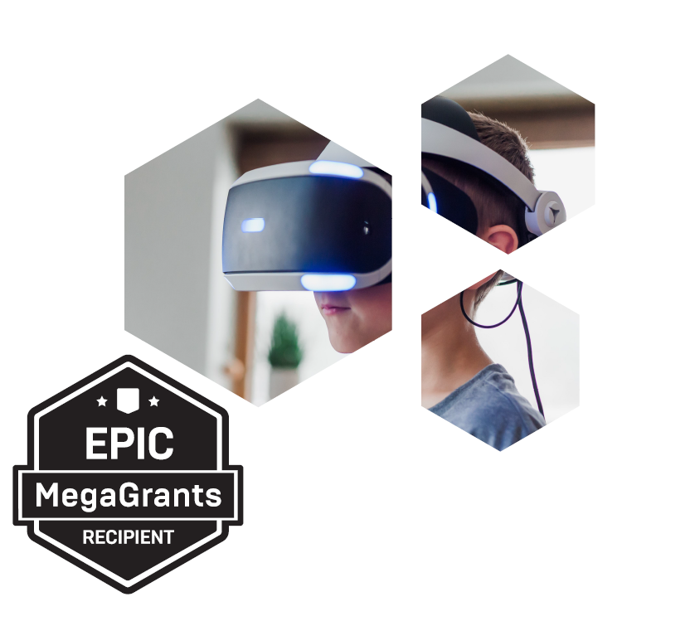
How can Augmented Reality
help bridge the gap between classroom and remote science
learning for primary schools ?

Slide 32
Geolocation.

Slide 33
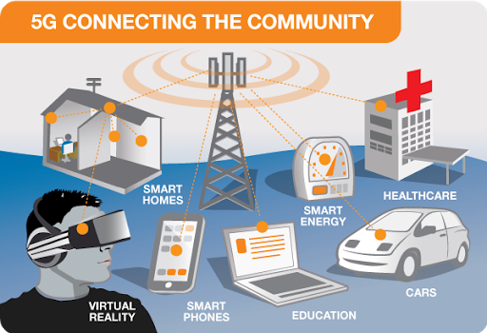
5G CONNECTIVITY
5G allows near real-time connectivity. Its lower latency and reliability permit faster transmission of massive data streams, even in extreme conditions, and will support a plethora of sensors, wearables and devices.
Location based learning emphasises the learner’s interactions with the physical environment, so AR can exploit these advantages through geo-location to track learners (De Lucia et al. 2012).

Slide 34
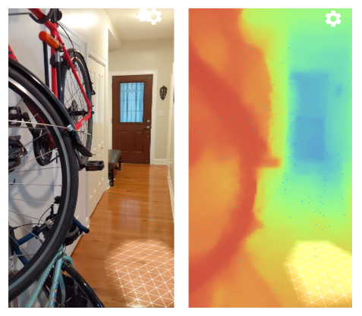
AR Core (Google)
ARCORE - Depth API (Application Programming Interface)
The Depth API uses a Depth API-supported device's RGB camera to create depth maps (also called depth images).
You can then use the information provided by a depth map to make virtual objects accurately appear in front of or behind real world objects, enabling immersive and realistic user experiences

Slide 35
AR Core (Google)

Slide 36
ARkit (Apple)
LiDAR (Light Detection and Ranging.)
LiDAR works in a similar way to Radar and Sonar yet uses light waves from a laser, instead of radio or sound waves.
A LiDAR system calculates how long it takes for the light to hit an object or surface and reflect back to the scanner. The distance is then calculated using the velocity of light.

Slide 37
PhD Research (Primary Schools in Science)
Adoption: Education (Schools) teachers wishing to use technology for teaching
CPD Training: Teachers being supported by IT leads to help train on XR applications.
Affordability: Democratisng of applications at a reasonable costs to schools or FREE.
Inclusive: Making the applications available to everyone to access (social, disabilities etc.)
Engaging: A great medium to engage students (and hook them in).
Active Learning: A way to actively learn through XR experiences.
Sharing: Being able to share ideas together on remote basis.
Pace: Students can learn at their own pace
Parental: Engaging parents within the process from remote environments.
Safeguarding: How are students safeguarded when using remote technologies?
And many more….
Paper to be released Jan / Feb 2021

Slide 38
Training.

Slide 39
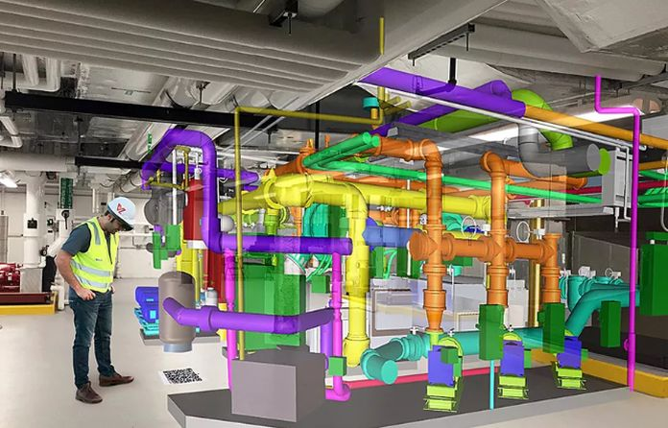
Skanska (BIM)
Building Information Modelling (BIM)
Construction Sector
Skanska is one of the first companies in the UK to license an augmented reality system designed to quickly visualise complex BIM models in the field. (2018).
As technology becomes more human-centric, AR could bring immersive experiences to the point that communication between people, businesses, and objects becomes increasingly transparent. (Gartner 2016).

Slide 40
Higher
Engagement rate
Results of a soft skills training in VR study, conducted by PWC.
Learners in VR were:
275% more confident to act on what they learned
4x faster than classroom training on average
4x more focused than e-learners
3.75x more emotionally connected to the content than classroom learners
Higher
retention rate
Benefits of
VR in Corporate
Training
Experiential
Learning
Reduce training and travel expenses
Safe for high-risk situations

Slide 41
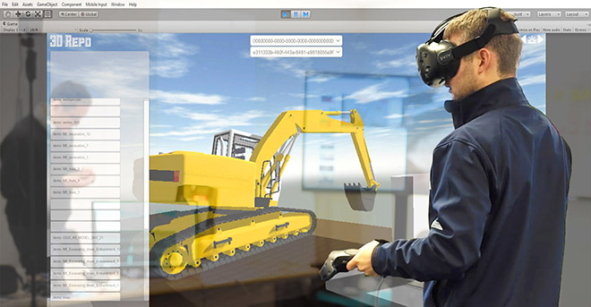
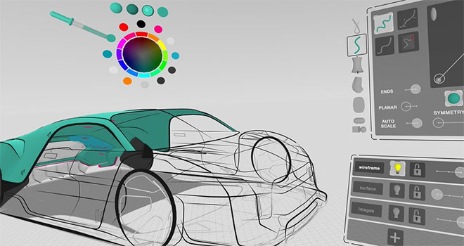
3D Repo is working with companies such as Balfour Beatty and Highways England to deploy a Virtual Reality (VR) simulation for health and safety training.
Working with Gravity Sketch, Ford has been using VR to produce car mockups with impressive results. Being able to start in 3D and stay in 3D has improved productivity and transformed designer workflow.

Slide 42
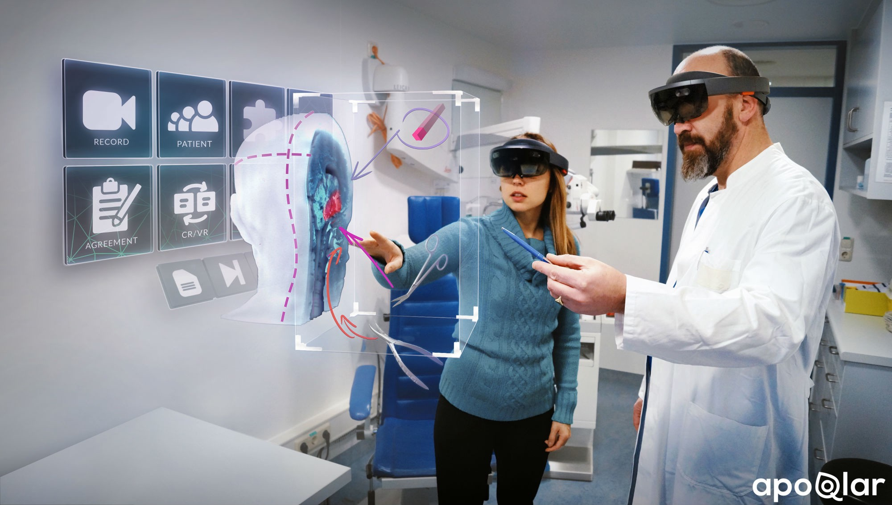
New Augmented Reality innovations can help enhance doctors and surgeon's ability to diagnose, treat, and perform surgery on their patients more accurately by giving them access to real-time data and patient information faster, and more precisely than ever before.
Augmented technology has made it possible to overlay 3-D anatomical information on top of the patient.
An AR display that integrates all imaging and patient data.
Training without the risk. AR technology helps students to use the theory knowledge in the practical world.

Slide 43
The Future.

Slide 44
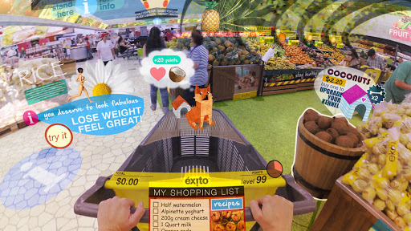
Keiichi Matsuda. Hyper Reality

Slide 46
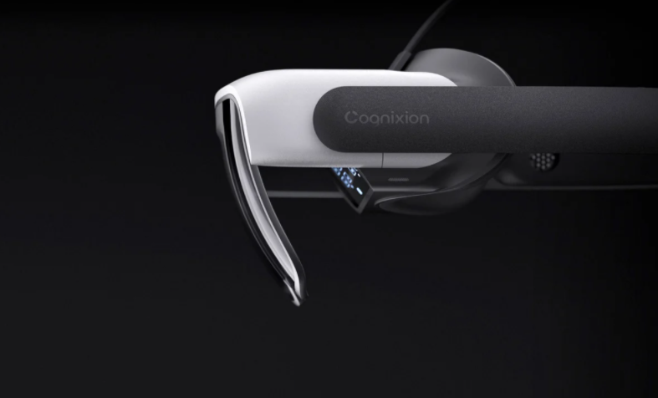
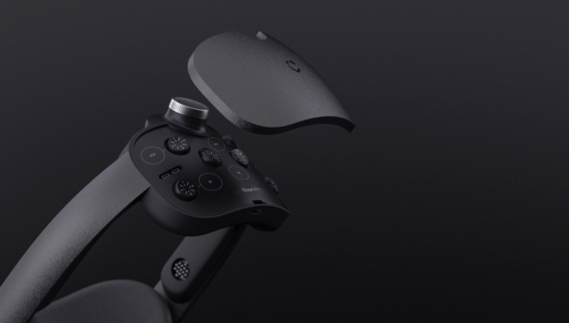
Cognixion ONE
The world’s first wearable brain computer with AR.
It can read your brain and speak for you. The headset can also interpret the words you're thinking and generate speech or convert them to text for private messaging.
Built for people with communication disorders such as Cerebral Palsy

Slide 47
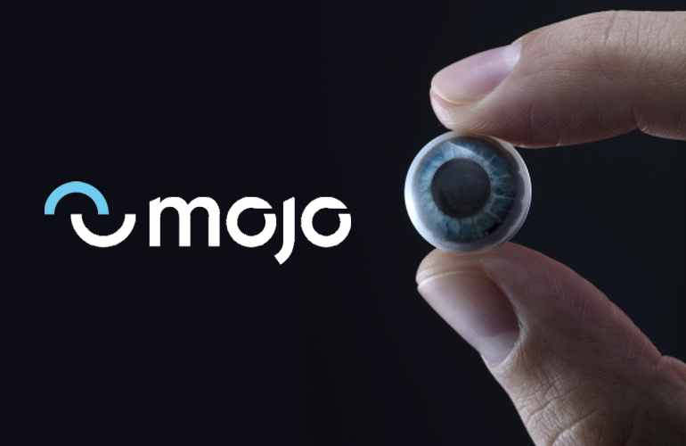
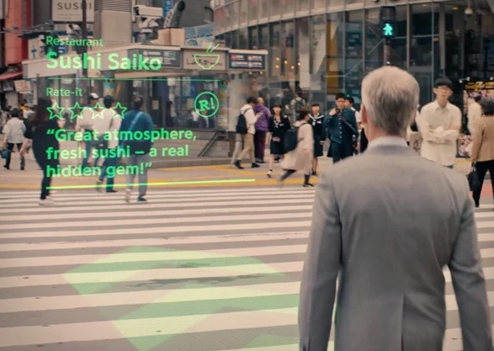
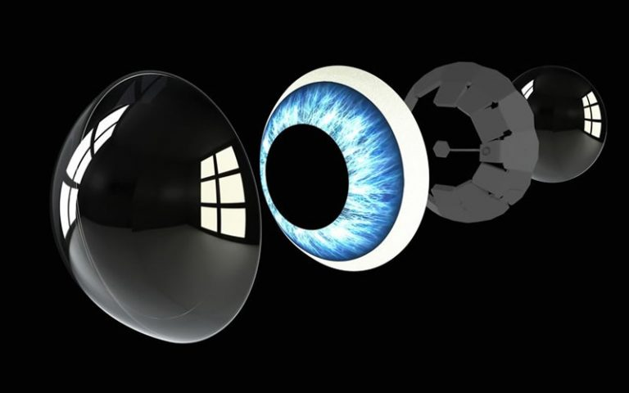

Slide 48
“Arguing against a mixed-reality future is difficult. At some point, it’s easy to imagine a future where real-time information is piped into a wearable (or even the brain itself). But there are going to be significant steps that lead us there, and today’s bulky headsets are closer to a wobbly toddler than an awkward adolescent.”
Alex Kipman, Lead Developer
(Microsoft Hololens)

Slide 49
Transhumanism is a class of philosophies of life that seek the continuation and acceleration of the evolution of intelligent life beyond its currently human form and human limitations by means of science and technology, guided by life-promoting principles and values.
Max More (1990)

Slide 50
Realtime Performance
3D Graphics

Slide 51
Service Design Thinking User Needs Empathetic PhD Research Findings
Partnership between educators and learning designers is needed to incorporate sound pedagogy with innovative technology to develop effective AR applications that maximize learning outcomes.
(Akcayır and Akcayır, 2017)

Slide 52
Thank you. Any questions? w.fearn@yorksj.ac.uk

