Slide 1
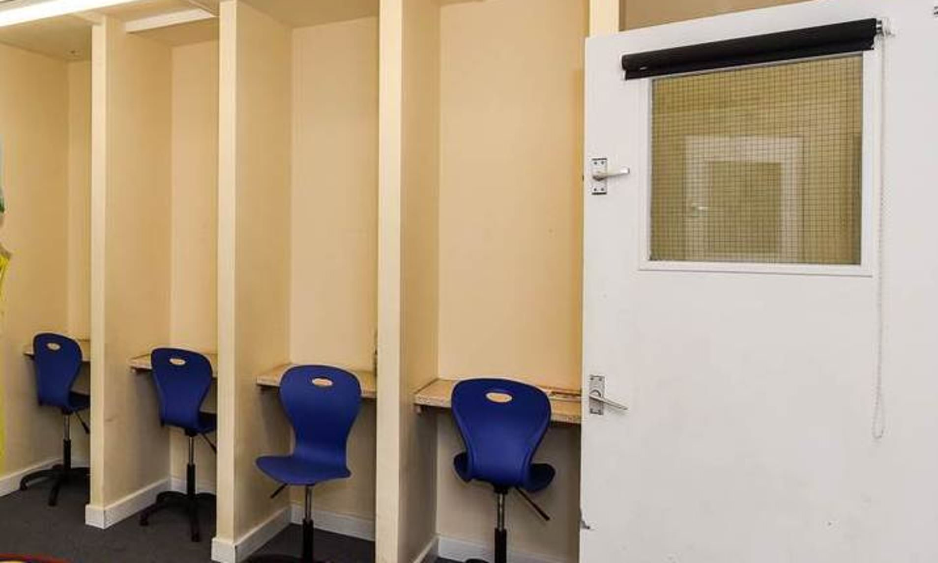
The banality of education policy
Discipline as extensive evil in the neoliberal era
Matthew Clarke
Emma Walker
Charlotte Haines Lyon

Slide 2
Overview
Empirical and conceptual background
‘Zero tolerance’ and ‘isolation’ as banal education policy
Implications and discussion

Slide 3
Education: A force for good?
Alienation of significant numbers of teachers and students from education (Hascher & Hadjar, 2018; Oleksiyenko, 2018; Tsang, 2018)
Characterisation of schools in a range of global contexts have as exam ‘factories’ (Coffield & Williamson, 2011; Hutchings, 2016; Kulz, 2017)
Growth of authoritarian models of schooling, involving ‘zero-tolerance’, ‘no-excuses’ disciplinary approaches

Slide 4
The banality of evil
“Eichmann was not Iago and not Macbeth… except for an extraordinary diligence in looking out for his personal advancement he had no motives at all…He merely, to put the matter colloquially, never realized what he was doing.”
(Arendt, 1963, p. 287)

Slide 5
The evil of banality
“It just takes a practiced conventionality, a clichéd conscience, emotional conformity, susceptibility to small-scale bribery by salary, goods, and/or status, a sense of isolation, and distrust of the reliability of others that works against taking a differing public stand. It just takes, that is, much of what in better times keeps a society provided with reliable and ambitious workers, status-anxious consumers, polite neighbors, agreeable team players, and citizens who make no waves: an ability to go along thoughtlessly, to play the game.”
(Minnich, 2017, p. 2)

Slide 6
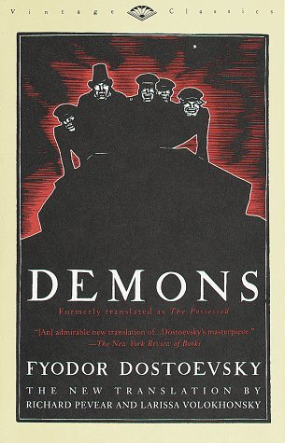
The Dostoevsky Paradigm
For Dostoevsky, ”the finite that seeks to elevate itself to infinity is the nesting spot for the power of evil… [involving] the desire to break down the boundaries of their own finitude to make themselves not only similar to God, but equal” (Forti, 2014, p. 56).

Slide 7
The paradigm of banal evil
“What is most dangerous is not an insignificant bureaucrat who thinks he is God but, rather, the God who pretends to be an insignificant bureaucrat.”
(Zupančič, 2011, p. 97)

Slide 8
Banal policy: The genealogy of 'no excuses'
The rise and acceleration of the academy programme in England has its roots in the authorised creation of public charter schools in the United States
Within the programme of public charter schools is a subset often termed 'no excuses' schools
Examples such as KIPP (Knowledge is Power Program) and Harlem Children's Zone Promise Academies share these characteristics of high-level authoritarian discipline practices

Slide 9
Laser focus on compliance
Time broken down into tiny sub-units and used 'productively'
The use of silence
'Track on me'
Shaming as a disciplinary tool

Slide 10
'Sweating the small stuff'
Broken Windows Theory (Wilson and Kelling, 1982)
Minutiae of control
Halting the possibility of misbehaviour

Slide 11
Isolation and the disciplining of bodies
Solitary confinement
Othering – polluting bodies (Sibley, 1995)
Ontological and ethical implications

Slide 12
'Nonincarcerated subjects are free to invest in the fictions of objectivity, autonomy, self-sufficiency, and individuality, all the while relying on their embodied experience of affective and intercorporeal depth to sustain a meaningful sense of Being-in-the-world. Only incarcerated subjects are forced to actually exist in such fictions, or to be broken by them' (Guenther, 2013:187)

Slide 13
English context
Strict discipline seen as antidote to inequalities and embedded into New Labour Academies project.
Links to aspiration and Hexis (Bourdieu 2010)
Embodiment of the suitable person.

Slide 14
Initial policy analysis
35 behaviour policies and guidance from secondary schools in England
All maintained secondary schools* in North Yorkshire
Largest academy trusts* – five or more schools (NB few had whole trust policies, most had general guidance to be interpreted by individual schools)
2 free schools
*Based on 2018/19 Government data tables

Slide 15
Use of Isolation
‘reflection’, ‘referral’, ‘inclusion’, ‘seclusion’, ‘exclusion’, ‘supervision’ or ‘consequence’.
19 out of 20 schools
8 out of 15 MATs (but we need to drill down into individual school policies).

Slide 16
Uses of Isolation
Alternative provision
Stage management – 18 out of 22 full policies

Slide 17
Framing of behaviour policies
Will be carrying out a full discourse analysis
Positive Behaviour Policy
Behaviour for Learning
Achievement for All
Levels of disruption and what is seen as serious behavioural issue.
Complex and labyrinthine

Slide 18
Framing of the students
Agent
Criminal
In need of control
Wonderous
Conformity v expression
Who knows best?
Focus on good or bad behaviour
Punishment
Restoration

Slide 19
Initial conclusions
Problematic for a range of reasons
Doesn't work – behaviour, climate etc (Skiba et al 2008)
Race issues – esp in US context
Ableist (Mills and Thomson 2018)
What are we setting students up to do and be?
Staff are caught up in a performative web, that is both difficult for them personally as well as the pupils.

Slide 20
Research project going forward
Discourse Analysis of policies
Interviews with school staff and students.
Survey some parents' groups.
How can we move towards a more relational approach?

Slide 21
References
Arendt, H. (1963). Eichmann in Jerusalem: A report on the banality of evil. London: Penguin.
Bourdieu, P. (2010). Outline of a theory of practice (25. printing). Cambridge: Cambridge University Press.
Forti, S. (2014). New demons: Rethinking power and evil today. Stanford, CA: Stanford University Press.
Guenther, L. (2013). Solitary confinement: Social death and its afterlives. Minneapolis: University of Minnesota Press.
Mills, M., & Thomson, P. (2018). Investigative research into alternative provision. Department for Education. https://www.gov.uk/government/publications/investigative-research-into-alternative-provision
Minnich, E. (2017). The evil of banality: On the life and death importance of thinking. Lanham, MD: Rowman & Littlefield Publishers.
Skiba, R. J., Reynolds, C. R., Graham, S., Sharas, P., Conoley, J. C., & Garcia-Vazquez, C. (2008). Are zero tolerance policies effective in the schools? An evidentiary review and recommendations. American Psychologist, 63(9), 852-862.
Sibley, D. (1995) Geographies of Exclusion: Society and Difference in the West. London: Routledge.
Wilson, J.Q. and Kelling, G. (1982) Broken windows: The police and neighbourhood safety Atlantic Monthly 29 – 38.
Zupančič, A., Kant, I., & Lacan, J. (2011). Ethics of the real: Kant, Lacan. London: Verso.

