Slide 1
Co-constructing reading lists: Breaking down the barriers to political agency
Charlotte Haines Lyon and Clare McCluskey-Dean

Slide 2
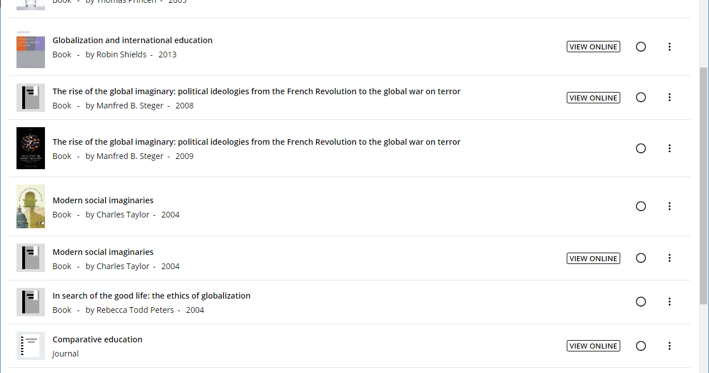
Reading list

Slide 3
The Problem
Global perspectives modules - not many global perspectives.
How can we deliver reading lists that provide a variety of perspectives?
Do we just include more Black authors on the reading lists?

Slide 4
Consumer v Political Agency
“There is a relationship between the emancipatory potential of information, political agency and the democratic responsibilities of the library and information profession […] Critical pedagogical theorists believe that education that goes beyond providing access to information to actively teaching critical thinking skills. This would be of benefit to individuals, particularly young people during their period of formal education. It could equip them with the skills they need to understand the political system and their place within it, and, where necessary, to challenge this.” (Lauren Smith 2013:16)

Slide 5
Engage students with the issue
"critical pedagogy is the best opportunity for young people to develop the knowledge, skills, and sense of responsibility needed to seek agency, justice and democracy” (Giroux 2012, cited in Lauren Smith 2013:19)

Slide 6
Task: students to critique and co-create reading lists.
Explore the systemic biases within the global publishing industry and their impact on both authors but also education.
To find authors who are not white, European or American who are writing about their chosen subject.
“The publishing industry concedes that it has a problem with a lack of diversity. Publishers recognise that writers of colour in particular have been historically excluded. Yet while publishers would like to publish more diversely, finding writers of colour and publishing them successfully remains a challenge.” (Anamik Saha and Sandra van Lente 2020:2)

Slide 7
However students agreed that it was an important issue.
“within much of northern scholarship there has been significant homogenisation, with the tendency to be indebted to the promotion of canonical scholars, while remaining unaware or oblivious (perhaps even ignorant) of underrepresented voices […] knowledge production is consequently tilted in such a way that it enhances the politics of skewed citationality” (Relebohile Moletsane, Louise Haysom and Vasu Reddy 2015:768)

Slide 8
Shock but also frustration prevailed
“Why can’t I find diverse authors on this subject?”
“This is too difficult!”
“I don’t have time to put in the real effort needed.”
“I had never thought about this before – oh my god!”

Slide 9
It is our responsibility as educators…but
“A critical approach to information literacy development means changing the view of education as the transfer of information or “getting the right knowledge into students’ heads” to an awareness of each person’s agency and ability to make meaning within the library setting.” (Jim Elmborg 2006:194)
How do we build in the time and also encourage students to keep going under adverse circumstances?

Slide 10
References
Elmborg, J. (2006). Critical information literacy: Implications for instructional practice. The Journal of Academic Librarianship, 32(2), 192–199.
Moletsane, R., Haysom, L., & Reddy, V. (2015). Knowledge production, critique and peer review in feminist publishing: Reflections from Agenda. Critical Arts: A South-North Journal of Cultural & Media Studies, 29(6), 766–784. https://doi.org/10.1080/02560046.2015.1151112
Saha, A., & Lente, S. van. (2020). Rethinking diversity in publishing. Goldsmiths, University of London. https://www.spreadtheword.org.uk/wp-content/uploads/2020/06/Rethinking_diversity_in-publishing_WEB.pdf
Smith, L. (2013). Towards a model of critical information literacy instruction for the development of political agency. Journal of Information Literacy, 7(2), 15–32.

