Slide 1
Caroline Elbra-Ramsay
Navigating the Pedagogical, Relational and Moral economies of assessment: an Analysis of the Development of Student Teachers’ understandings of Feedback

Slide 2
Feedback has been acknowledged as being key to progress (Black and Wiliam, 1998; Mutch, 2003; Orrell, 2006; Kahu, 2008; Hattie, 2009; Hattie and Clarke, 2018) however it is frequently listed as an area of student discontent in the National Student Survey (NSS) (Boud and Molloy,2012; Sambell, 2016; Brooks, 2018; McArthur, 2018; Steen-Utheim and Hopfenbeck, 2019). Furthermore feedback can have significant implications on teacher/tutor workload (Mao and Crosthwaite, 2019; Richards and Richardson, 2019), can be misunderstood (Defeyter and McPartlin, 2007) and often goes ignored by the learner (Paterson et al., 2020; Gul et al., 2016; Glover and Brown, 2006,. Indeed it appears that the potential of feedback is largely unfulfilled (Clarke, 2003; Crisp, 2007; Johnson et al., 2016; Molloy and Boud, 2013; Wiliam, 2011; Winstone and Carless, 2019).

Slide 3
‘teachers’ own practices and knowledge of’ feedback practices is an ‘area worthy of further study particularly teachers’ knowledge, concerns, and beliefs with regard to the feedback they give ‘ (Van Den Berg et al. 2013 p.357).
Roles, Contexts and Concepts

Slide 4
Feedback as …..
Self-regulation
identify
relationship
dialogue
cycle
motivation

Slide 5
Research Questions
What are student teachers’ conceptions of feedback as learners?
What are student teachers’ conceptions of feedback as practising primary school teachers?
What are the relationships between the developing understanding of feedback as a student and a student teacher?

Slide 6
Q1. What are student teachers’ conceptions of feedback as learners?
Q2. What are student teachers’ conceptions of feedback as practising primary school teachers?
Year 1
YSJ University Modules
Data Collection Point 1
School Experience 1
Data Collection Point 2
Year 2
YSJ University Modules
Data Collection Point 3
School Experience 2
Data Collection Point 4
Year 3
YSJ University Modules
Data Collection Point 5
School Experience 3
Data Collection Point 6
Q3. What are the relationships between the developing understanding of feedback as a student and a student teacher?

Slide 7
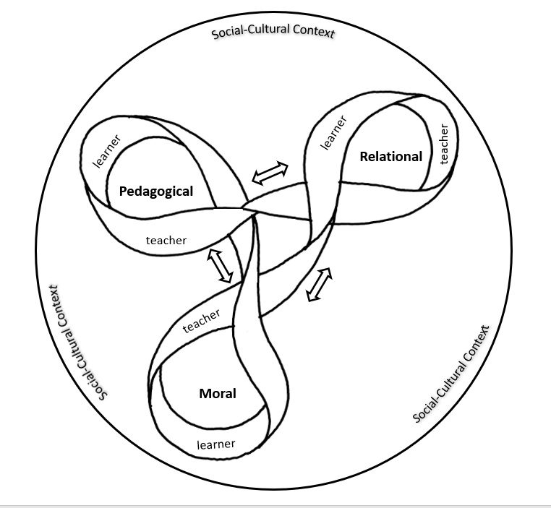
The Feedback Ribbon
Bourdieu uses the economic metaphor to describe cultural and societal capital that people can invest in, accumulate and distribute (Lewis, Waldron and Fiske 1992)

Slide 8
Pedagogical Economies
Feedback as a deficit
Lilly: I think it is a key aspect within progression because I think if I was to hand in that piece of work and I were to get no feedback back, and then I went to hand in another piece of work, I wouldn't have known where to kind of improve ..(Interview 3)
Feedback as a gift
Daisy: I think most of the feedback role was with the tutor here because he was more knowledgeable than me on the basis of this, so he could tell me what I needed to do, and what I'd done so far (Interview 3)…… Because in a teaching situation I am the expert, so I know the correct answer in most cases, …whereas in a peer situation I don’t know the best way so it’s more difficult to tell people what to do. (Interview 5)
Feedback as a cycle
Lilly: it’s not… about that linear progress. It’s more … a continuum, that circle or a triangle or whatever you want to do, it’s just like a continuous thing, like a ball that won’t stop rolling sort of thing (Interview 6).

Slide 9
Relational Economies
Face to face feedback
Eleanor: … verbal feedback’s immediate. You can question, if they give you a sort of garbled answer you can pick out you know you can ask them in a different way so they get chance to respond and let you know, you know you can better understand what they’re saying to you and you can explain in as many different ways as it takes how what you were trying to get across… (Interview 2)
Lilly: Whereas if you're face to face with someone, so giving oral feedback, you can then more say right don't worry about it, we can help you move forward, it is nothing to be ashamed of if you haven't done very well. (Interview 3)
To be known and to know
Eleanor: To my mind effective feedback, you have to know the person that you're feeding back to or about, to know what they’re going to respond to. (Interview 3)
In reference to peer feedback Eleanor: it’s always nice to hear someone say, ‘Oh, that’s really good,’ but what are you basing that opinion on? It’s not on years of expertise. ‘Are you just being polite, or can you recognise good work when you see it?’ …. You sort of make a judgement call based on what you know about that person. (Interview 1)

Slide 10
Relational Economies
Trust and respect
Eleanor: …. but it probably affects how I react to feedback when I get it because it was the first thing I looked for [was] who had marked it, before I looked at the grade.’ ……. the person who I thought might be marking it, I don’t really respect them as much.
Nick: A tutor’s job is to develop the best out of the student …I think it’s just because I know [tutor’s name]. I’m very clear on the fact that [tutor’s name] has the best intention for his students. (Interview 5)
The influence of emotions
Nick: When I first got given the feedback it was more angry… Then it went to disheartened, when I got the feedback and I was just like, ‘Really, that’s what it’s come to?’ Now, I'm all right with it. When I talk about it I get still a bit agitated sometimes…

Slide 11
Moral Economies
Teaching as a moral duty
Daisy: you’re a tutor I feel like we, sort of, not trust your opinion more but, we understand that you’ve sort of got more knowledge than our peers. So if a tutor was to give us constructive criticism you would be like, okay that’s a good plan – we’ll try and implement that. (Daisy Interview 5)
Doing it for the file
Jenny: [in reference to her adapting the timings related to the returning of written feedback] … because I thought they needed it because otherwise I wasn’t going to be able to prove the standard [related to pupils acting on feedback]. (Interview 6)
Jenny: I think that it’s just a sign of progression from the primary school and I suppose it’s proof here. You could get all your assignments printed off on that page and you could say ‘This is what everyone said about me’
Interviewer: What do you want the proof for? Proof for what?
Jenny: For me to show that I’ve acted on it, so made it better. So, the first year, for example, if it was couldn’t reference through for my life, then I can prove, okay, now I can and I can do …
Interviewer: Who are you proving it to?
Jenny: Myself. (Interview 6)

Slide 12
Moral Economies
Truth and honesty
Jenny: [honesty in feedback] does... but...I think … it comes back to the feelings thing, I think everyone’s just so much more sensitive here and we take it personally and then you’ve got to deal with your whole group being in a strop. (Interview 5)
Identity
Lottie: well originally I thought that like getting feedback was constructive and motivating however after [placement] I feel like it’s actually demotivated me hugely … because ...the feedback that I got was always ‘not improving’, I wasn’t improving, it just kind of demotivated me... I feel like I did act on the feedback and I was quite positive about it at first but the more I kept trying things and then my feedback would get worse and I was like ‘oh my god like what am I doing that’s wrong?’ and then I was trying everything in my power to be able to change things and it still wasn’t getting any better …Yeah please tell me something is improving…. I just thought what’s the point of looking at it? Like what is the point? Like I was a bright eyes and bushy tailed student on day 1 in placement and it was towards the end, it sounds bad because this is not me at all, it was just like ‘what is the point? what is the point in me even trying?’ (Interview 6)

Slide 13
Conclusions - HE
Re-examine how feedback is conceptualised and experienced by the students.
Feedback needs to be framed as a relationship ; practices should be considered to see how they influence the development, or not, of a relationship. Face to face feedback is significant.

Slide 14
Conclusions-ITE
Opportunities for low stake discussion and exploration
Harnessing the learner experience
Critical consideration of the Teachers’ Standards

Slide 15
Conclusions- School
The mechanics of feedback have sometimes taken over from the principles and purposes of feedback (a consequence of performativity).
Schools should try to develop as sites for critical debate about what feedback is, what is experienced and understood about feedback and what the implications are for the classroom
Actively discourage any dichotomous discourse where school policy and practice are positioned as either ‘good’ or ‘bad.’

Slide 16
If you want to know more…..
Understanding Feedback: A critical exploration for teacher educators
Caroline Elbra-Ramsay
c.elbraramsay@yorksj.ac.uk

Slide 17
References
Black, P. and Wiliam, D. (1998) Inside the black box: Raising standards through classroom assessment. London: Granada Learning.
Boud, D. and Molloy, E. (2012) 'What is the Problem with Feedback?'Feedback in higher and professional education London: Routledge, pp. 11-20.
Brooks, C. (2018) 'What makes students satisfied? A discussion and analysis of the UK’s national student survey AU - Bell, Adrian R', Journal of Further and Higher Education, 42(8), pp. 1118-1142. doi: 10.1080/0309877X.2017.1349886.
Clarke, S. (2003) Enriching feedback in the primary classroom: Oral and written feedback from teachers and children. London: Hodder and Stoughton.
Crisp, B.R. (2007) 'Is it worth the effort? How feedback influences students’ subsequent submission of assessable work', Assessment & Evaluation in Higher Education, 32(5), pp. 571-581.
Defeyter, M.A. and McPartlin, P.L. (2007) 'Helping Students Understand Essay Marking Criteria and Feedback.', Psychology Teaching Review, 13(1), pp. 23-33.
Hattie, J. (2009) Visible learning: A synthesis of over 800 meta-analyses relating to achievement. Abingdon: Routledge.
Hattie, J. and Clarke, S. (2018) Visible Learning: Feedback. Abingdon: Routledge.
Johnson, C.E., Keating, J.L., Boud, D.J., Dalton, M., Kiegaldie, D., Hay, M., McGrath, B., McKenzie, W.A., Nair, K.B.R. and Nestel, D. (2016) 'Identifying educator behaviours for high quality verbal feedback in health professions education: literature review and expert refinement', BMC medical education, 16(1), pp. 96.
Kahu, E.R. (2008) 'Feedback: The heart of good pedagogy', New Zealand Annual Review of Education, 17, pp. 187-197.
Lewis, L.A., Waldron, D. and Fiske, J. (1992) The Adoring Audience: The Cultural Economy of Fandom. London, Routledge.
Mao, S.S. and Crosthwaite, P. (2019) 'Investigating written corrective feedback:(Mis) alignment of teachers’ beliefs and practice', Journal of Second Language Writing, 45, pp. 46-60.
McArthur, J. (2018) Assessment for Social Justice: Perspectives and Practices Within Higher Education. London: Bloomsbury Academic Publishing.
Van Den Bergh, L., Ros, A. and Beijaard, D., 2013. Teacher feedback during active learning: Current practices in primary schools. British Journal of Educational Psychology, 83(2), pp. 341-362.

Slide 18
Questions?

