Slide 1
Partnership models – one size fits all?
Caroline Elbra-Ramsay
David Scott
York St John University

Slide 2
Introductions
Caroline Elbra-Ramsay
Head of Programme for Assessment and Student Outcomes
David Scott
Head of English
Y1 UG, Y2 UG, PGCE (Uni / SD)

Slide 3
Partnership models – one size fits all?
Partnership at YSJ
Subject knowledge
Current partnership model for the teaching of phonics
The impact of this approach
Grammar
Current practice and issues in schools
Transferability of the model
Recommendations

Slide 4
Small scale research project
Qualitative and quantitative
Student module / placement evaluation data
Student voice comments
SE data
Teacher questionnaires
Teacher interviews

Slide 5
What does partnership mean at YSJ?
Internationally, Initial Teacher Education (ITE) is often challenged because ‘what is taught in education classes is disconnected from teachers’ work in the classroom’ (Kotelawala cited in Cajkler, Wood et al. 2013 p.537)
Collaborative provision
Jointly run programmes
School placements
Visiting school staff
Training and development
Assessed school placements
Focused non-assessed placements
‘Recent OECD reports draw attention to the need for ITE to be more flexible
and responsive to the realities of teaching by providing an authentic and integrated teacher education programme based on collaborative partnerships with local schools (Musset, 2010; OECD, 2011)….. Musset (2010) challenges ITE providers and schools to take shared responsibility for teacher education in order to ensure a smoother transition into the teaching profession (Harlow, Cobb 2014 p.71)

Slide 6
The heightened place of subject knowledge
2014 English curriculum firmly stresses the importance of secure subject knowledge amongst teachers.
2015 Carter Report highlights the significance of subject knowledge within ITE.
‘The Teachers’ Standards (Department for Education (DfE), 2011) set a common expectation across the system about the knowledge, understanding and skills new teachers should have. However, we have found considerable variability in ITT content across the system. We have identified what appear to be potentially significant gaps in a range of courses in areas such as subject knowledge development, subject-specific pedagogy …’ (2015 p.6)
‘All ITT partnerships should:
i. rigorously audit, track and systematically improve trainees’ subject knowledge throughout the programme
ii. ensure that changes to the curriculum and exam syllabi are embedded in ITT programmes
iii. ensure that trainees have access to high quality subject expertise
iv. ensure that trainees have opportunities to learn with others training in the same subject (Carter 2015 p.7)
‘Both trainers and mentors should have a strong grasp of subject-specific pedagogy. ‘(Carter 2015 p.8)
Introduction of 2016 SPAG material & tests
2016 White Paper ‘We will strengthen ITT content, focusing on helping new teachers enter the classroom with sufficient subject knowledge…’ (2016 p. 12)…’ strengthen university and school-led training, increasing the rigour of ITT content with a greater focus on subject knowledge and evidence-based practice ‘(2016 p. 24)…’

Slide 7
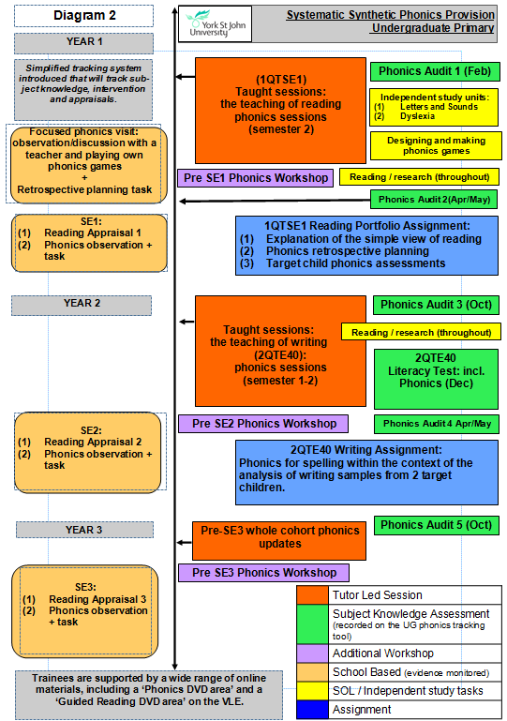
The SSP Partnership Model

Slide 8
Phonics Placement
In discussion of policy and practice on partnership between higher education providers and other stakeholders in initial teacher education (ITE), one significant approach has been to stress the desirability of developing models which are truly collaborative. (Smith, Brisard et al. 2006 p.147)
Pre-Placement
Taught sessions (subject knowledge and pedagogy), independent learning tasks, audits
Communication with schools about children’s needs
Planning and developing games
Prepare Q + A
Placement
9.20 - Arrive
9.30 - Phonic Lesson Observation
9:50 – Work in pairs to play phonic games with groups of children
10.20-10.40 - Trainees to meet with two of the teaching staff for discussion
Post-Placement
Reflection tasks

Slide 9
What is the impact? Student Teachers
‘The session was very interactive and all children appeared engaged. It has given me the confidence to try interactive approaches in my own teaching.’
‘Before the visit, it was difficult to visualise the structure of a lesson. ‘
‘The visit helped me understand the importance of modelling and how this strategy helps to support children in their learning. ‘
‘The clear structure of the lesson allowed me to make the links between what is taught at university and how it might look like in some schools. ‘
‘Seeing how children used the terminology was very helpful and I now have more confidence in using it myself.’
‘The question and answer session was useful and the teachers were honest when answering questions. This gave me a realistic view of how to teach early reading.’
‘Being able to make a game and then play it with children has had a positive impact on my subject knowledge and confidence. ‘
‘Really helpful to see a full phonics lesson as my placement school does not follow the same structure.’
‘It made me see the benefits of focused phonic sessions – I enjoyed the experience.’
‘It was such a good school and the phonics taught was almost exactly how we have been taught at university. ‘

Slide 10
Collaborative partnerships favour a dialectical approach to theory and practice through the encouragement of a form of reflective practice in the student which draws upon the different forms of professional knowledge contributed by staff in higher education (HE) and staff in schools, seen as equally legitimate (McIntyre, 1990; Furlong et al., 2000 cited in Smith, Brisard et al. 2006 p.148).

Slide 11
What is the impact? Student teachers
What has had the biggest impact this year?
Research for our phonics game and working with the children during our visit
Phonics visit
The workshop, the phonics visit and regular audits
The biggest impact to me was that how a phonics lesson should be short, interactive and varied lesson styles to present it.
Phonic assessments
The motivation to do well in the phonics audit
Seminars in class working in groups
Experience during school placement and also during individuals group seminars
Lectures and phonic audits have had a big impact on my phonic knowledge. The audits in particular, as they have provided me with important feedback on areas that I need to improve on to develop my subject area knowledge.

Slide 12
The phonic visit and making the phonics games have had a positive impact on my subject knowledge
The phonic visit and making the phonics games have had a positive impact on my understanding of how to teach phonics
Please rate your experience of taking part in the phonics visit in relation to it informing your understanding of how to teach early reading/phonics

Slide 13
What is the impact? - Schools
‘strong overlaps between schools and HEI could be for the mutual benefit of both’ (Edwards, Mutton 2007 p506).
What are the benefits of the phonics placement?
The students always say it gives them a good insight into teaching phonics through both the observed lesson and in practising their teaching with the groups. The children are always excited to have the students in - they cheer when I tell them! They love the variety of games that the students bring and are always highly engaged and motivated.
The teaching staff also love the games and I always tell the students that they inspire the teachers too. The teaching staff also get a rare chance to observe their children doing phonics so they use this for assessment purposes. 2. Benefits to students: a chance to see phonics in practice; to understand the levels children within each year group are working and to get classroom experience.

Slide 14
What is the impact?
‘What are the benefits of the phonics placement?
Benefits to children: an opportunity to be involved in lots of lovely, interactive phonics games, to increase their confidence by working with other adults and showing off their skills
Benefits to teachers: to gain ideas for phonics activities, to reignite a passion for teaching in a creative and interactive way!
Students see first hand how misconceptions are dealt with and how teachers support and extend pupils throughout the lesson. The children gain experience of working with different adults and with different activities. As the phonic activities are usually closely tailored to the needs of small groups of pupils, children are able to focus on the development of particular skills. During the Q&A session, teaching staff are able to be quite analytical about their own practice. The games and activities provided by the students enable teaching staff to gain some new ideas as well as observe the way groups of pupils are working.

Slide 15
What are the outcomes?

Slide 16
The benefits of the model re. SSP
The ‘knowledgeable other’
Links between theory and practice
Supports subject knowledge
Terminology
Phonic knowledge
Phonic skills
Supports pedagogy
4 part structure
Engaging, multi-sensory, interactive
Use of terminology
Systematic and synthetic
Planning and assessment
Opportunities for Blending/segmenting
Resources
Reinforces collaborative understanding of good practice

Slide 17
Difficulties faced by our students
When asked ‘which area of English subject knowledge do you feel you need to develop?’ – 73% of our students identified grammar and related terminology.
Many of our students begin their training with little or no pre-existing grammar subject knowledge as a result of conflicting guidance (Clark 2010)
The terminology has become a hurdle to developing grammar subject knowledge due to a decline in the understanding of grammatical amongst school levers (Alderson & Hudson 2012)

Slide 18
Current provision
A series of grammar workshops are delivered to support subject knowledge
Aspects of grammar are embedded within reading/writing modules
Subject knowledge is audited throughout our students training & tracked
Workshops are informed by audit result

Slide 19
Gaps
The need to develop secure subject knowledge has led to some decontextualized learning. This problem is also identified within schools as stated by Stafford et al (2015)
Issues with subject knowledge v. subject specific pedagogy
Student teachers are not seeing an embedded approach to the teaching of grammar in school.
The abstract nature of grammar subject knowledge means that our students find many concepts difficult to understand
‘Primary teacher training is not required to contain any instruction in how to teach explicit grammar knowledge, and it seems unlikely that there is space in a crowded curriculum anyway. Wales (2009, 538)noted that provision of materials was inadequate without training, and this seems true today too’ (Bell 2015)

Slide 21
But…..
‘Learning to label and dissect language into its component parts and learning to underline grammatical errors in artificially generated sentences will not equip young learners to become confident and mature language users.’ Myhill (2012, p.22)
‘By introducing children to grammatical features and language in context, you will help them internalise these principles. Try not to go for the ready-made solution by using a worksheet or book. It will make very little difference to children’s use of language and will be meaning less for those who are not yet able to think in an abstract way.’ Waugh, Warner and Waugh (2016, p.19)
‘The grammar test format influences teaching content & approaches.’ ‘Time spent teaching decontextualized and contextualised grammar has increased.’ Safford et al (2015, p.2)

Slide 22
Effective Teaching of Grammar
By clear what is to be taught during each unit and how this impacts on language use.
Introduce and model terminology at beginning of unit. Teach discretely through practical activities.
Investigate grammatical concepts in reading through shared and guided work.
Apply grammatical concepts and model using shared and guided writing
Children independently apply grammatical knowledge in their writing and evaluated the impact this has on effective language use and the reader.
Adapted from (Waugh, Warner et al. 2016, p.18)

Slide 23
Our partnership schools & their approach to the teaching of grammar
Our schools take different approaches. There is not one consistent approach to the teaching of grammar.
KS1 uses the phonic model and teaches an aspect of grammar & punctuation discretely. An active approach is taken, e.g. adding actions to underpin terminology.
KS2 – Aspects of grammar to be covered during a particular unit are taught discretely but these are returned to during guided writing. They are modelled by the teacher and become specific marking points during feedback.
Teacher confidence has a marked impact on the teaching of grammar. The less confident teachers are, the more decontextualized the teaching becomes.

Slide 24
‘Having a command of grammar is like controlling a horse. If you let go of the reigns the horse controls you. If you hold onto the reigns and guide the horse you become an expert writer.’
Quote from KS2 Teacher

Slide 25
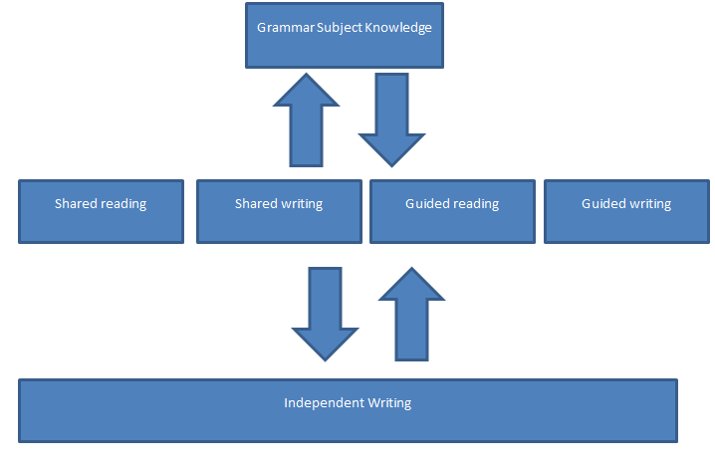

Slide 26
Teacher
Confidence
and
enthusiasm
Models of Quality
Shared reading / text analysis
Discrete skills session
Contextualised skills – limited writing
Contextualised – whole text application
Contextualised across the curriculum

Slide 27
Would partnership model work?
Partnerships schools would have to provided examples of best practice & this is still being developed with schools.
The phonic model is based on the discrete teaching of SSP and this is in conflict with best practice if applied to grammar.
The existing model would affirm the decontextualized teaching of grammar.

Slide 28
Implications / next steps
For the English team
For our partnership
For all schools
Model contextualised teaching of grammar;
Increase student led learning to develop confidence;
Support pedagogy as well as subject knowledge
Discussion centred on why (impact) as well as what.
Share best practice within the partnership;
Ensure partnership models match pedagogical approaches;
Consider extended models of partnership to engage in the full sequence of learning.
Establish a coherent approach to the teaching of grammar with links to best practice;
Ensure teachers are clear about what good practice is as well as what subject knowledge is;
Ensure current CPD is not driven by terminology but the impact on language use

Slide 29
Any Questions ?

Slide 30
References
Alderson, J and Hudson, R., 2012. The metalinguistic knowledge of undergraduate students of English language or linguistics. Language Awareness 22 (4). pp. 320-337.
Bell, H., 2015. The Dead Butler revisited: grammatical accuracy and clarity in the English Primary Curriculum 2013–2014. Language and Education, 29(2), pp. 140-152.
Cajkler, W., Wood, P., Norton, J. and Pedder, D., 2013. Lesson Study: towards a collaborative approach to learning in Initial Teacher Education? Cambridge Journal of Education, 43(4), pp. 537-554.
Carter, A., 2015. Carter review of initial teacher training (ITT) Crown
Clark, U., 2010. Grammar in the Curriculum for English: What Next? Changing English, 17(2), pp. 189-200.
Department of Education, 2016 Educational Excellence Everywhere Crown copyright
Edwards, A. and Mutton, T., 2007. Looking forward: rethinking professional learning through partnership arrangements in Initial Teacher Education. Oxford Review of Education, 33(4), pp. 503-519.
Harlow, A. and Cobb, D.J., 2014. Planting the Seed of Teacher Identity: Nurturing Early Growth through a Collaborative Learning Community. Australian Journal of Teacher Education, 39(7), pp. n7.
MyhilL. D. (2012) The role for grammar in the curriculum, in meeting high expectations: Looking for the heart of English available from https://heartofenglishblog.wordpress.com/meeting-high-expectations/the-role-for-grammar-in-the-curriculum-debra-myhill/ accessed 22/6/16
Smith, I. Brisard, E. and Menter, I. 2006. Models of partnership developments in initial teacher education in the four components of the United Kingdom: recent trends and current challenges. Journal of Education for Teaching, 32(2), pp. 147-164.
Stafford, K. Messer, D. McLachlan, J. Walker, K. (2015) Teaching grammar and testing grammar in the English primary school. The impact on teachers and teaching of the grammar element of the statutory test in Spelling, Punctuation and Grammar (SPaG) in England. UKLA: London.
Waugh, D., Warner, C. and Waugh, R., 2016. Teaching Grammar, Punctuation and Spelling in Primary Schools. Learning Matters: London

