Slide 1
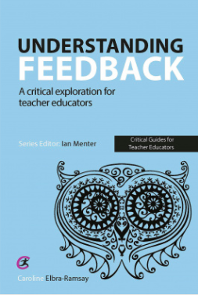
Caroline Elbra-Ramsay York St John University
Navigating the Pedagogical, Relational and Moral economies of assessment: an Analysis of the Development of Student Teachers’ understandings of Feedback

Slide 2
‘teachers’ own practices and knowledge of’ feedback practices is an ‘area worthy of further study particularly teachers’ knowledge, concerns, and beliefs with regard to the feedback they give ‘ (Van Den Berg et al. 2013 p.357).

Slide 3
Research Questions
What are student teachers’ conceptions of feedback as learners?
What are student teachers’ conceptions of feedback as practising primary school teachers?
What are the relationships between the developing understanding of feedback as a student and a student teacher?

Slide 4
Q1. What are student teachers’ conceptions of feedback as learners?
Q2. What are student teachers’ conceptions of feedback as practising primary school teachers?
Year 1
YSJ University Modules
Data Collection Point 1
School Experience 1
Data Collection Point 2
Year 2
YSJ University Modules
Data Collection Point 3
School Experience 2
Data Collection Point 4
Year 3
YSJ University Modules
Data Collection Point 5
School Experience 3
Data Collection Point 6
Q3. What are the relationships between the developing understanding of feedback as a student and a student teacher?

Slide 5
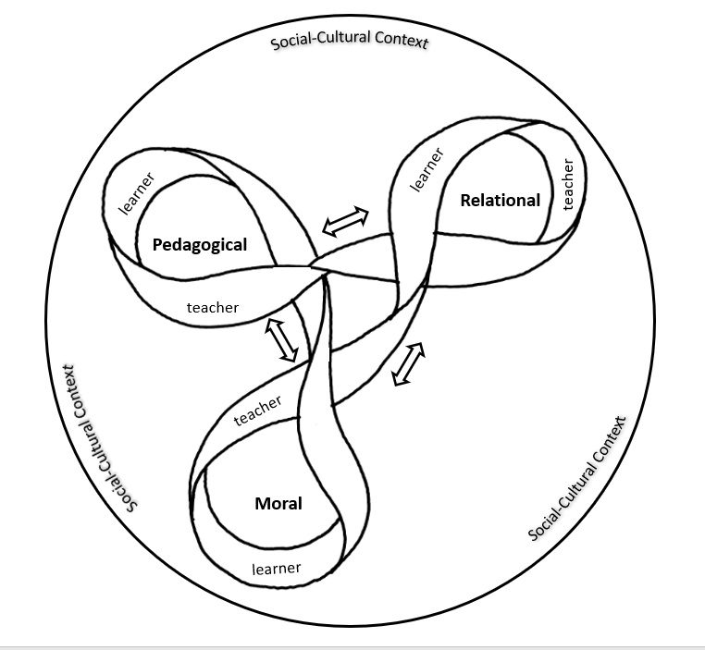
The Feedback Ribbon

Slide 6
Pedagogical Economies
Feedback as a deficit
Lilly: I think it is a key aspect within progression because I think if I was to hand in that piece of work and I were to get no feedback back, and then I went to hand in another piece of work, I wouldn't have known where to kind of improve ..(Interview 3)
Feedback as a gift
Daisy: I think most of the feedback role was with the tutor here because he was more knowledgeable than me on the basis of this, so he could tell me what I needed to do, and what I'd done so far (Interview 3)…… Because in a teaching situation I am the expert, so I know the correct answer in most cases, …whereas in a peer situation I don’t know the best way so it’s more difficult to tell people what to do. (Interview 5)
Feedback as a cycle
Lilly: it’s not… about that linear progress. It’s more … a continuum, that circle or a triangle or whatever you want to do, it’s just like a continuous thing, like a ball that won’t stop rolling sort of thing (Interview 6).

Slide 7
Relational Economies
Face to face feedback
Eleanor: … verbal feedback’s immediate. You can question, if they give you a sort of garbled answer you can pick out you know you can ask them in a different way so they get chance to respond and let you know, you know you can better understand what they’re saying to you and you can explain in as many different ways as it takes how what you were trying to get across… (Interview 2)
Lilly: Whereas if you're face to face with someone, so giving oral feedback, you can then more say right don't worry about it, we can help you move forward, it is nothing to be ashamed of if you haven't done very well. (Interview 3)
To be known and to know
Eleanor: To my mind effective feedback, you have to know the person that you're feeding back to or about, to know what they’re going to respond to. (Interview 3)
In reference to peer feedback Eleanor: it’s always nice to hear someone say, ‘Oh, that’s really good,’ but what are you basing that opinion on? It’s not on years of expertise. ‘Are you just being polite, or can you recognise good work when you see it?’ …. You sort of make a judgement call based on what you know about that person. (Interview 1)

Slide 8
Relational Economies
Trust and respect
Eleanor: …. but it probably affects how I react to feedback when I get it because it was the first thing I looked for [was] who had marked it, before I looked at the grade.’ ……. the person who I thought might be marking it, I don’t really respect them as much.
Nick: A tutor’s job is to develop the best out of the student …I think it’s just because I know [tutor’s name]. I’m very clear on the fact that [tutor’s name] has the best intention for his students. (Interview 5)
The influence of emotions
Nick: When I first got given the feedback it was more angry… Then it went to disheartened, when I got the feedback and I was just like, ‘Really, that’s what it’s come to?’ Now, I'm all right with it. When I talk about it I get still a bit agitated sometimes…

Slide 9
Moral Economies
Teaching as a moral duty
Daisy: you’re a tutor I feel like we, sort of, not trust your opinion more but, we understand that you’ve sort of got more knowledge than our peers. So if a tutor was to give us constructive criticism you would be like, okay that’s a good plan – we’ll try and implement that. (Daisy Interview 5)
Doing it for the file
Jenny: [in reference to her adapting the timings related to the returning of written feedback] … because I thought they needed it because otherwise I wasn’t going to be able to prove the standard [related to pupils acting on feedback]. (Interview 6)
Jenny: I think that it’s just a sign of progression from the primary school and I suppose it’s proof here. You could get all your assignments printed off on that page and you could say ‘This is what everyone said about me’
Interviewer: What do you want the proof for? Proof for what?
Jenny: For me to show that I’ve acted on it, so made it better. So, the first year, for example, if it was couldn’t reference through for my life, then I can prove, okay, now I can and I can do …
Interviewer: Who are you proving it to?
Jenny: Myself. (Interview 6)

Slide 10
Moral Economies
Truth and honesty
Jenny: [honesty in feedback] does... but...I think … it comes back to the feelings thing, I think everyone’s just so much more sensitive here and we take it personally and then you’ve got to deal with your whole group being in a strop. (Interview 5)
Identity
Lottie: well originally I thought that like getting feedback was constructive and motivating however after [placement] I feel like it’s actually demotivated me hugely … because ...the feedback that I got was always ‘not improving’, I wasn’t improving, it just kind of demotivated me... I feel like I did act on the feedback and I was quite positive about it at first but the more I kept trying things and then my feedback would get worse and I was like ‘oh my god like what am I doing that’s wrong?’ and then I was trying everything in my power to be able to change things and it still wasn’t getting any better …Yeah please tell me something is improving…. I just thought what’s the point of looking at it? Like what is the point? Like I was a bright eyes and bushy tailed student on day 1 in placement and it was towards the end, it sounds bad because this is not me at all, it was just like ‘what is the point? what is the point in me even trying?’ (Interview 6)

Slide 11
Conclusions - HE
policy makers and practitioners should reframe the discourse away from processes related to compliance with University systems and re-examine how feedback is conceptualised and experienced by the students
Feedback needs to be framed as a relationship between the giver and receiver. Practices should be re-examined to see how it influences the development, or not, of a relationship.

Slide 12
Conclusions- school
The mechanics of feedback have sometimes taken over from the principles and purposes of feedback (a consequence of performativity).
Schools should try to develop as sites for critical debate about what feedback is, what is experienced and understood about feedback and what the implications are for the classroom
Actively discourage any dichotomous discourse where school policy and practice are positioned as either ‘good’ or ‘bad.’

Slide 13
Conclusions-ITE
Opportunities for low stake discussion and exploration
Harnessing the learner experience
Critical consideration of the Teachers’ Standards

Slide 14
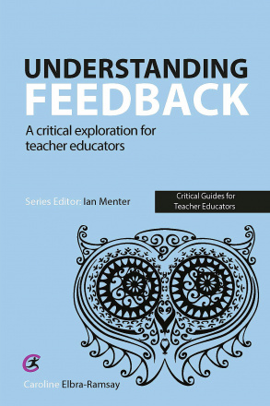
If you want to know more…..
Understanding Feedback: A critical exploration for teacher educators
25% discount using the voucher code TEAN21 (£15 total)
www.criticalpublishing.com

Slide 15
References
Ali, N, Ahmed, L and Rose, S (2017) 'Identifying predictors of students’ perception of and engagement with assessment feedback', Active Learning in Higher Education , pp 1469787417735609.
Beck, L.G. (1992) Meeting the challenge of the future: The place of a caring ethic in educational administration. American Journal of Education, 100 (4), pp.454-496.
Black, P and Wiliam, D (1998) Inside the black box: Raising standards through classroom assessment. London: Granada Learning.
Boud, D and Molloy, E (2012) Feedback in higher and professional education: understanding it and doing it well. London ; New York: Routledge.
Bohm, D (2013) On Dialogue. London: Routledge.
Boud, D and Molloy, E (2012) 'What is the Problem with Feedback?' Feedback in higher and professional education London: Routledge, pp 11-20.
Brown, G T L (2011) 'Teachers' conceptions of assessment: comparing primary and secondary teachers in New Zealand', Assessment Matters, 3, pp 45+.
Buber, M. (2013) I and Thou. London, Bloomsbury.
Cheng, M M, Cheng, A Y and Tang, S Y (2010) 'Closing the gap between the theory and practice of teaching: Implications for teacher education programmes in Hong Kong', Journal of Education for Teaching, 36(1), pp 91-104.
Donche, V. and Van Petegem, P., 2009. The development of learning patterns of student teachers: a cross-sectional and longitudinal study. Higher Education, 57(4), pp.463-475.
Endedijk, M D Vermunt, J D, Meijer, P C and Brekelmans, M (2014) 'Students' development in self-regulated learning in postgraduate professional education: a longitudinal study', Studies in higher education, 39(7), pp 1116-1138.
Hargreaves, E (2005) 'Assessment for learning? Thinking outside the (black) box', Cambridge Journal of Education, 35(2), pp 213-224. doi: 10.1080/03057640500146880.
Hattie, J (2003) Teachers Make a Difference, What is the research evidence? , Melbourne,. October 2003. Australian Council for Educational Research, .
Hattie, J and Clarke, S (2018) Visible Learning: Feedback. Abingdon: Routledge.

Slide 16
References
Holquist, M. (2002) Dialogism: Bakhtin and His World. London, Psychology Press.
Linell, P. (2007) Essentials of dialogism. Aspects and elements of a dialogical approach to language, communication and cognition [Internet]. Available from http://citeseerx.ist.psu.edu/viewdoc/download?doi=10.1.1.203.831&rep=rep1&type=pdf [Accessed 24.5.19].
Nicol, D and Macfarlane-Dick, D (2004) Rethinking formative assessment in HE: a theoretical model and seven principles of good feedback practice. Higher Education Academy, .
Ramaprasad, A (1983) 'On the definition of feedback', Behavioral science, 28(1), pp 4-13.
Robinson, A (2011) In theory Bakhtin: dialogism, polyphony and heteroglossia. Available at: https://ceasefiremagazine.co.uk/in-theory-bakhtin-1/ (Accessed: 20.3.19).
Sadler, D R (1989) 'Formative assessment and the design of instructional systems', Instructional science, 18(2), pp 119-144.
Strijbos, J and Ufer, S (2019) 'Preservice mathematics teachers’ beliefs about peer feedback, perceptions of their peer feedback message, and emotions as predictors of peer feedback accuracy and comprehension of the learning task AU - Alqassab, Maryam', Assessment & Evaluation in Higher Education, 44(1), pp 139-154. doi: 10.1080/02602938.2018.1485012.
Winstone, N (2018) How are cultures of feedback practice shaped by accountability and quality assurance agendas? SRHE.
Van Den Bergh, L., Ros, A. and Beijaard, D., 2013. Teacher feedback during active learning: Current practices in primary schools. British Journal of Educational Psychology, 83(2), pp. 341-362.

