Slide 1
Learning effectiveness of short term study abroad through the lens of transformative learning: a comparative study of international students in China and the UK ECE 2021 17th July 2021
Dr Xianghan O'Dea, York St John University, United Kingdom Dr Chen Wang, Durham University, United Kingdom Dr Mike O'Dea, York St John University, United Kingdom

Slide 2
Outline
Introduction
Background
Methodology
Findings
Conclusions and Recommendations

Slide 3
Introduction
The paper compares the results of two studies that looked at Transnational students:
One looked at Chinese students studying a top-up degree in a u.k. university
The other looked at international students studying a short term language course in a Chinese University
Their experiences are compared and analysed using Transformative Learning to assess how effective their learning was.

Slide 4
Background
Study abroad programmes are more challenging when the cultural differences between the native countries of the student and the host countries where they are studying are very different.
Transformative Learning (Merizow, 1997) has been used in the study to evaluate the effectiveness of learning by the students within these environments and contexts.

Slide 5
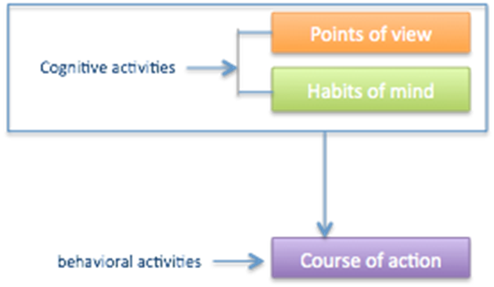
Transformative Learning
Merizow argues learning can become a challenging and daunting task to adult learners when their learning environment and the surroundings are changed significantly.
Learners must alter existing learning beliefs if they want to learn effectively within changing contexts.
Learning divided into 2 components
Cognitive aka Frames of Reference
Points of View
Habits of Mind
Behavioural
Course of Action

Slide 6
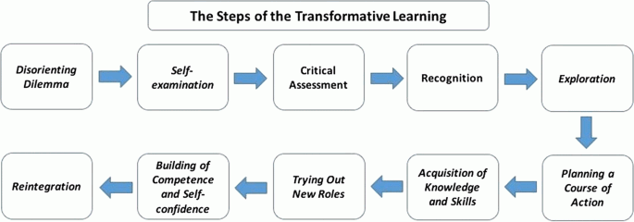
Transformative Learning
Merizow (1997)

Slide 7
Transformative Learning
Initiated when learner faces a “disorienting dilemma” (Jones and Miles 2017; Schrittesser et al. 2014).
Study abroad is considered a disorienting dilemma
Methods to assist transformative learning include:
Reflecting individually, which enables learner to question their Habits of Mind and potentially amend them (Joubert and Slabbert 2017; Cheng et al. 2015).
Reflecting with others (Collaborative reflection) – modify points of view (Tsang 2011).
It has frequently been used to analyse learning of International students (Conceição et al. 2020; Kumi–Yeboah and Waynne 2014)
Issues – length of study is considered to affect the effectiveness of TL (Stone et al. 2017).

Slide 8
Research Question
RQ: Can Transformative Learning be achieved in short-term study abroad programmes?
RSQ 1: Is the study period significant?
RSQ 2: What role does self-reflection play?

Slide 9
Methodology
This presentation combined 2 qualitative studies both of which focussed on the individual experiences of International students
Samples
Chinese students studying a 1 year top up degree at a uk university – 12 students from 3 Chinese universities
International students (U.k., Spain, Russia and NL) studying a 1 semester long language course at a Chinese university – 15 students
Study 1 – Portrait methodology
Study 2 – Case study

Slide 10
Methodology
Both study methodologies have significant commonalities
Main data collection method was semi-structured interview
The data in both studies were then analysed and interpreted through first and second cycle coding processes.
The first cycle coding identified the distinct concepts or areas that emerged in the transcripts.
In the second cycle coding process, the areas and concepts identified in first coding were categorized, and then themes were generated.
Portrait methodology.
The intention of portrait methodology is to provide the researcher’s interpretations of the experiences, views and feelings of those being researched through the production of portraits
Portraits are a summary of the researcher’s interpretation of the interview.
Integral to the methodology is the sharing of the portraits with the interviewee who reflects on the portraits and comments upon its accuracy

Slide 11
Methodology
The 2 studies differed in the following way: -
The case study of the international students in China used a single interview for each participant, which was carried out towards the end of the study period abroad.
The Portrait methodology study of the Chinese students in the UK was a longitudinal study, which carried out 3 interviews with each student over a 2 semester period with one set of interviews after they had returned to China, each interview was followed up by a portrait, which they reviewed and commented upon.
The questions asked in both studies were similar. They focussed on the teaching and learning methods, study support, learning environment and cross cultural adaptation of students
The findings were analysed together for this paper

Slide 12
Findings
Both groups’ behaviour showed no change or very little change in they way they studied from the beginning to the completion of their programmes – they didn’t achieve Transformative Learning
Both studies reported very little interaction between the participant groups and local students – which the participants considered to be a problem. They would have liked more and thought it affected their learning
Both groups did not initially possess similar reflective abilities. The Chinese students were not used to, or had much experience of, self reflecting as part of their studying.

Slide 13
Findings
However, Chinese students in uk appear to have updated some learning approaches – they critically reflected and recognised the issues so that during their study period they became aware they needed to make modifications to their learning attitudes if wanted to achieve. This occurred towards the end of their first semester in the uk.
They Self Reflected, but this was instigated as part of portrait methodology and not by their main programme of study
International students showed very little change in learning approaches and/or learning attitudes.
They didn’t self reflect – so no real self examination occurred.

Slide 14
Discussion
RQ. Can Transformative Learning be achieved in short-term study abroad programmes?
Main findings:
Both groups showed changes to their points of view. They began to understand their educational contexts. This concurs with Transformative Learning theory which suggests that points of view are easiest to change.
Self reflection is significant. In the group that was shorter and had no opportunity for self reflection they did not show a change in habits of mind. In the group that self reflected there was evidence of some change to habits of mind. TL suggests habits of mind are more difficult to change.
Both groups did not spend long enough abroad.
More progress to TL was shown by the Chinese students studying in the uk as there appeared to be some change to Habits of Mind.

Slide 15
Discussion
There were differences self reflection in carried out between the groups and in the time spent in the host institution.
Chinese students spent 2 Semesters in u.k. compared to 1 semester by the international students in China.
The length of time appears to have been significant in mitigating against Transformative Learning taking place.
However, the Chinese students in the u.k. showed some progress towards achieving this. This could have solely been due to the length of time they were abroad.
However, self reflection occurred in these students in S1 of their studies and the realisation that they had to change their approach to studying also occurred in S1. In the International students studying in China this did not occur at all and they did not alter their approach to studying.
This suggests that self reflection had a major role to play in the process of achieving partial TL in the Chinese students.

Slide 16
Discussion
Students felt that interaction and integration with local students was important to them and when it didn’t occur they felt their learning was impacted.
TL theory suggests that integration with local students may have enabled the types of group activities that would have assisted further TL to have occurred
To what extent it impacted the TL of these groups we could not assess.

Slide 17
Recommendations and Conclusion
These finding are taken from 2 qualitative studies, so care must be taken in generalising findings.
However, the findings do indicate that both time spent abroad and self reflection are important for successful Transformative Learning to take place.
Would like to follow up with a large scale quantitative study.

Slide 18
Recommendations and Conclusion
Recommendations
Better Pre-departure preparation on the difference in teaching practice and culture of the host institution and country and in the expectations of the destination course
Reflection integrated into learning and teaching
Enable integration with local students for international students

Slide 19
References
Cheng, M., Barnes, P., Edwards, C., & Valyrakis, M. (2015). Transition skills and strategies – Critical self reflection. https://www.enhancementthemes.ac.uk/docs/ethemes/student-transitions/critical-self-reflection.pdf
Conceição, S.C., Mina, L. & Southern, T. (2020). Brazilian Students Studying in the United States: Perceptions of Their Lived Experiences 6 Months After Returning Home. Journal of Transformative Education
Jones, P. & Miles, D. (2017). Transformative Learning in International Student Exchange: A Critical Perspective, Advances in Social Work and Welfare Education 19(2): 47–60.
Joubert, J., & Slabbert, J. (2017). Facilitating transformative learning: students experiencing unique challenges. Support for Learning, 32(2):180-194
Kumi–Yeboah, A., & Waynne, J. (2014). Transformative Learning Experiences of International Graduate Students From Asian Countries. Journal of Transformative Education, 12(1), 25–53.
Mezirow, J. (1997) Transformative learning; Theory to practice. New Directions for Adult and Continuing Education, 74: 5-12.
Schrittesser, I., Gerhartz-Reiter, S.& Paseka, A. (2014). Innovative learning environments: About traditional and new patterns of learning. European Educational Research Journal 13(2): 143–154.
Stone, G. A., Duerden, M. D., Duffy, L. N., Hill, B. J. & Witesman, E. M. (2017). Measurement of transformative learning in study abroad: An application of the learning activities survey. Journal of Hospitality, Leisure, Sport & Tourism Education, 21: 23-32.
Tsang, A. KL. (2011). In-Class Reflective Group Discussion as a Strategy for the Development of Students as Evolving Professionals. International Journal for the Scholarship of Teaching and Learning, 5(1):1.

Slide 20
Contact Details
Xianghan (Christine) O’Dea c.odea@yorksj.ac.uk

