Slide 1
What might the linguistic, narrative and semiotic devices used in children’s eco-narratives tell us about their views on the climate emergency?
Dr Clare Cunningham (YSJ Linguistics)

Slide 2
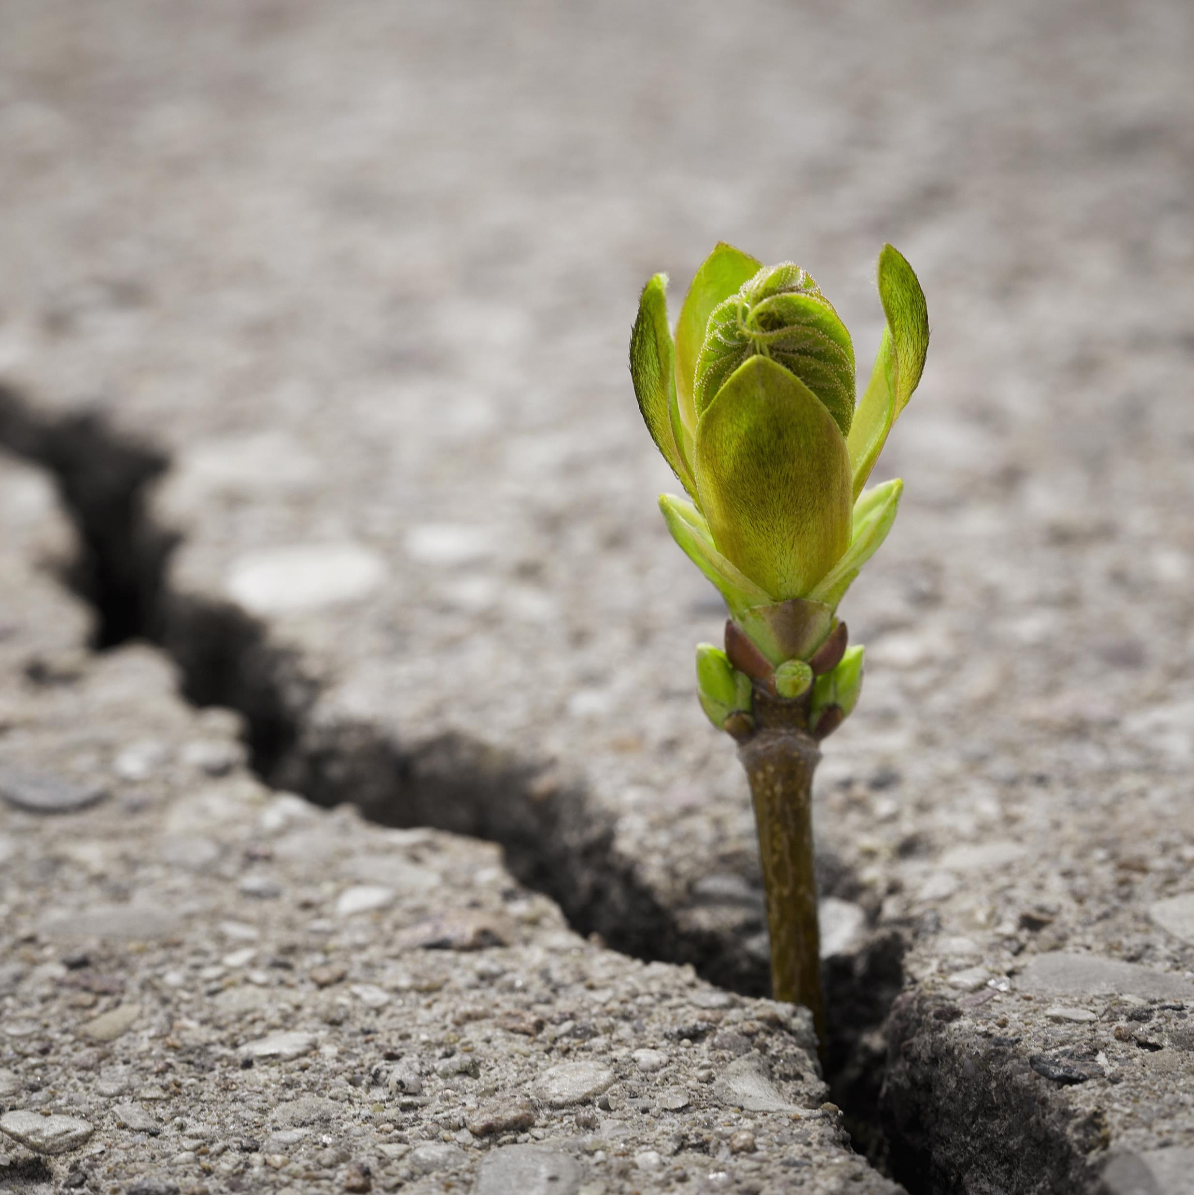
Context for this study of children’s writings
Ecolinguistics (Stibbe 2015; 2021) – a search for new stories-to-live-by:
New Economics
Stories that are not ‘new’
But what about the youngest generation?
Notes:
Stibbe (2015) posits that one of the aims of the relatively new field of ecolinguistics is to find new stories to live by, in a quest to counteract some of the destructive ideologies that currently prevail and that are, at least partially, responsible for the ongoing climate emergency. He suggests that some of these new stories come from New Economics (with the Circular Economy and the Green New Deal, for example) and that some of these ‘new’ stories are not new at all, but are based in traditional and indigenous communities’ interactions with their local environments (First Nation and Australian Aboriginal communities and their relationship with nature, for example).
However, limited research has been conducted to date on another potential seam of ‘new’ stories, that from the youngest generation, those who are growing up in the time period in which the climate emergency has been framed as just that, a crisis.

Slide 3
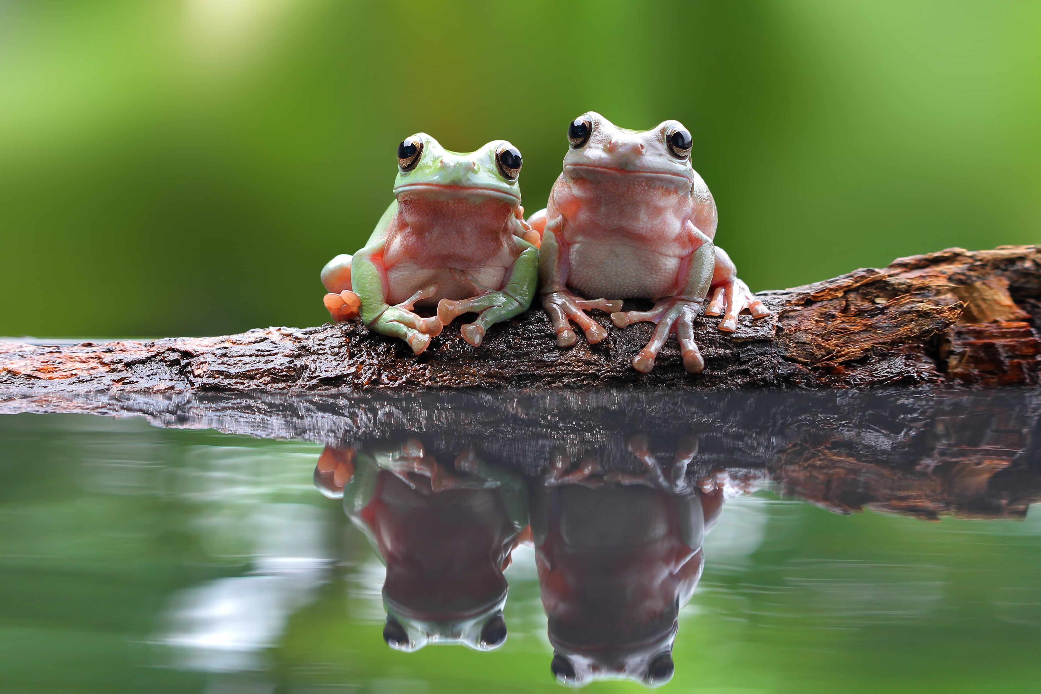
Research with children on the climate emergency
analysis of children’s drawings about the environment (Ahi and Atasoy, 2019; Barazza, 1999)
‘interviews’ and discussions about nature (Rios and Menezes, 2017)
capturing reactions to environmental story-telling (Yilmaz, Temiz and Karaarslan Semiz, 2020)
asking children to write about their drawings about nature (Kalvaitis and Monhardt, 2012)
However, research based purely on children’s writings about nature is scarce
Notes:
Children’s eco-narratives or stories about the environment have not received much attention in this field of research to date. Research has been conducted to analyse children’s drawings about the environment (Ahi and Atasoy, 2019; Barazza, 1999), undertake discussions about nature (Rios and Menezes, 2017), capture reactions to environmental story-telling (Yilmaz, Temiz and Karaarslan Semiz, 2020) and to ask children to write about their drawings about nature (Kalvaitis and Monhardt, 2012). However, research based purely on children’s writings about nature are scarce.

Slide 4
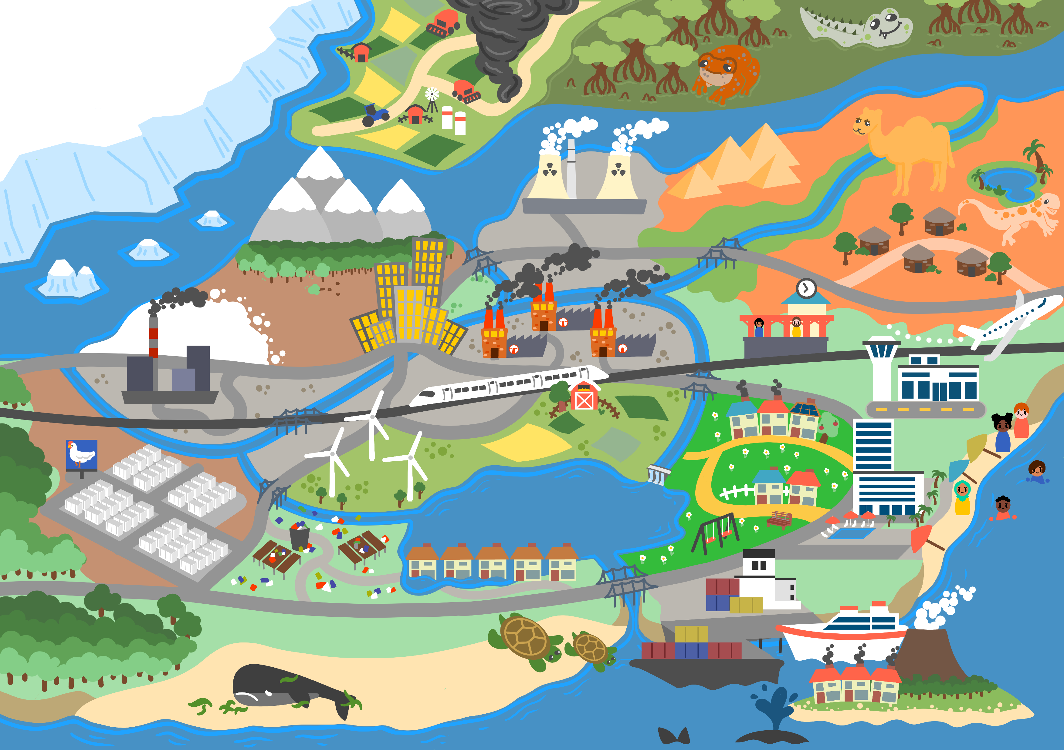
My study
40 stories from 37 primary-aged children (March-July 2021)
Gathered through Microsoft Forms (demographic information and consent)
Map used as a stimulus
Parents and after-school club leader as facilitators
Incentives given to a proportion (20x £10 voucher)

Slide 5
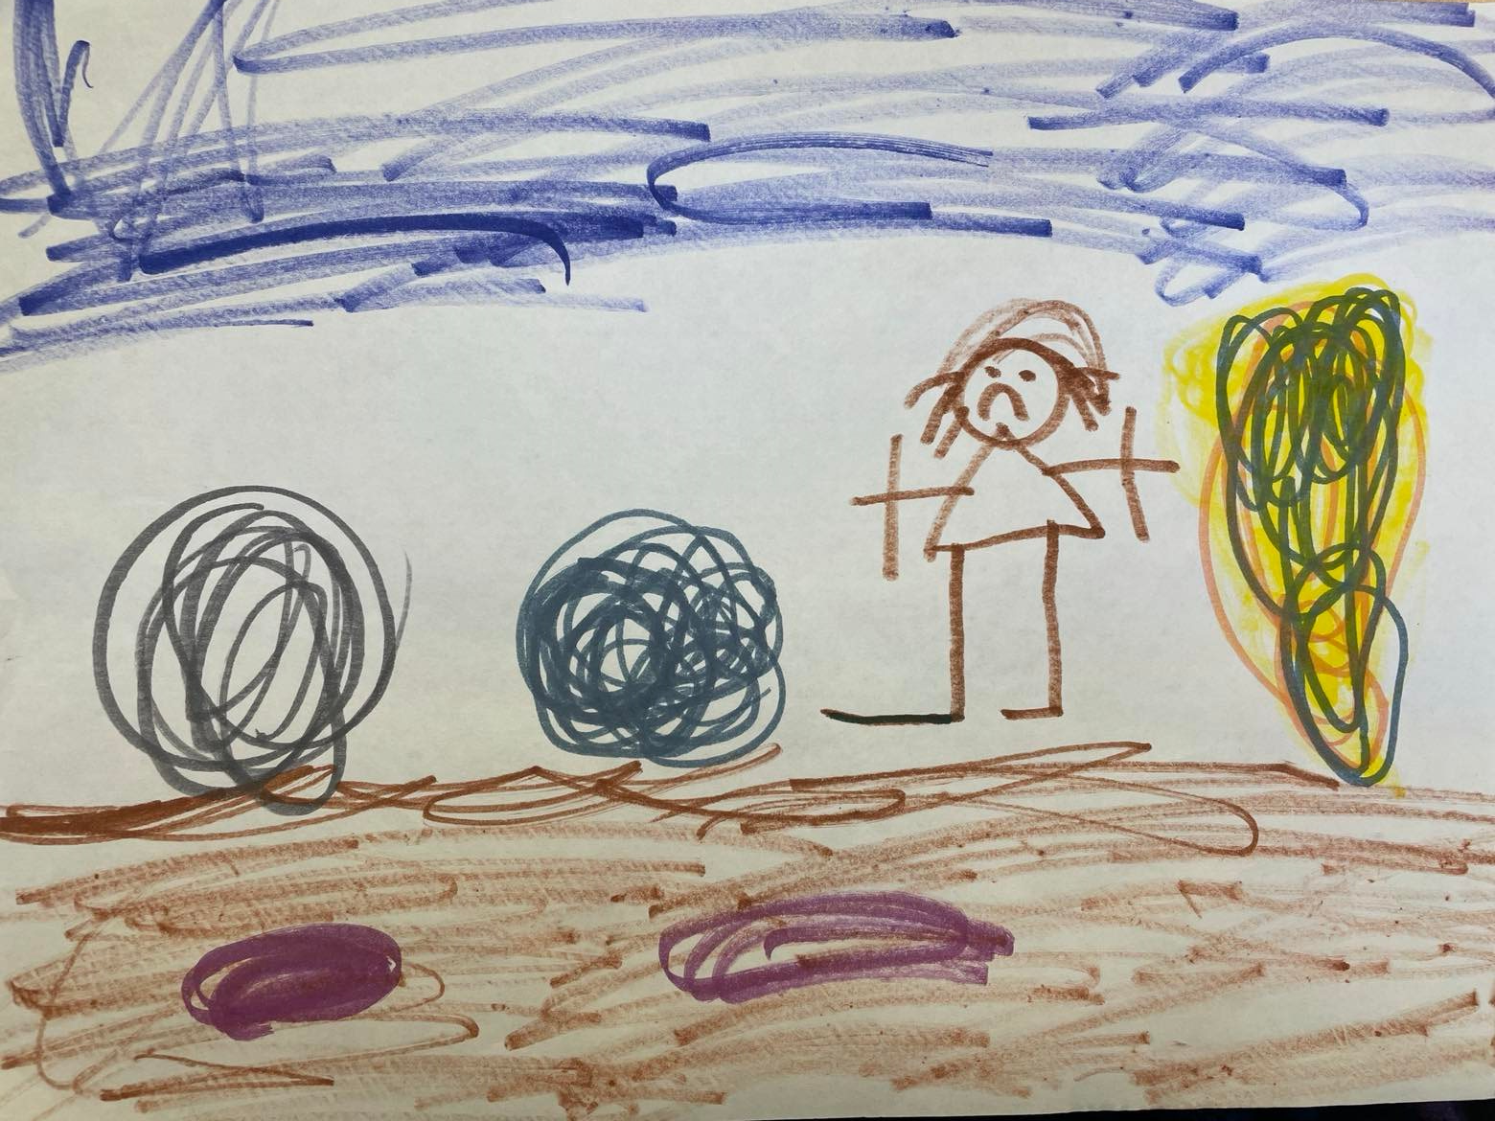
Some demographics
Ten aged 6 or under
Nine aged 7
Six aged 8
Three aged 9
Nine aged 10 or 11
Notes:
Across the whole data set, the gender split is very even – 19 boys and 18 girls.

Slide 6
Story titles and overview
The classic fairy tale style:
The town of the Big
The camel who knew
The tale of the whale
Lots of references to ‘saving’
Lots of one-word titles, focusing on particular features: Swamp, Beach, Forest, Frog
A mixture of dramatic fiction, observations and calls to action/ factual narratives

Slide 7
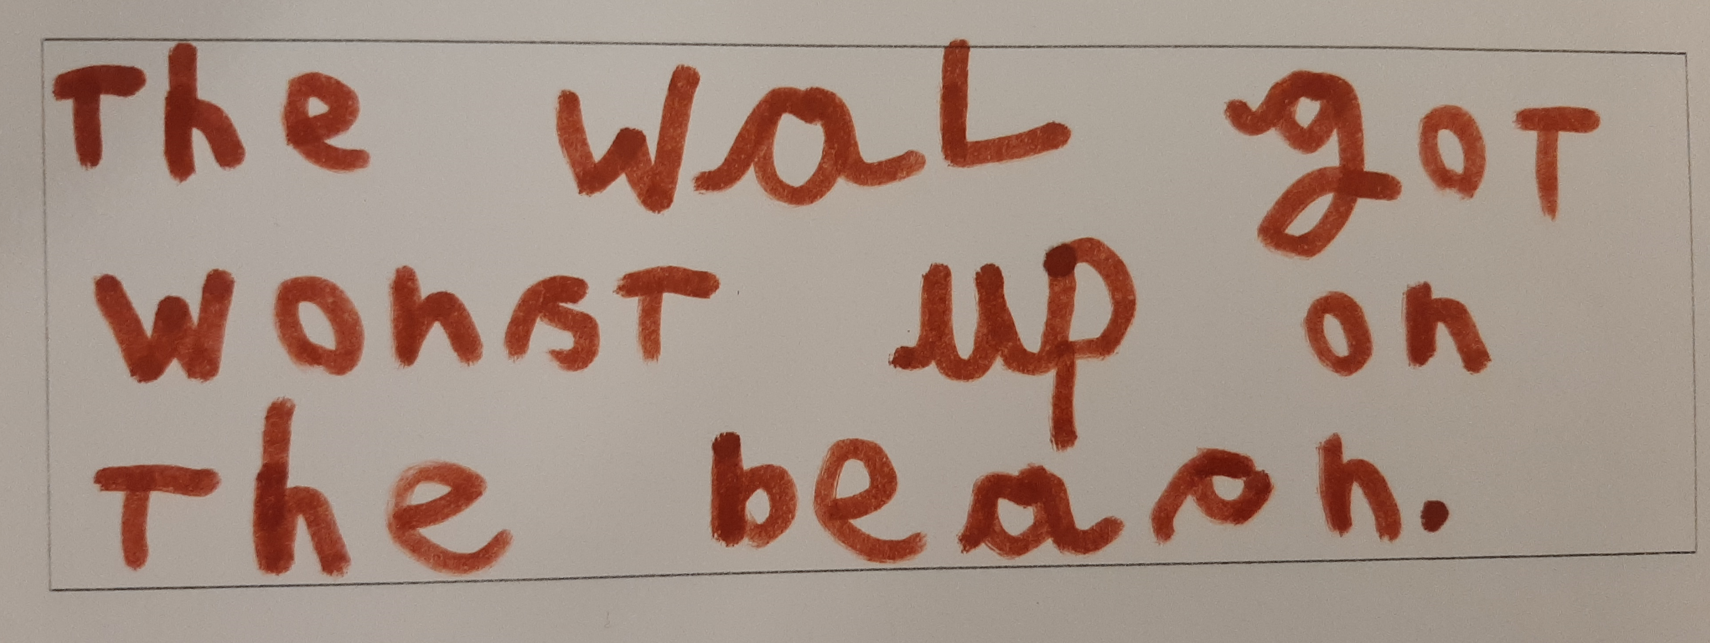
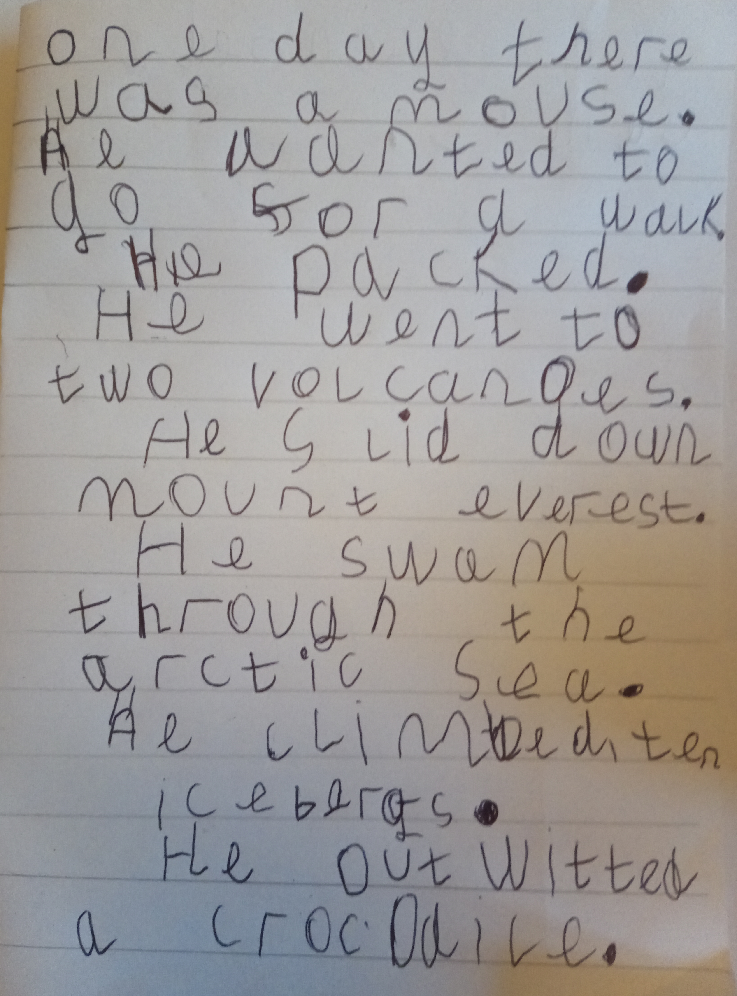
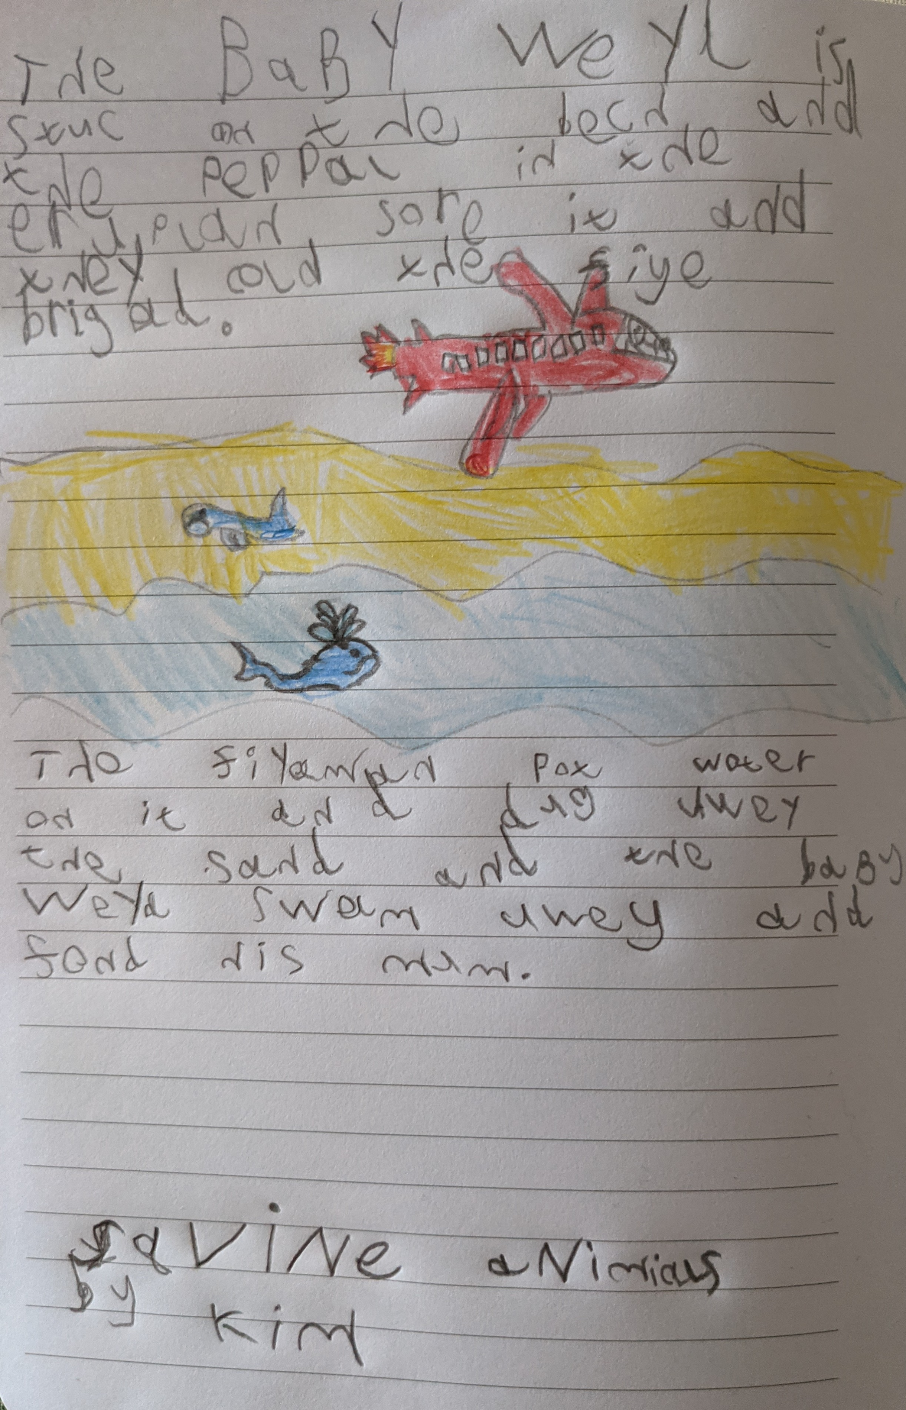
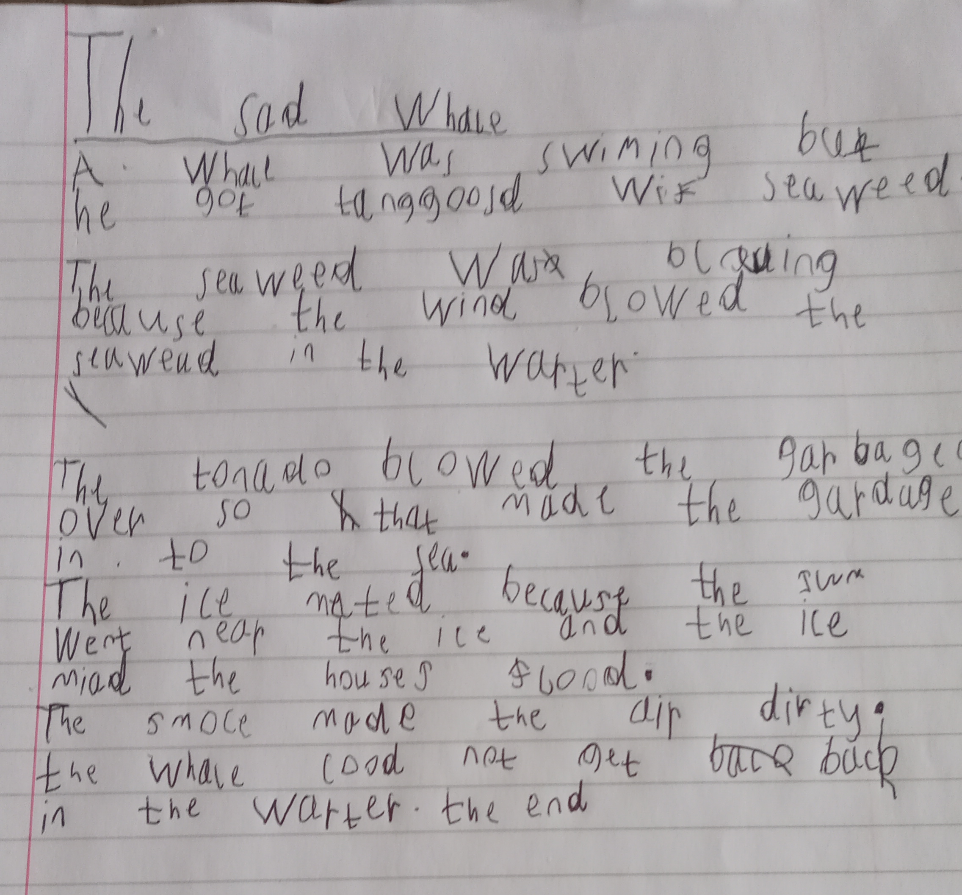
The younger group
Ten aged 6 or under
Notes:
The impact of age is important to note. Four of the stories produced by children 6 and under are quite sophisticated but a few narrated their story to a care-giver so it will be interesting to look at the differences. A focus in this age group on the whale. Plenty of stories not overtly concerned with climate change. But from some, a very strong sense of the interconnectedness of the natural world. I find it interesting to think about who the villains and saviours are in the stories too.

Slide 8
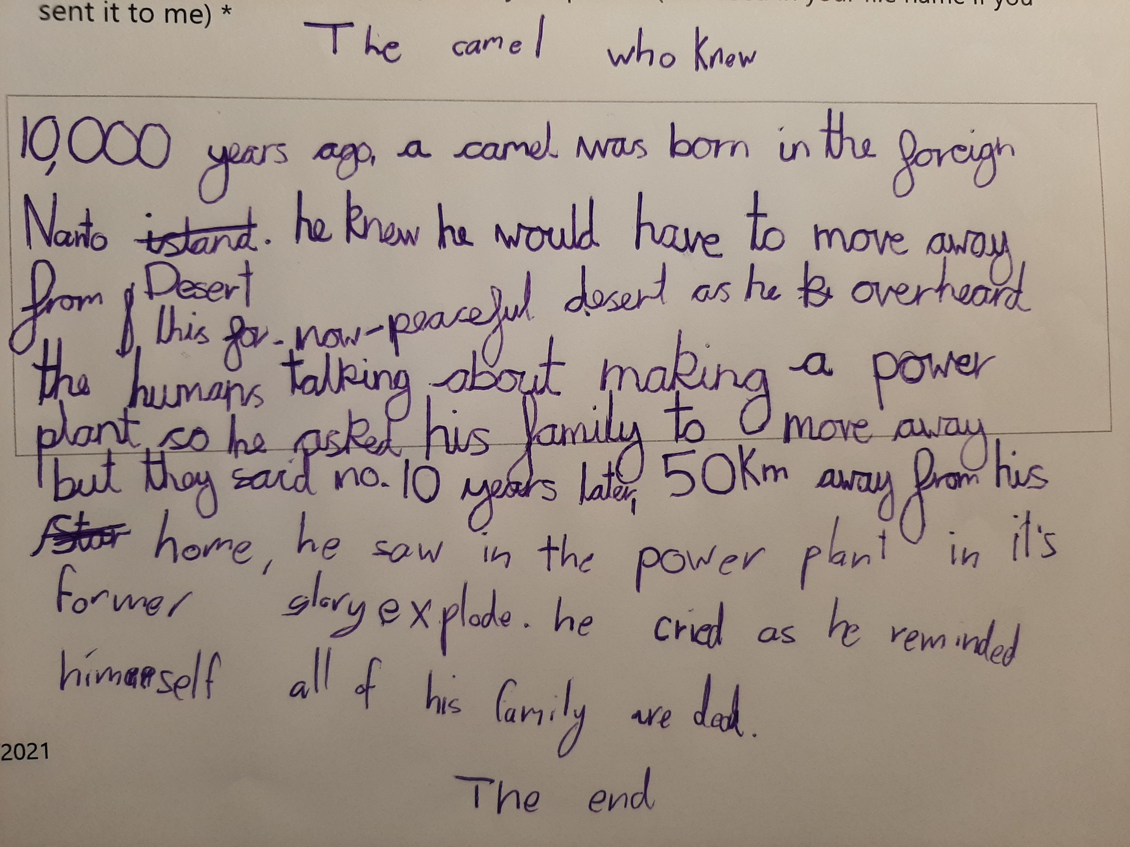
Some examples
Notes:
In these stories (both by 10 or 11 year olds) ‘the humans’ are responsible here, but also reference to not being able to persuade his own kind – climate denial? Very sad story – with interesting poetic choices – ‘now-peaceful’ and ‘former glory’. The caps lock in the second story here is also an interesting feature, in this dramatic story of metamorphosis.

Slide 9
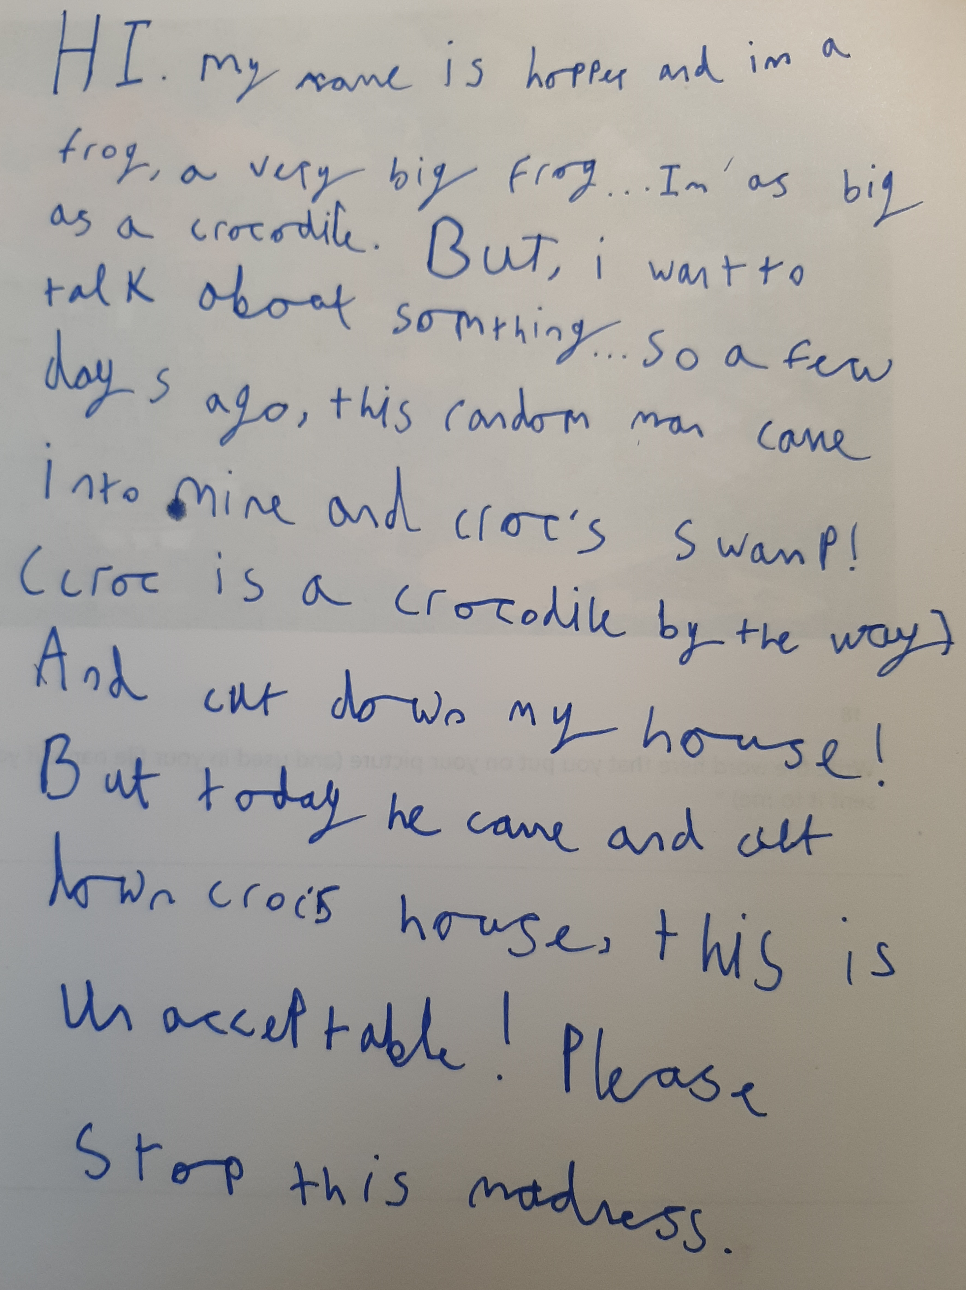
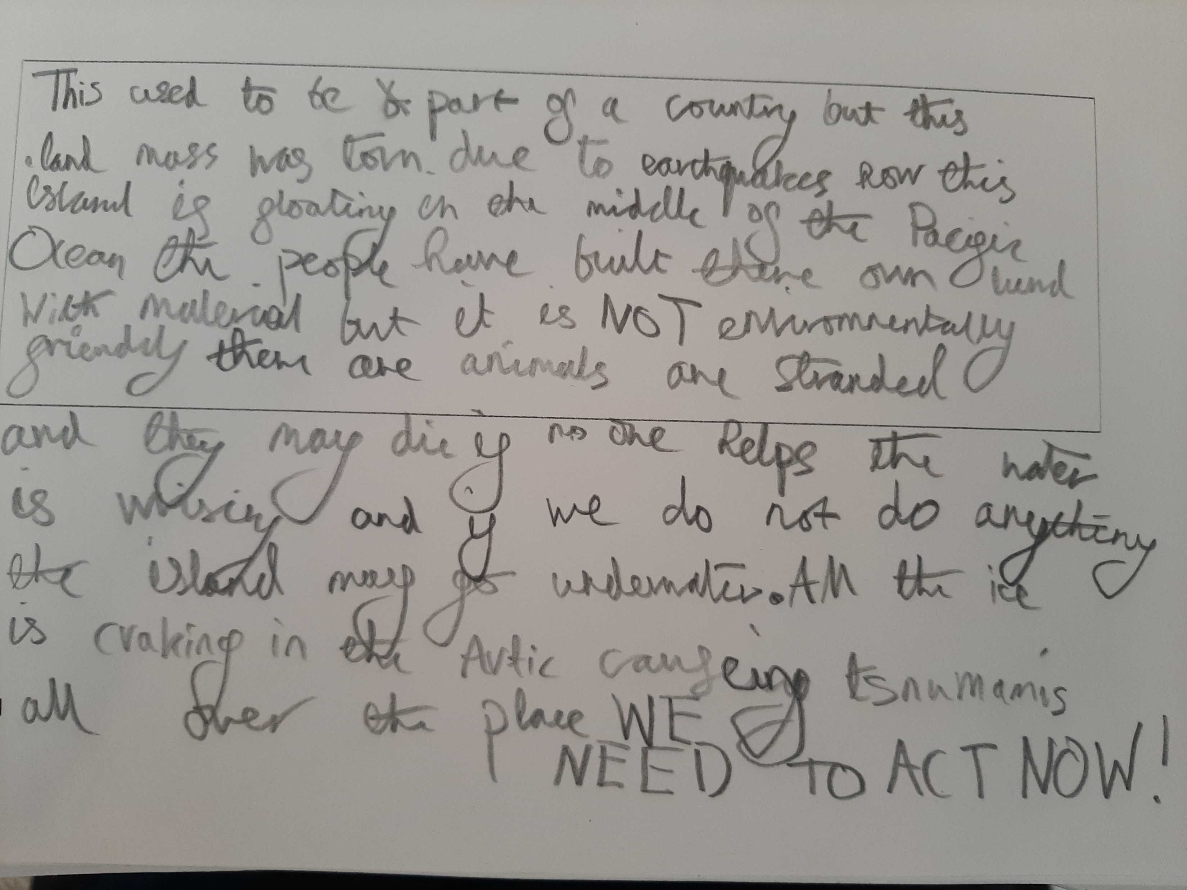
Notes:
The two are also from the older age group. Some stories focus on one animal like this about the frog with its sense of a call to action, and the villain of ‘the random man’. The second story here, though, makes fabulous use of the map stimulus to explain how this landmass came into existence and how it is under threat in a piece that melds fiction and fact with more use of caps lock in the final stages.

Slide 13
Thank you!
Any questions?

Slide 14
Berat Ahi & Volkan Atasoy (2019) A phenomenographic investigation into preschool children’s relationships with nature through drawings, International Research in Geographical and Environmental Education, 28:4, 281-295.
LAURA BARRAZA (1999) Children's Drawings About the Environment, Environmental Education Research, 5:1, 49-66,
Darius Kalvaitis & Rebecca M. Monhardt (2012) The architecture of children’s relationships with nature: a phenomenographic investigation seen through drawings and written narratives of elementary students, Environmental Education Research, 18:2, 209-227.
Clementina Rios & Isabel Menezes (2017) ‘I saw a magical garden with flowers that people could not damage!’: children’s visions of nature and of learning about nature in and out of school, Environmental Education Research, 23:10, 1402-1413.
Simge Yılmaz, Zeynep Temiz & Güliz Karaarslan Semiz (2020) Children's understanding of human–nature interaction after a folk storytelling session, Applied Environmental Education & Communication, 19:1, 88-100.
Stibe Aaron (2021).

