Slide 1
English Primary School Teachers and Their Discourses about Classroom Practices using Languages beyond English
Clare Cunningham (York St John University, UK)
Sabine Little (university of Sheffield, UK)

Slide 2
overview
Context of the study and national background
The study: data collection, protocols and focus
Data and analysis
Discussion and implications

Slide 3
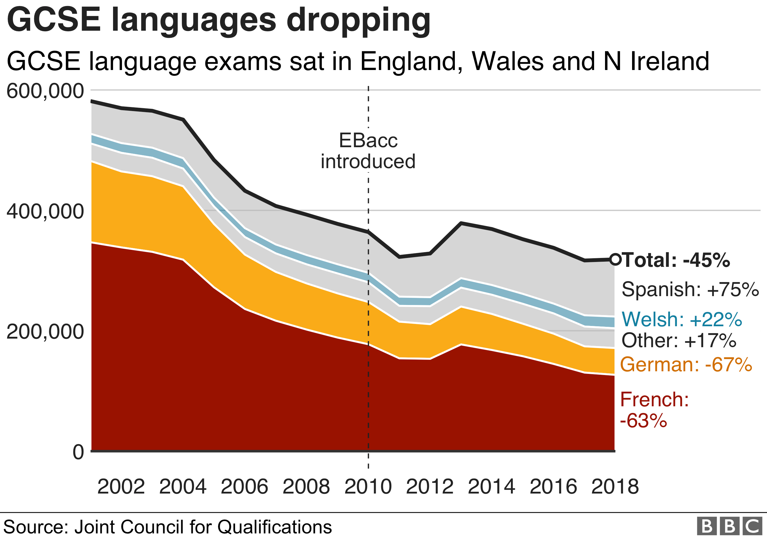
Languages in the uk
The UK, and perhaps particularly England, is often seen as a nation subscribing wholeheartedly to a monolingual mindset with pockets of support for some indigenous languages (e.g. Wales)
The study of MFL (modern foreign languages) has been and continues to be seen as being ‘in crisis’ (Lanvers and Coleman, 2017)
Hierarchy of languages very strong – ability in European languages perceived more positively. Capacity in ‘immigrant’ minority languages far less celebrated
Mainstream classroom teachers only very rarely represent the linguistic diversity of their schools (Tinsley and Board, 2016)

Slide 4
The (Non)-impact of the ‘multilingual turn
Guidance for monolingual teachers on best practice with children’s home languages in the classroom have been available for almost twenty years (Bourne, 2001),
There has never been an official policy, and guidance for teachers on working with multilingualism has now been absent from the governmental publications for over ten years (last govt. publication 2009)
Despite the strength of the ‘multilingual turn’ (Conteh and Meier, date) and the growth of understanding of the concept of translanguaging in applied linguistics, the current research literature and anecdotal evidence suggests that translanguaging practices are still very rarely adopted in English schools.

Slide 5
The place for languages beyond english
The place of Languages beyond English (Cunningham, 2019b) in UK (English) schools at all remains extremely uncertain and patchy (Flynn, various; Cunningham, 2019a; Bailey and Marsden, date) in reality
In the total absence of top-down policy on supporting LBEs, more grass-roots and de-centralised groups are emerging (Bell Foundation, NALDIC still nationally, but also local hubs and regional interest groups)
But it’s in the classroom that really matters so what class teachers think and say is critical

Slide 6
Our study
Today, we are reporting on a tiny part of a much broader study
International comparative study – 8-9 countries, sharing interview protocol to explore Attitudes, Beliefs and Knowledge about Multilingualism (AILA ReN on Social and Affective Factors in Language Maintenance and Development
In England, 40 interviews with primary and pre-primary teachers across a range of settings, SES, and types of teacher
Interviews lasted 30 mins – 1 hour 20 mins
Analysis: combination of Appraisal analysis and Thematic analysis (the latter here)

Slide 7
FOCUS: DISCOURSES around Classroom practices with LBE
Discourses arose across the interviews but were more apparent during the section in which we adapted the statements from Pulinx, van Avermaet and Agirdag (2016) on how much linguistic diversity is tolerated
Key findings: significant contradictions exist between and within participants, tolerance and positivity towards LBEs expressed throughout but there are many BUTs (pragmatic, practical, funding, resources etc.)

Slide 8
FOCUS: DISCOURSES around Classroom practices with LBE
There also exists (at least) two forms of what we propose to call: Inert Benevolence
The inertia can be internally caused – clashing ideologies leading to inaction, or externally caused by policies and unwritten rules preventing individual teachers from taking the action they might like to

Slide 9
Res: it is more important that students who speak a language other than English at home (.) obtain a high level of proficiency in English (.) rather than in their home language
T: it would depend on (.) what you’re choosing cri- so is it what is it important for (R: hmmm) that would be my (R: hmmm) question for that so I (.) you know if they’re planning on staying in this country and getting a job in this country and going to university in this country it would be important but I don’t think I would ever say that one is more important than the other (.) I think (.) I don’t know it almost feels a bit (R: hmmm) personal and insulting to say to someone who speaks two languages well this language is more important than the other (.) um (.) no I dont think I (.) would agree
R: hmmm
T: I think they’re both important and I think they can both help each other (R: hmmm) um ((pause, 4)) but then with my teacher head on (R: hmmm) sorry I’m just like kind of going round in circles here because (.) for me (.) the criteria that our children are assessed on is in English (.) and (.) for things like the SATs you know they need that English though I suppose for in school (R: hmmm) yes their English is more important
R: hmmm
T: but (.) overall no (R: hmmm) cause I don’t think (.) you could say to someone one language is more important than (.) that one (R: hmmm) they might need their language to communicate with their family and in that case how can you say that this language is more important (R: hmmm) so no I don’t think I would agree
R: hmmm
T: was that clear
Notes:
To avoid overloading this talk with data which is so often the issue in presentations using qualitative data, we’ve decided to use three longer pieces of data to try and exemplify this concept of inert benevolence and how it manifests itself in teacher discourses. This first example shows a circularity in argument through just one of these statements being presented as the participant is battling with how to handles LBEs in the context of a system that privileges just one language.
Six lines after saying that she would never say one language was more important than the other, she does do exactly that, with lots of understandable caveats about the language of assessment. Also of note in this excerpt is the level of ownership of the varying opinions. In Peter and White’s terms, the Engagement is quite heteroglossic whilst not being at all certain (lots of I think, I don’t know)

Slide 10
Res: it is more important that students who speak a language other than English at home (.) obtain a high level of proficiency in English (.) rather than in their home language
T: more a practicality thing I think I think its wonderful that they have that language and (.) you know if we had all the time in the world then id love for them to get that but (.) I think it would be more important for them (.) to have that grasp of English so that they can (.) progress in England
Notes:
Second excerpt – In response to the same question, this teacher is quite quick to point to time as a core issue, but, as she progresses, conflicting ideologies also come into play. Interestingly, the link here is not necessarily with the school system, but with the country as a whole.

Slide 11
Res: students who speak a language or languages other than English at home should receive home language instruction i.e. learn their home language at school
T: I probably wouldn’t agree with that (.) just because I don’t see how it would work in our school (.) with all the different children
Res: yeah
T: with the (.) different languages (.) it’d be a impossible task for us I think (1) I think it’s important that they speak that language at home still with their parents they don’t lose it
Res: mm: mm:
T: cos that would be a (.) awful I think if they (.) lost that language (.) erm: (1) but in school (.) use it, like you said use it to kind of help lessons an: um celebrate their culture but a- uh (.) I honestly don’t think we could do that
Notes:
Finally, a slightly different statement, asking about home language instruction. Nearly all teachers argued that formal instruction in the home language would be impossible to integrate, despite other nations (e.g. Sweden) having such an arrangement in place. The teacher here undergoes a thinking process, recognising importance of identity formation, but ultimately feeling forced to sideline it in a formal education context.

Slide 12
Discussion and implications
These small excerpts are part of a broader set of contradictory discourses as teachers in England battle with:
Language ideology issues – against a politically fraught background (years of under-funding languages, standard language ideology, monolingual habitus and Brexit)
Language of assessment
Curriculum and testing pressures (‘we’ve no time for EAL’ as one participant says)
Tolerance and admiration (sometimes jealousy, in fact) for multilingualism but limited understanding about how to handle it due to very limited training on EAL, multilingualism or SLA

Slide 13
references
Bailey, Elizabeth G, and Emma Marsden. 2017. “Teachers’ Views on Recognising and Using Home Languages in Predominantly Monolingual Primary Schools.” Language and Education 31 (4): 283–206.
Bourne, Jill. 2001. “Doing ‘What Comes Naturally’: How the Discourses and Routines of Teachers’ Practice Constrain Opportunities for Bilingual Support in UK Primary Schools.” Language and Education 15 (4): 250–68
Conteh, J. and Meier, G. (Eds). The Multilingual Turn in Languages Education: Opportunities and Challenges. Bristol, UK: Multilingual Matters
Cunningham, C. (2019a). ‘”The Inappropriateness of Language”: discourses of power and control over languages beyond English in primary schools.’ Language and Education, 33(4): pp. 285-301.
Cunningham, C. (2019b). ‘Terminological tussles: taking issue with 'EAL' and 'languages other than English.’ Power and Education, 11 (1): pp. 121-128.
Flynn, Naomi. 2013. “Linguistic Capital and the Linguistic Field for Teachers Unaccustomed to Linguistic Difference.” British Journal of Sociology of Education 34 (2): 225–42.
Lanvers, U. and Coleman, J. A. (2017) The UK language learning crisis in the public media: A critical analysis. U Lanvers, JA Coleman. The Language Learning Journal 45 (1), 3-25
Pulinx, R., Van Avermaet, P., & Agirdag, O. 2016. ‘Silencing linguistic diversity: The extent, the determinants and consequences of the monolingual beliefs of Flemish teachers.’ International Journal of Bilingual Education and Bilingualism.
Board, Kathryn and Teresa Tinsley. 2015. Language Trends 2014/15, the state of language learning in primary and secondary schools in England. (CfBT).

