Slide 1
Physical and mental health outcomes of burnout in athletes: A systematic review
By Hanna L Glandorf, Daniel J Madigan, Owen Kavanagh & Sarah Mallinson-Howard
14/09/2021
Northern Research and Applied Practice Showcase

Slide 2
What is Health?
Multidimensional
Physical health (objective measurements & self-report)
Mental health
Mental health disorders (diagnostic criteria & symptom frequency)
Positive mental health (e.g., life satisfaction)
Based on Krahn et al., 2021

Slide 3
What is Athlete Burnout?
Emotional and physical exhaustion
Reduced sense of accomplishment
Devaluation
Based on Raedeke & Smith (2001)

Slide 4
Does Burnout Affect Health?
Allostatic overload
Multisystem Dysfunction
Immune system
Cardiovascular system
Anabolic activity
HPA-axis
Ability to cope
Environmental challenges
Allostatic Load Theory, simplified from McEwen & Stellar (1993)

Slide 5
Does Burnout Affect Health?
Cognitive appraisal
Physiologic responses
Coping & Task behaviours
Stress
Situation
i.e., Tension, depression, insomnia, illness susceptibility
High demands low resources
Perceived overload
Burnout
i.e., Withdrawal
Cognitive-Affective Model of Athletic Burnout, simplified from Smith (1986)

Slide 6
Does Burnout Affect Health?
Occupational Burnout
Physical health problems (e.g., musculoskeletal pain; Williams et al., 2019; Sabagh et al., 2018; Salvagioni et al., 2017)
Mental health problems (e.g., depression; Williams et al., 2019; Sabagh et al., 2018; Salvagioni et al., 2017)
Wellbeing problems (e.g., quality of life; Williams et al., 2019; Sabagh et al., 2018; Salvagioni et al., 2017)
Biomarkers (e.g., cortisol; Danhof-Pont et al., 2011)
Athlete Burnout
Not yet reviewed

Slide 7
Methods
Literature Search
Databases: PsychINFO, PsychARTICLES, MEDLINE, SPORTDiscus, ScienceDirect, ProQuest Dissertations
Search Terms: burnout, athletes, health
Time Period: Jan 2001 to 17th Mar 2022
Inclusion Criteria
Burnout measure
Health measure
Athlete sample (unique)
Journal articles, thesis or presentation
Language: English

Slide 8
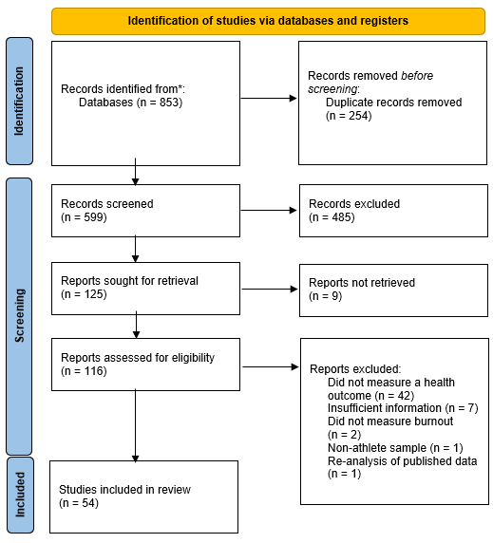
PRISMA Diagram

Slide 9
Results
Athlete Samples
13,976 athletes (age M = 19.8; 35% females)
Burnout Measure
Majority ABQ (89%)
Mix of global score (48%), dimensional scores (29%), both (15%), exhaustion (8%)
Study Design
41 cross-sectional
11 longitudinal + 1
1 prospective
Quality Assessment
Not all sources of bias addressed (n = 54)
Source of bias persisted (n = 41)

Slide 10
Results: Negative Mental Health Outcomes
Depression (13 studies, 5 LONGL)
Small-to-medium effects
Burnout → Depression; Depression → Burnout (Frank et al., 2017)
Anxiety (10 studies, 0 LONGL)
- Small-to-medium effects
Addictive behaviour (3 studies, 0 LONGL)
Small effects, mixed findings
Insomnia (2 studies, 2 LONGL)
Small-to-medium effects
Burnout → Insomnia only (Li et al., 2017; Gerber et al., 2018)

Slide 11
Results: Negative Mental Health Outcomes
Worry (2 studies, 0 LONGL)
- Small-to-medium sized
Mood (2 studies, 1 LONGL)
- Small-to-medium sized
Psychological distress (2 studies, 1 LONGL)
- Mixed findings
Body image dissatisfaction (2 studies, 0 LONGL)
Small effects

Slide 12
Results: Positive Mental Health Outcomes
Satisfaction (11 studies, 2 LT)
- Small-to-medium effects
- Fixed and random effects (DeFreese & Smith, 2014)
Subjective vitality (8 studies, 3 LT)
Small-to-medium effects
No test for temporal association
Quality of life (1 study, 0 LT)
- Small-to-medium effects

Slide 13
Results: Physical Health Outcomes
Biomarkers (8 studies, 1 Prosp, 1 LT)
Mixed results
HPA-axis, muscle function, immune system, nutrition
Physical and somatic symptoms (5 studies, 0 LT)
Small-to-medium effects
Physiological indices (3 studies, 1 LT)
Mixed results
Injury (2 studies, 0 LT)
- Small effects

Slide 14
Does Burnout Affect Health?
Future Research Recommendations
More research required
Acute vs. chronic biomarkers, other biomarkers e.g., epigenetics (e.g., Bakusic et al., 2020)
Strength of design and analyses
Longitudinal work
Multilevel analyses
The dimensionality of the ABQ
Different effects for different dimensions?
Lack of theoretical mechanisms
Integration of Smith’s cognitive-affective model with Allostatic Load Theory

Slide 15
Burnout affects health
Implications
Burnout is important to health
Prevention and treatment

Slide 17
References
Bakusic, J., Ghosh, M., Polli, A., Bekaert, B., Schaufeli, W., Claes, S., & Godderis, L. (2020). Epigenetic perspective on the role of brain-derived neurotrophic factor in burnout. Translational Psychiatry, 10(1), 1-9. https://doi.org/10.1038/s41398-020-01037-4
Danhof-Pont, M., van Veen, T., & Zitman, F. (2011). Biomarkers in burnout: A systematic review. Journal Of Psychosomatic Research, 70(6), 505-524. https://doi.org/10.1016/j.jpsychores.2010.10.012
DeFreese, J., & Smith, A. (2014). Athlete Social Support, Negative Social Interactions, and Psychological Health Across a Competitive Sport Season. Journal Of Sport And Exercise Psychology, 36(6), 619-630.
Frank, R., Nixdorf, I., & Beckmann, J. (2017). Analyzing the Relationship Between Burnout and Depression in Junior Elite Athletes. Journal Of Clinical Sport Psychology, 11(4), 287-303. https://doi.org/10.1123/jcsp.2017-0008
Gerber, M., Best, S., Meerstetter, F., Isoard-Gautheur, S., Gustafsson, H., & Bianchi, R. et al. (2018). Cross-Sectional and Longitudinal Associations Between Athlete Burnout, Insomnia, and Polysomnographic Indices in Young Elite Athletes. Journal Of Sport And Exercise Psychology, 40(6), 312-324. https://doi.org/10.1123/jsep.2018-0083
Krahn, G., Robinson, A., Murray, A., Havercamp, S., Havercamp, S., & Andridge, R. et al. (2021). It's time to reconsider how we define health: Perspective from disability and chronic condition. Disability And Health Journal, 14(4), 101-129. https://doi.org/10.1016/j.dhjo.2021.101129

Slide 18
References
Li, C., Ivarsson, A., Stenling, A., & Wu, Y. (2018). The dynamic interplay between burnout and sleep among elite blind soccer players. Psychology Of Sport And Exercise, 37(1), 164-169. https://doi.org/10.1016/j.psychsport.2017.08.008
McEwen, B., & Stellar, E. (1993). Stress and the Individual. Archives Of Internal Medicine, 153(18), 20-93. https://doi.org/10.1001/archinte.1993.00410180039004
Raedeke, T., & Smith, A. (2001). Development and Preliminary Validation of an Athlete Burnout Measure. Journal Of Sport And Exercise Psychology, 23(4), 281-306. https://doi.org/10.1123/jsep.23.4.281
Sabagh, Z., Hall, N., & Saroyan, A. (2018). Antecedents, correlates and consequences of faculty burnout. Educational Research, 60(2), 131-156. https://doi.org/10.1080/00131881.2018.1461573
Salvagioni, D., Melanda, F., Mesas, A., González, A., Gabani, F., & Andrade, S. (2017). Physical, psychological and occupational consequences of job burnout: A systematic review of prospective studies. PLOS ONE, 12(10), 1-12. https://doi.org/10.1371/journal.pone.0185781
Smith, R. (1986). Toward a Cognitive-Affective Model of Athletic Burnout. Journal Of Sport Psychology, 8(1), 36-50. https://doi.org/10.1123/jsp.8.1.36
Williams, E., Rathert, C., & Buttigieg, S. (2019). The Personal and Professional Consequences of Physician Burnout: A Systematic Review of the Literature. Medical Care Research And Review, 77(5), 1-10.

Slide 19
Does Burnout Affect Health?
Full List of Search Terms:
“burnout” AND “athletes” AND “health OR wellbeing OR mental health literacy OR mental health attitudes OR self-perception OR values OR cognitive skills OR performance OR emotions OR behaviour OR self-management OR social skills OR relationships OR interpersonal OR meaning of life OR quality of life OR depression OR anxiety OR tension OR anger OR sleep OR fatigue OR illness OR withdrawal”

Slide 20
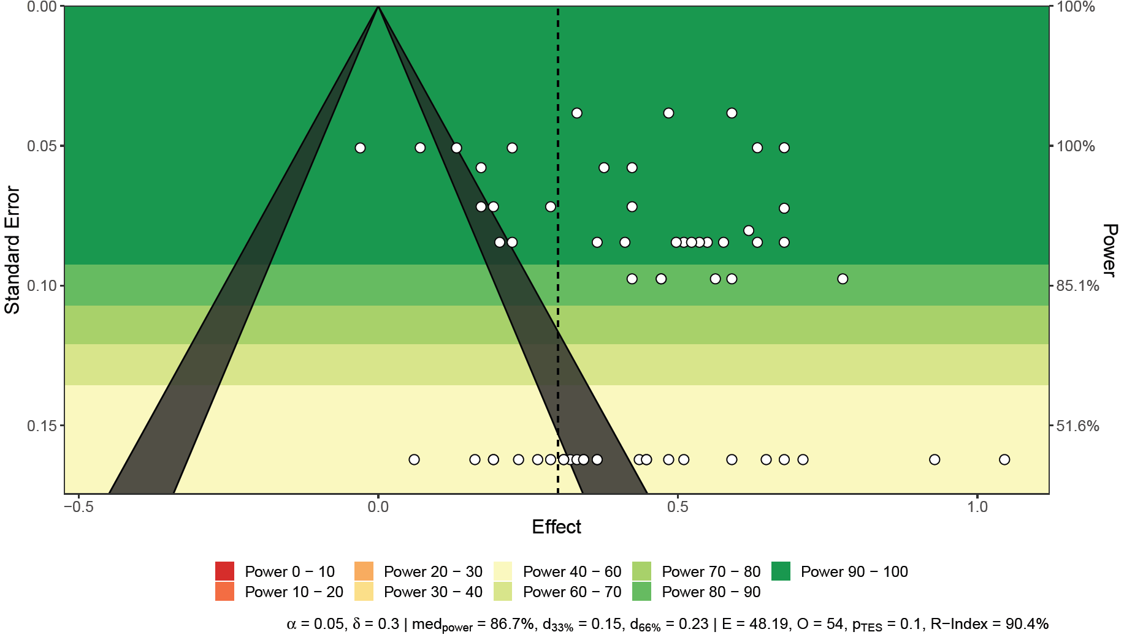
Meta-Analyses: Depression
$r^{+}$ = .39, 95% CI [.32; .51], p < .001, [g = .42])
Not affected by outliers
Low likelihood of publication bias
Significant moderators:
Outcome measure
Burnout measure
Burnout dimension

Slide 21
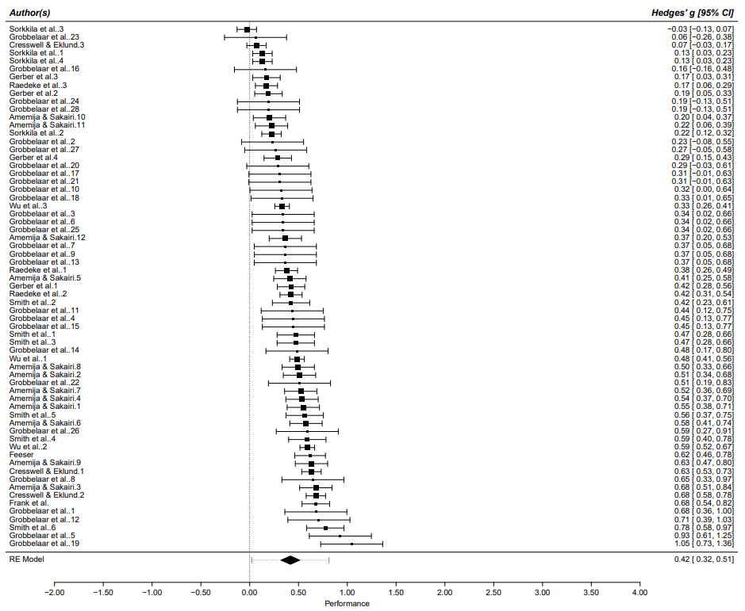
Meta-Analyses: Depression

Slide 22
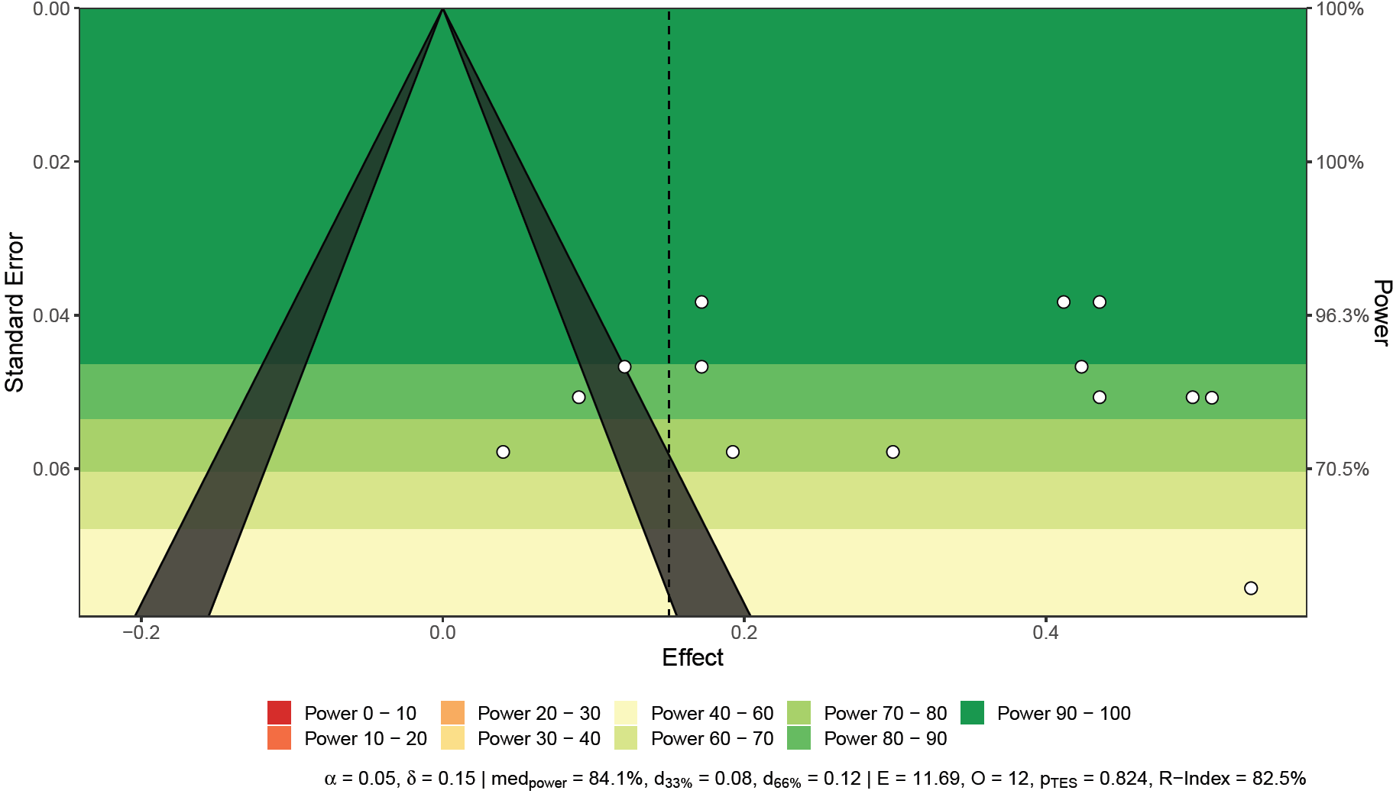
Meta-Analyses: Anxiety
$r^{+}$ = .30, 95% CI [.21; .41], p < .001, [g = .31])
Not affected by outliers
Low likelihood of publication bias
Significant moderators: none

Slide 23
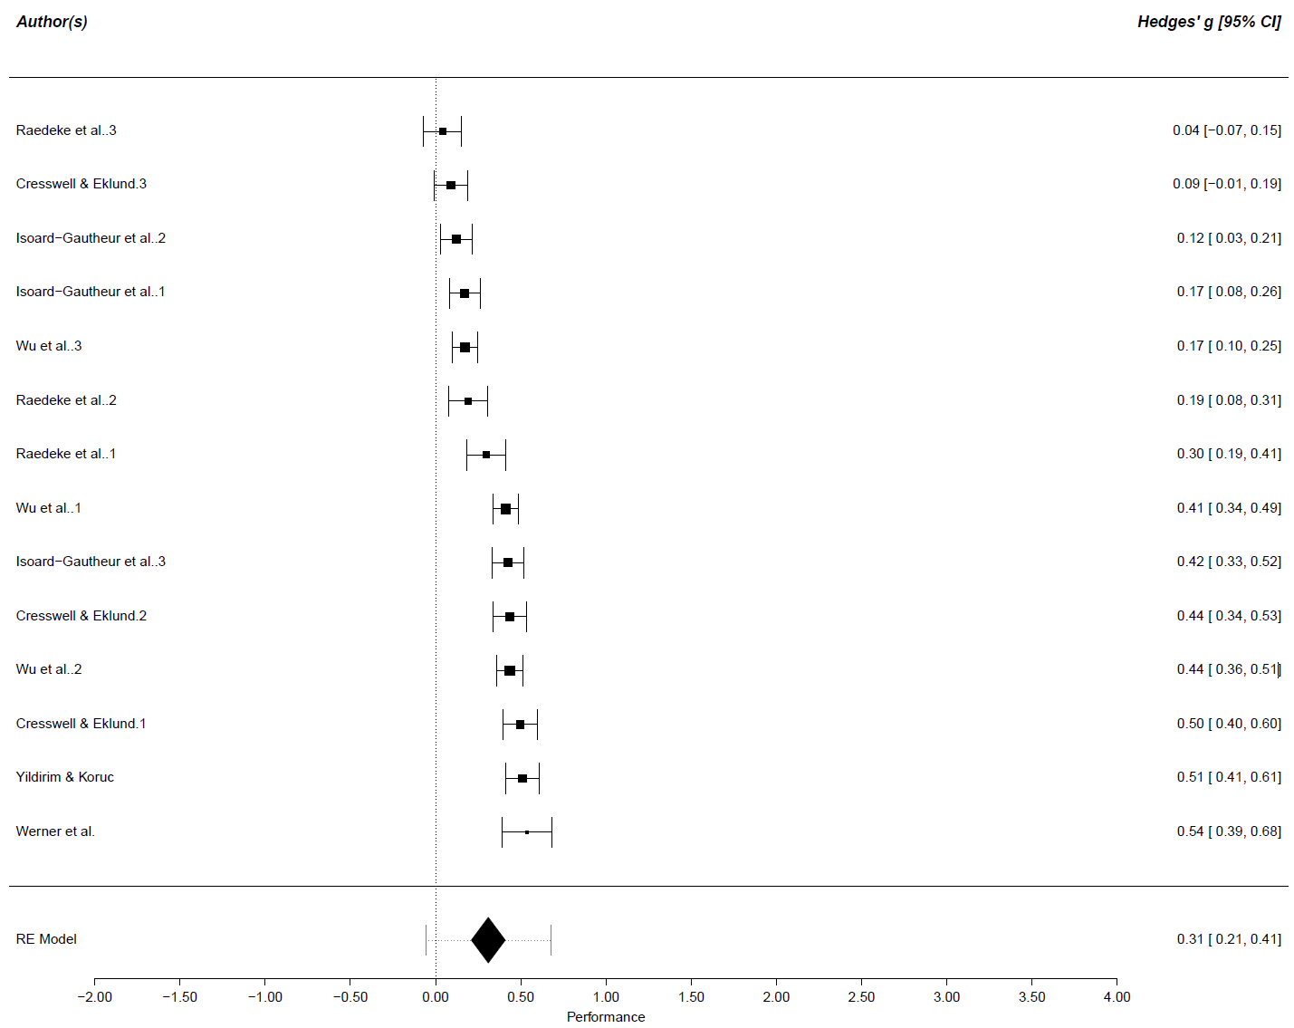
Meta-Analyses: Anxiety

Slide 24
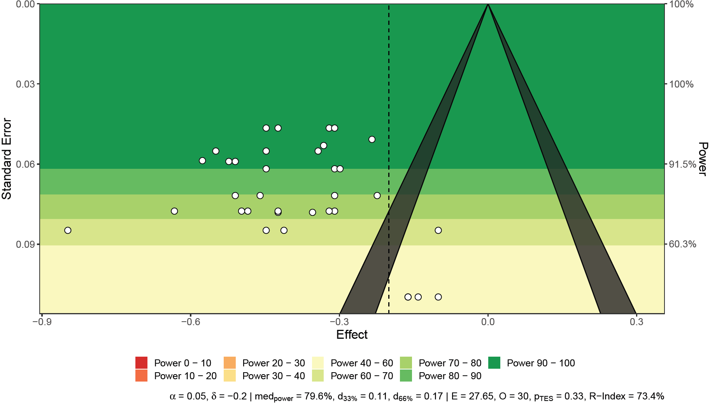
Meta-Analyses: Satisfaction
$r^{+}$ = -.37, 95% CI [-.44; -.33], p < .001, [g = -.39])
- Not affected by outliers
Low likelihood of publication bias
Significant moderators:
Burnout dimension

Slide 25
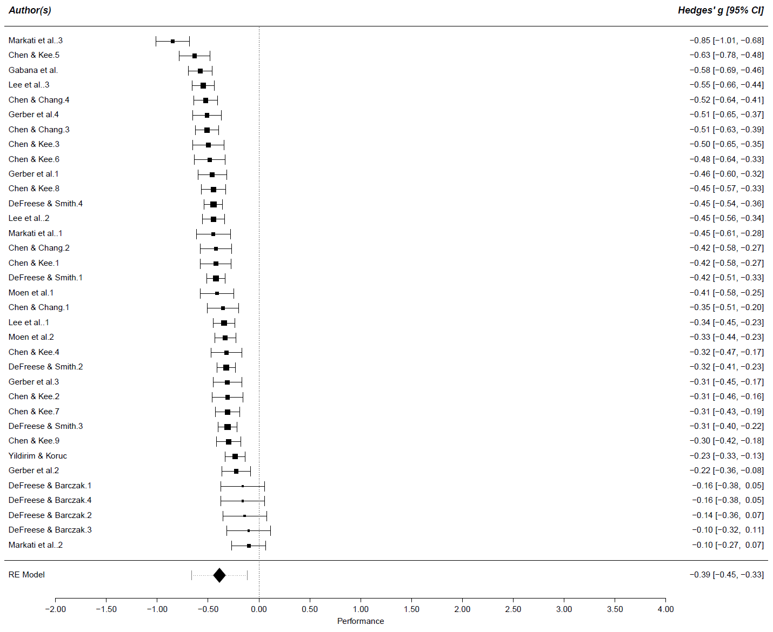
Meta-Analyses: Satisfaction

Slide 26
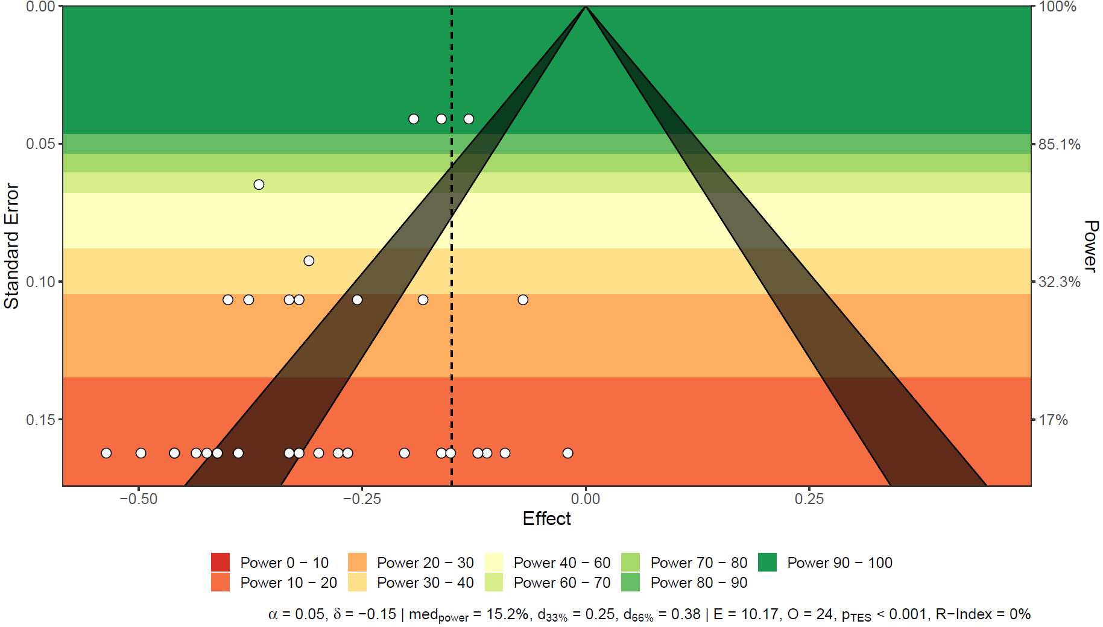
Meta-Analyses: Vitality
$r^{+}$ = -.26, 95% CI [-.34; -.19], p < .001, [g = -.27])
- Affected by outliers (above values are following exclusion of outliers)
Low likelihood of publication bias
Significant moderators: none

Slide 27
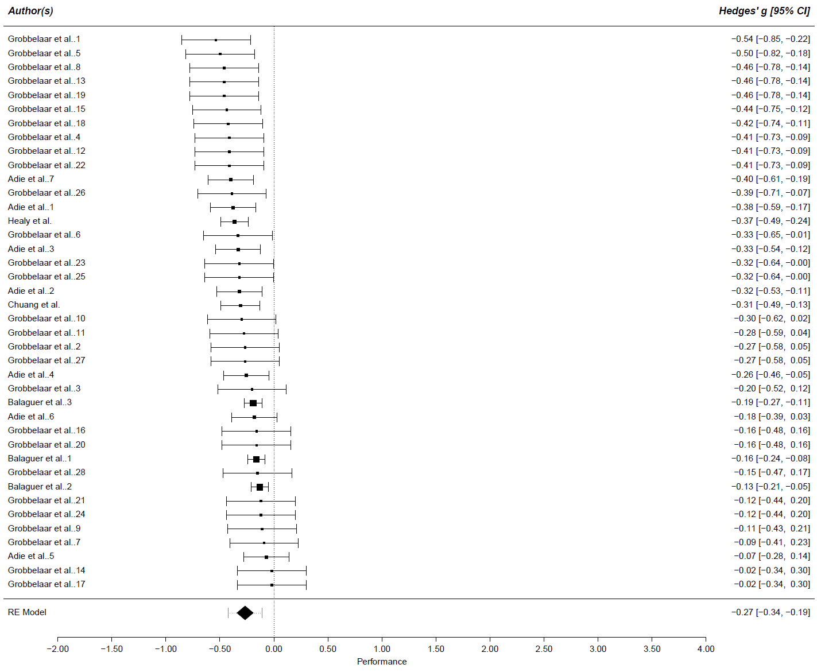
Meta-Analyses: Vitality

Slide 28
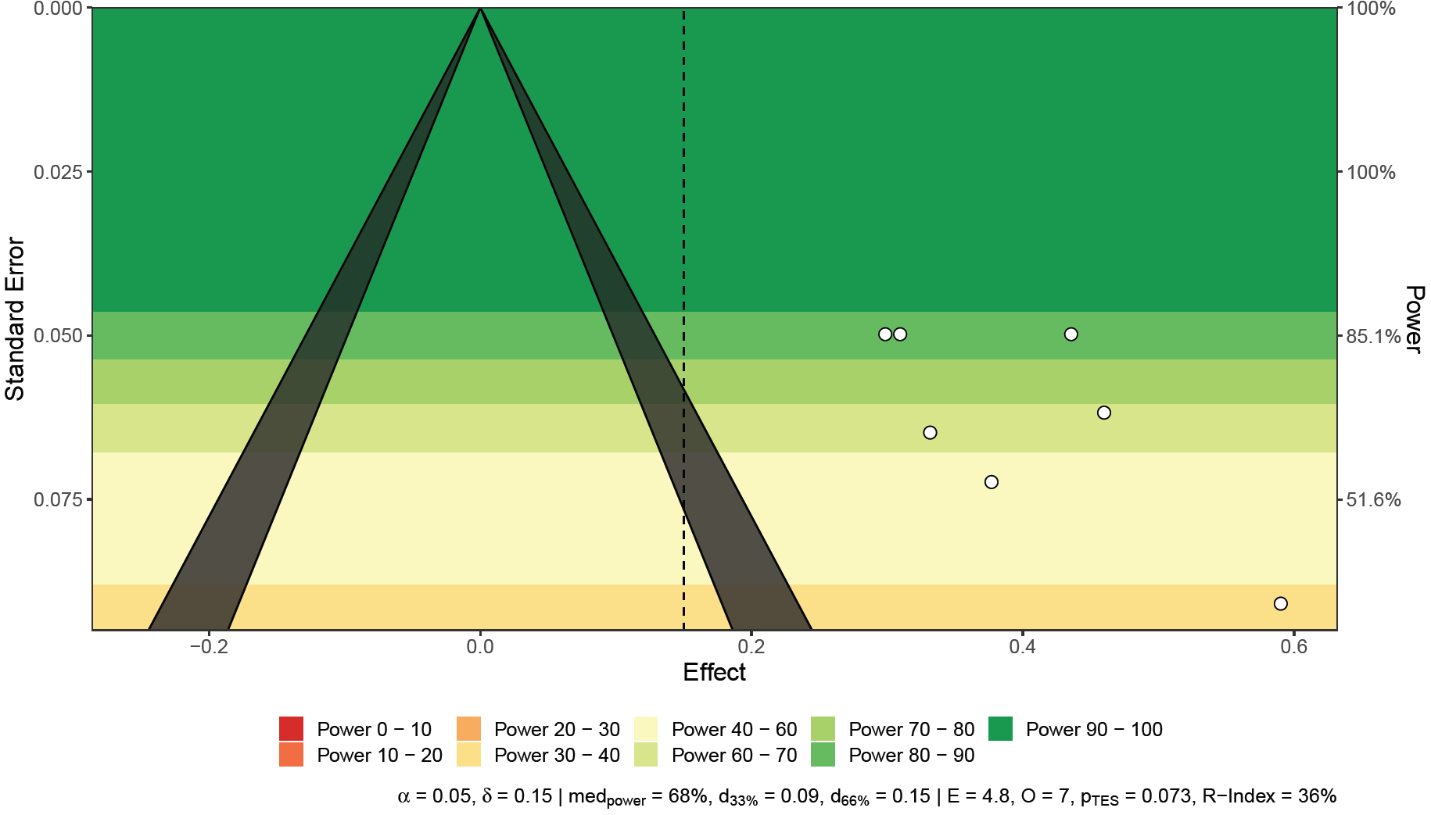
Meta-Analyses: Physical Symptoms
$r^{+}$ = .38, 95% CI [.30; .49], p < .001, [g = .40])
No meaningful partitioning of variance
Not affected by outliers
Low likelihood of publication bias
Significant moderators: none

Slide 29
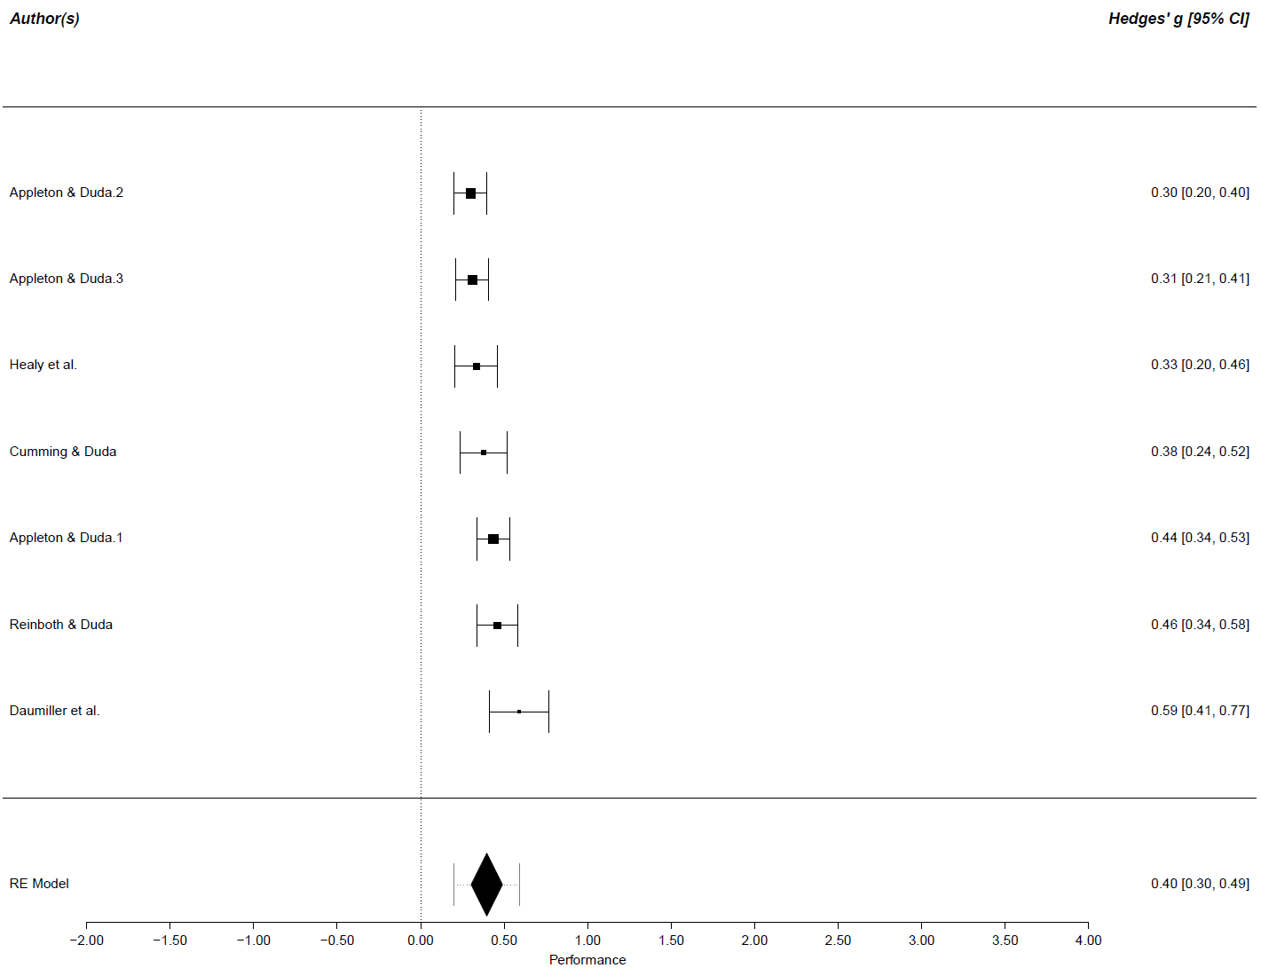
Meta-Analyses: Physical Symptoms

