Slide 1
Short Term Ethnography and its Value in Relation to Education Research Work-in-progress paper: essayistic reflection on fieldwork
Ruth Unsworth, Senior Lecturer (ITE)
York St John University, England
r.unsworth@yorksj.ac.uk

Slide 2
What influences the formation of teachers’ classroom practices?
Unified theoretical framework: ANT-LS
Classroom practices as an actor-network (produced through the ways that social, material and metaphysical actors associate and order)
Literacy studies as a ‘way in’ to a textually saturated profession (literacy practices within a school: how texts mediate/ are mediated by action within literacy events)
Does this matter to a discussion of short-term ethnography?
Maybe.

Slide 3
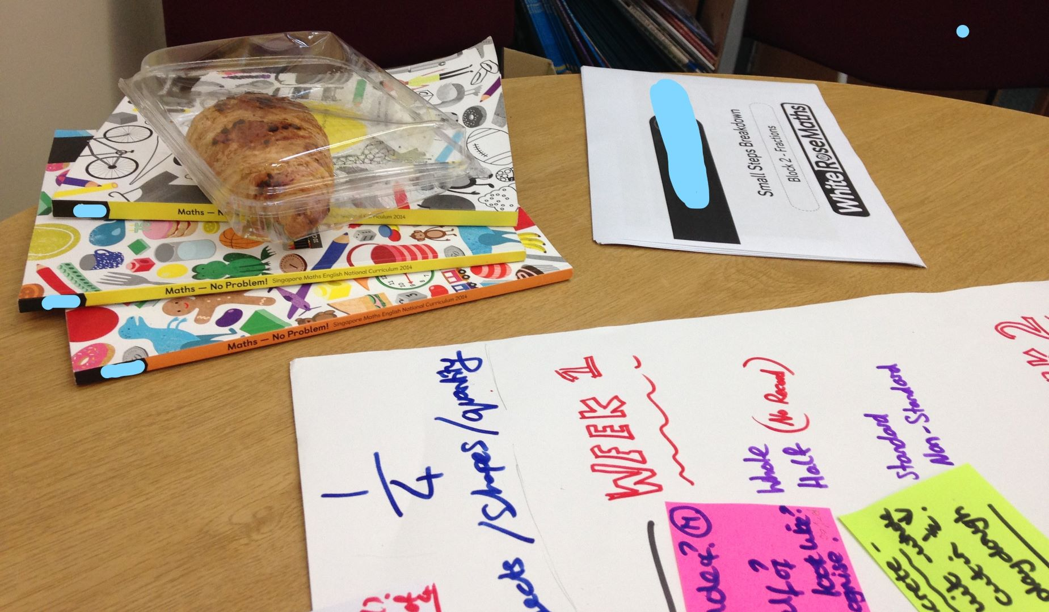
4 months (April-July 2018)
One English primary school
Daily professional lives (ten teachers, a school leader, a teacher trainer)
12 semi-structured interviews
86 documents analysed

Slide 4
Short-term ethnography and education research
A (very) brief history
Education as episodic
Study of episodes illuminates parts of a wider, complex picture

Slide 5
Common criticisms of shorter fieldwork periods
Hurry and harry (Wolcott, 1999)
Need time for naturalisation, familiarisation and knowledge through observation
Comprehensive picture of culture not possible
Cartoon Credit: Chris Ryan/Nature https://www.nature.com/articles/nj7534-401a

Slide 6
What is short-term ethnography?
Study of selected episodes/ culture traits
Researcher positionality: an insider
Making the familiar unfamiliar (Knoblauch, 2005)
Observer-as-participant (Higginbottom et al., 2013)
Early selection of a focus: an episode/ small trait
Intensive, immediate, ongoing iterative induction analysis

Slide 7
Challenges faced by the short-term researcher
Study of selected episodes/ culture traits
Researcher positionality: an insider
Making the familiar unfamiliar (Knoblauch, 2005)
Observer-as-participant (Higginbottom et al., 2013)
Early selection of a focus: an episode/ small trait
Intensive, immediate, ongoing iterative induction analysis

Slide 8
Challenge: Selecting a focus
Critique: Potential for missing parts of the culture which unlock its working (Wolcott, 1999)

Slide 9
Pre-fieldwork

Slide 10
Immediate and ongoing iterative inductive analysis

Slide 11
Seek an authentic episode: open dialogue

Slide 12
Challenge: hurry and harry (Wolcott, 1999). Harried: feeling strained as a result of having demands persistently made on one; harassed. What influence does this state of mind have on the selection of focus and gathering of data?

Slide 13
Challenge: Consequences of familiarity
“So, I’m going to tell you this because you’re one of us…”

Slide 14
‘Conclusions’: my perspective
Pro:
detailed account of ‘episodes’ in the lived experience of education
Con:
too short a time explore in depth more than episodes/ culture traits
Relies on:
Intensive preparation
Immediate and ongoing iterative-inductive analysis
Open, two-way dialogue with participants
‘Insider’ familiarity
Maintaining awareness of ethics: field relationships

Slide 15
Questions
Are there points you would like greater focus on in the paper?
Any questions?

