Slide 1
Optimising kanji order in teaching Japanese using corpora
TaLC 2022
Sara Librenjak, PhD
Lecturer in Japanese and Linguistics
York St John University

Slide 2
Outline
Japanese language teaching and kanji script
Kanji teaching order – research and optimisation
Japanese language corpora and kanji frequency
Model of an algorithm for a goal-based kanji ordering
Application and evaluation

Slide 3
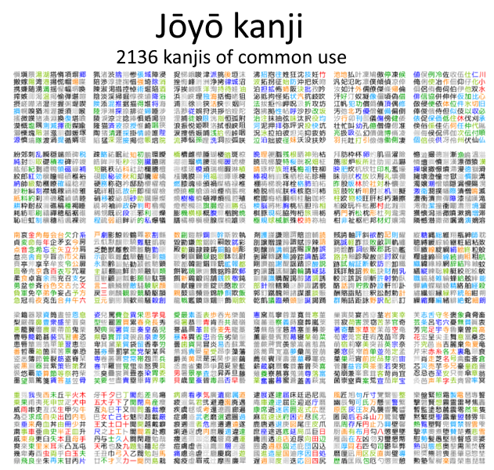
Japanese language teaching and kanji script
Three* scripts
ひらがな カタカナ 漢字
2136 regular use characters and countless combinations and readings

Slide 4
Kanji teaching order
Japanese school order (for native speakers)
Textbooks for learners of Japanese as a second language
Other materials and research
What can we learn from teaching order of Chinese hanzi
Japanese kanji order research

Slide 5
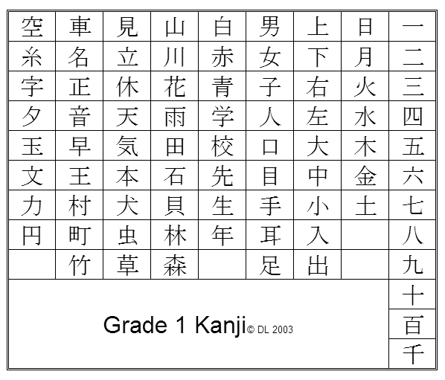
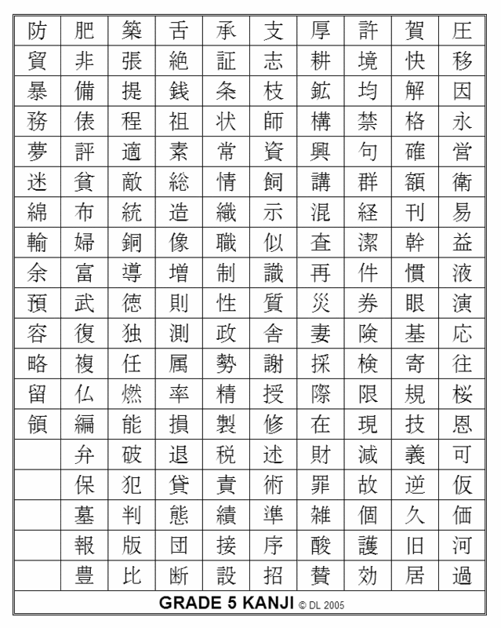
Order as taught in Japanese schools
Elementary school Grade 1-6 – 1026 kyoiku kanji
Middle school and High school – remaining jouyou kanji

Slide 6
Order as taugh it textbooks for foreign learners
Influenced by school grade order, JLPT (standard test), word frequency, semantic groups and word combinations
Not considered:
Kanji complexity and similarity
Components (part before the whole)
Kanji strategies and excercises well prepared, but kanji order as an afterthought

Slide 7
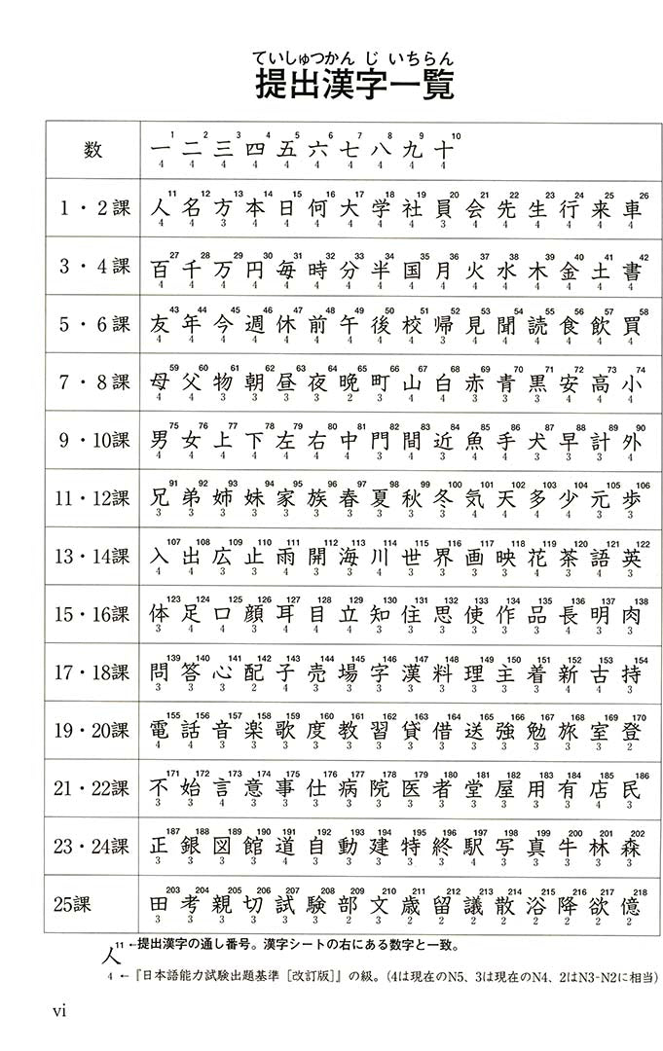
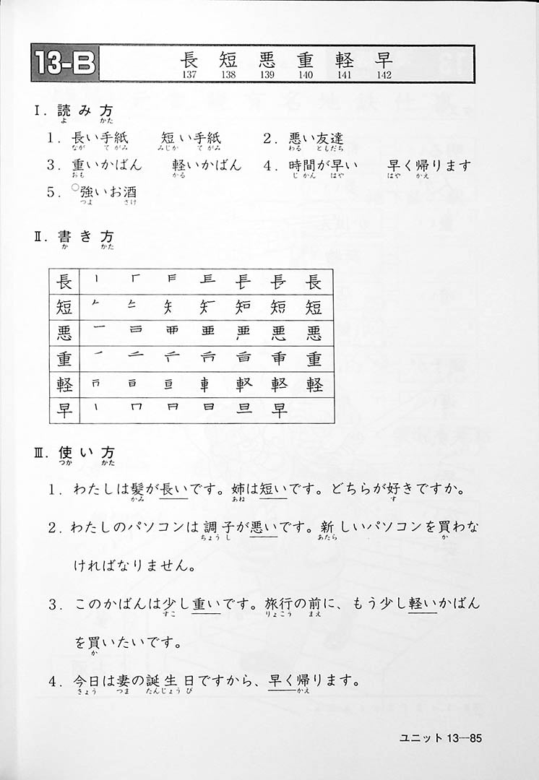
Minna no Nihongo textbook – vocabulary integrated approach

Slide 8
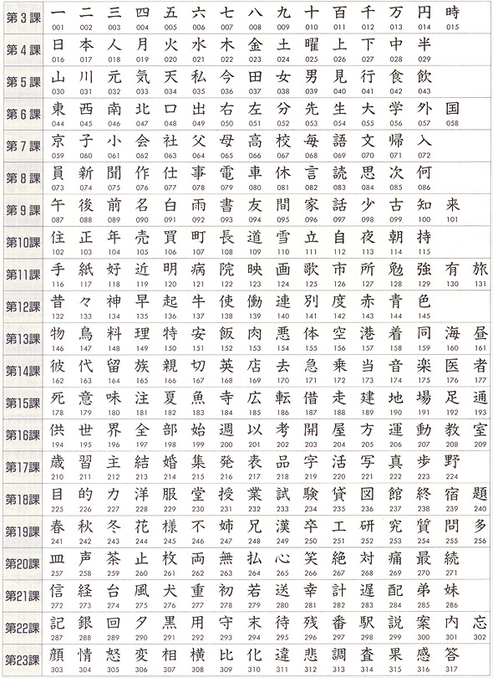
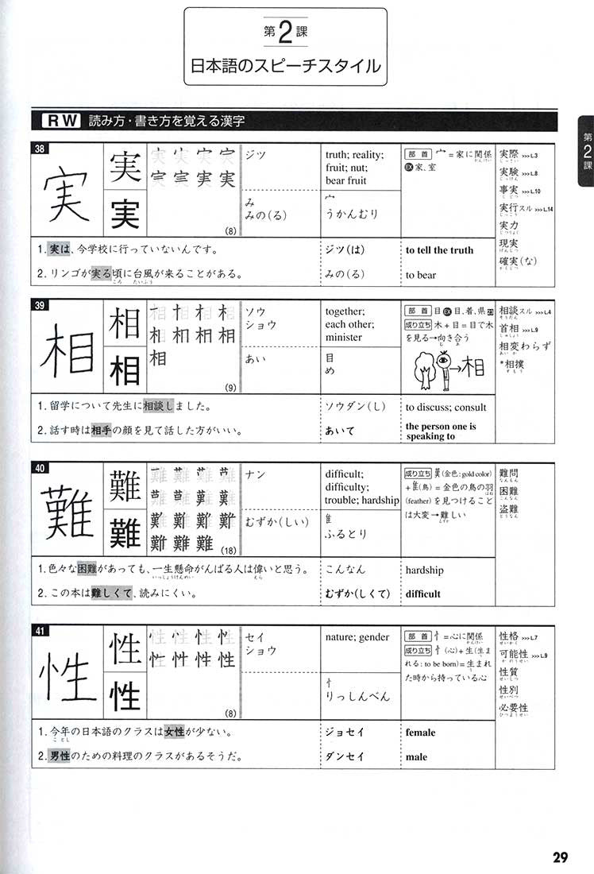
Left:
Genki 1 and 2 kanji
Right: Tobira supplementary textbook

Slide 9
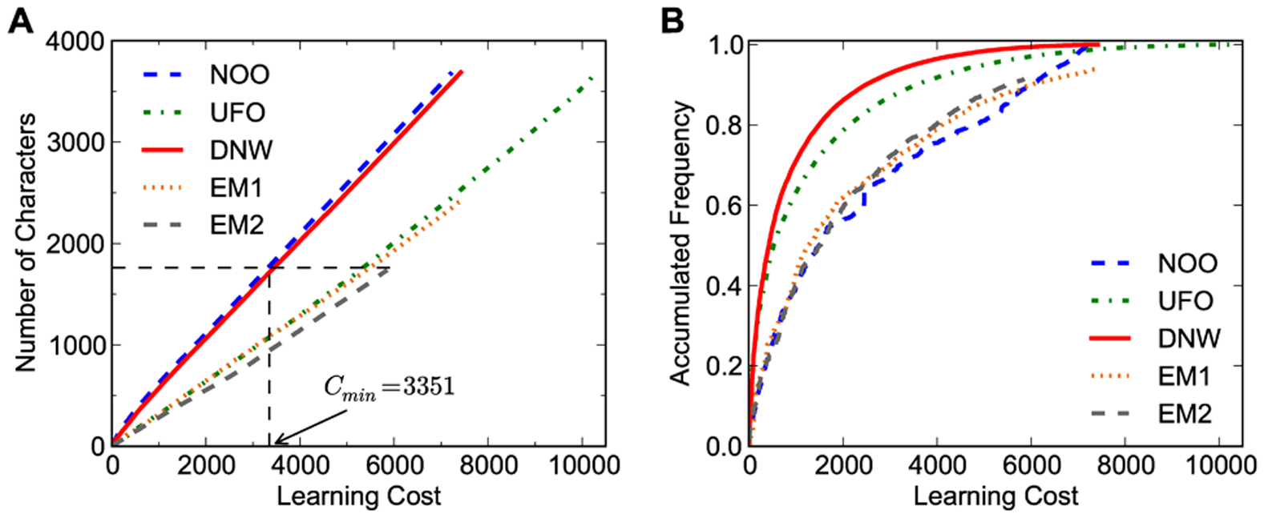
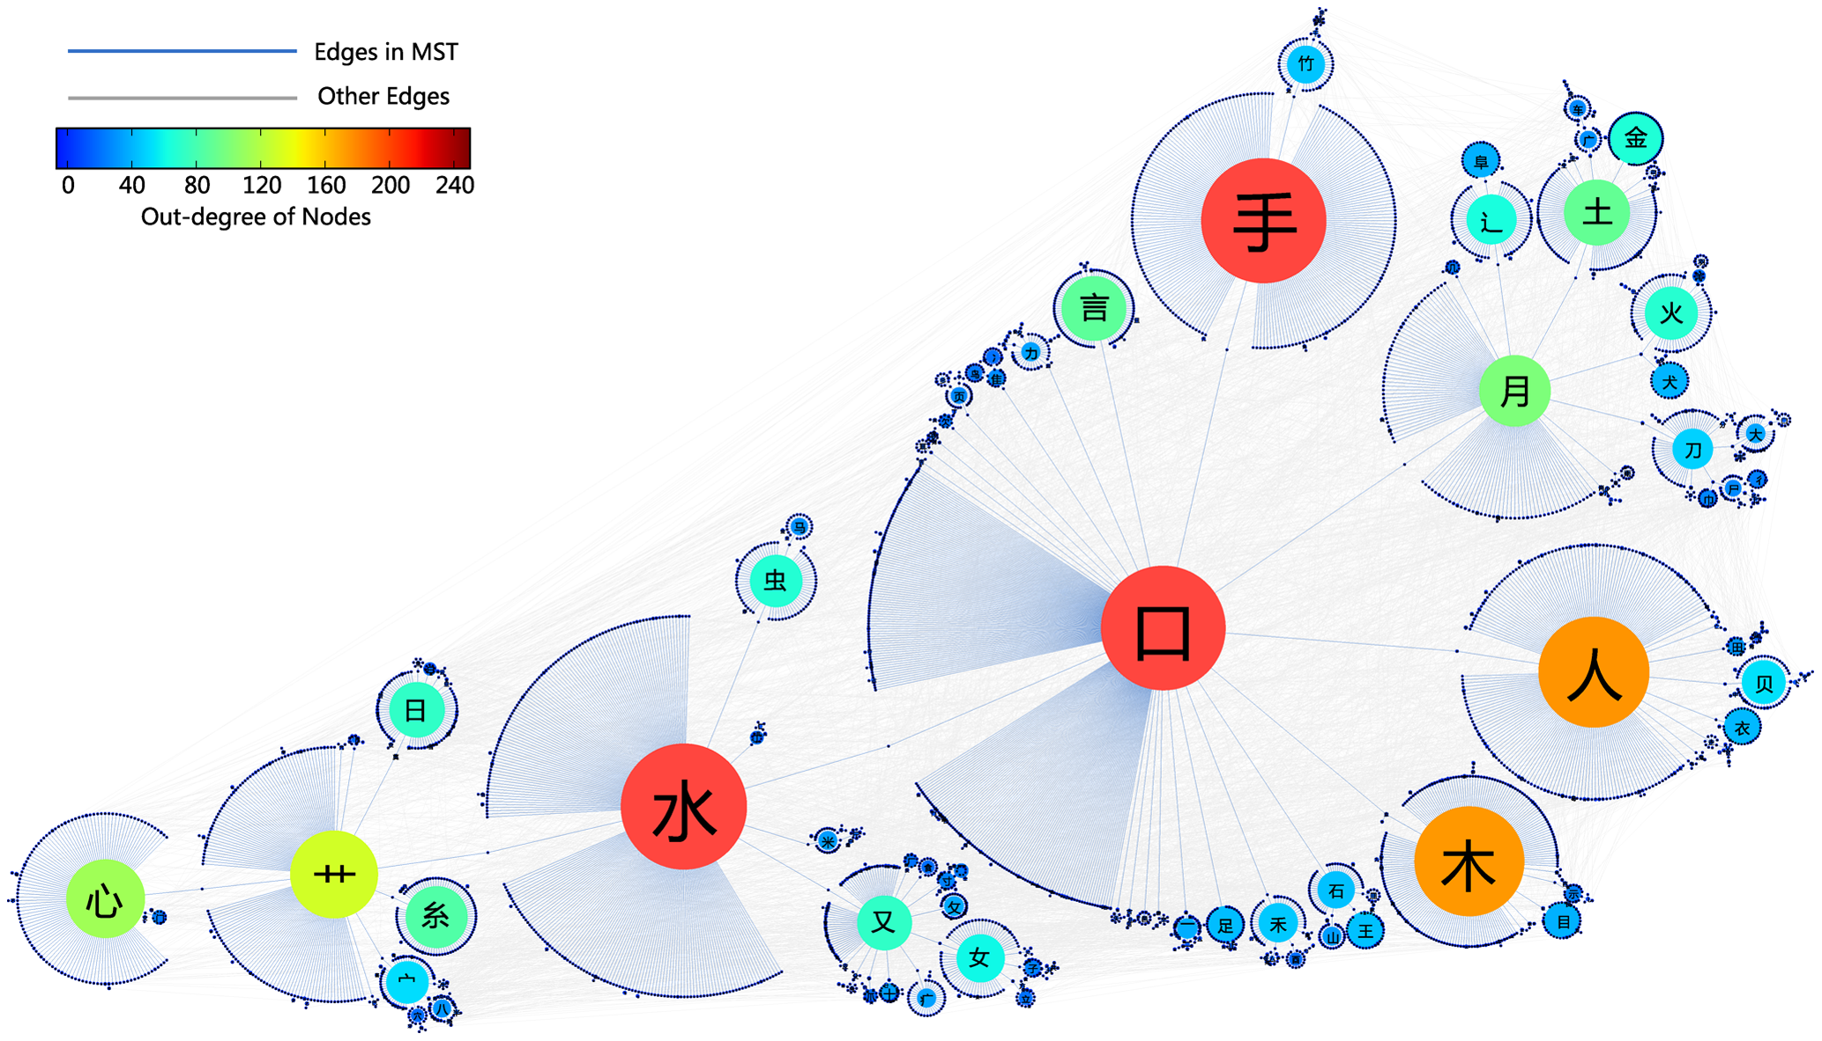
Optimisation of the teaching order – example of Chinese Hanzi
Yan et al. (2013) – concept of weights and learning cost

Slide 10
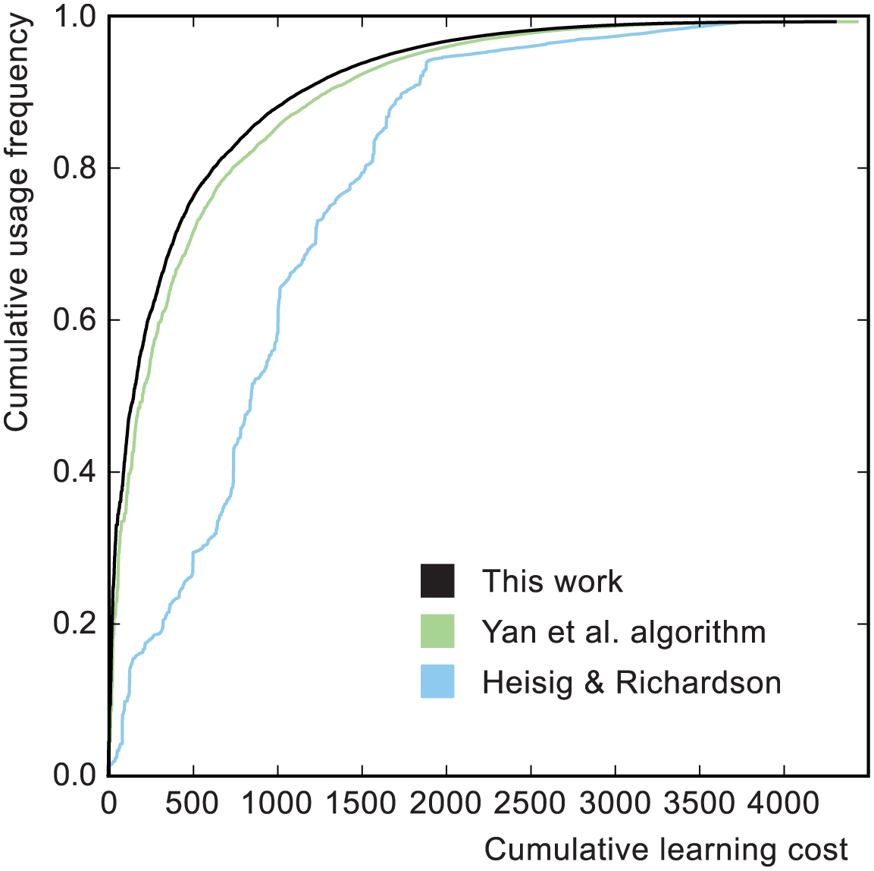
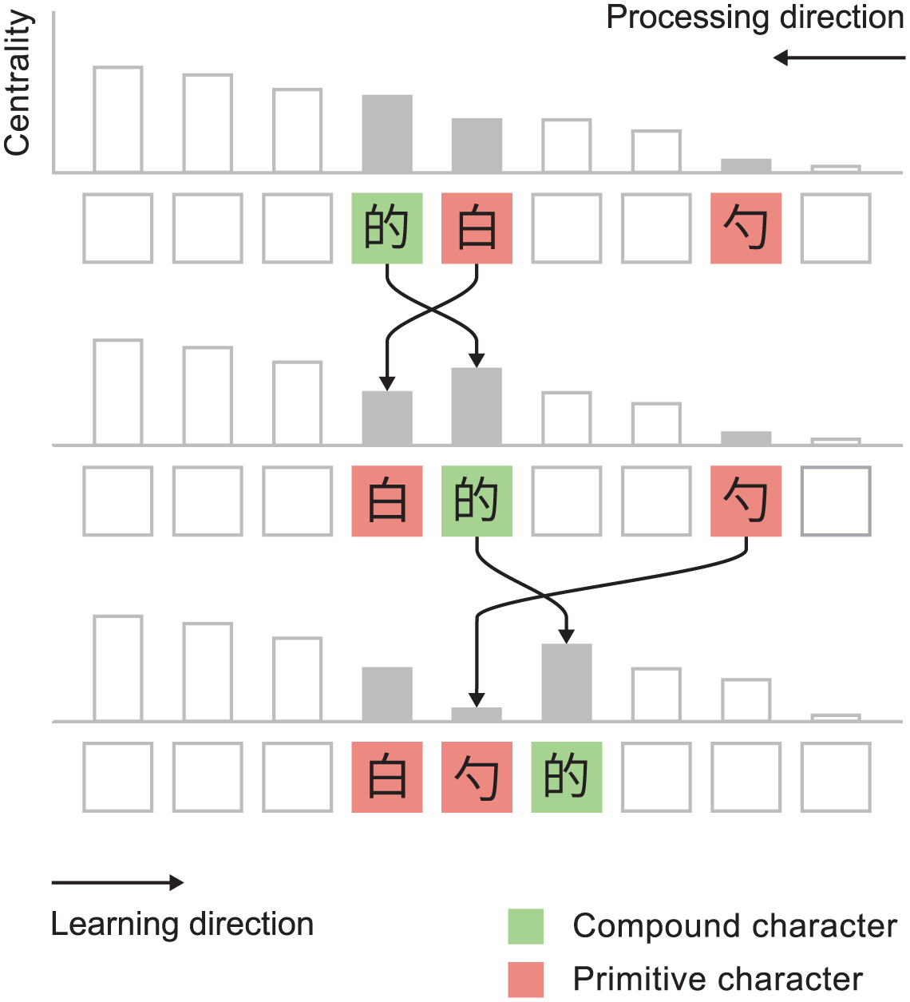
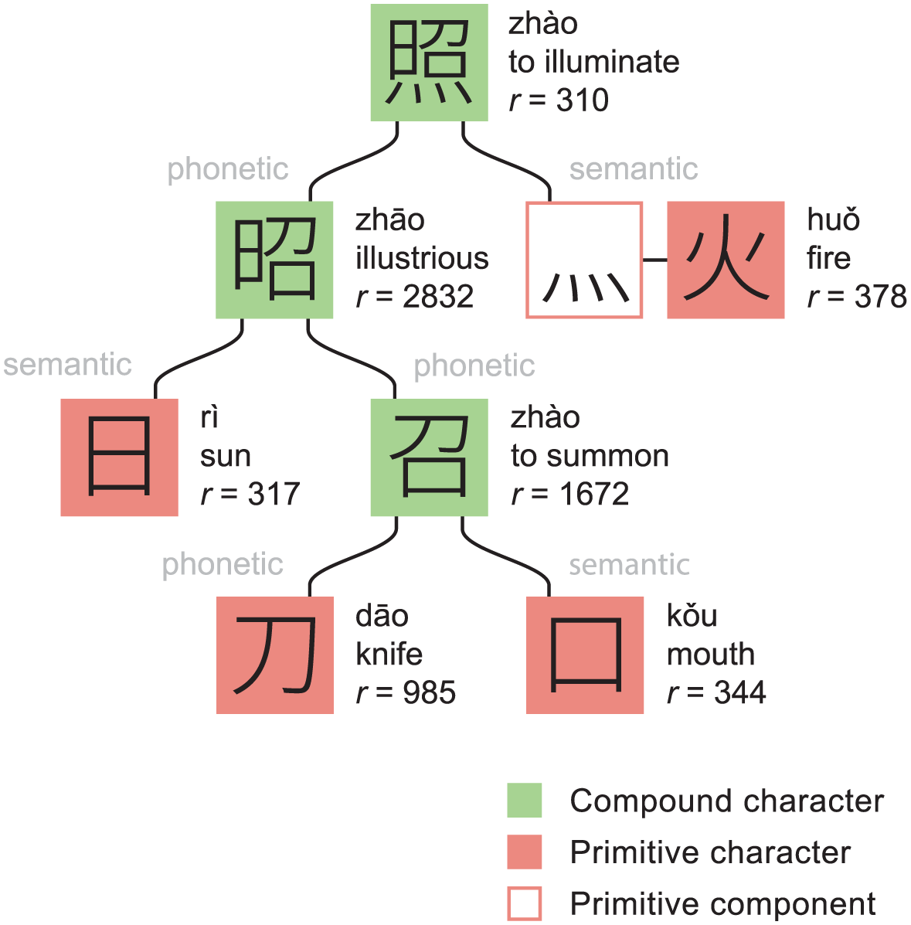
Optimisation of the teaching order – example of Chinese Hanzi
Loach and Wang (2016)

Slide 11
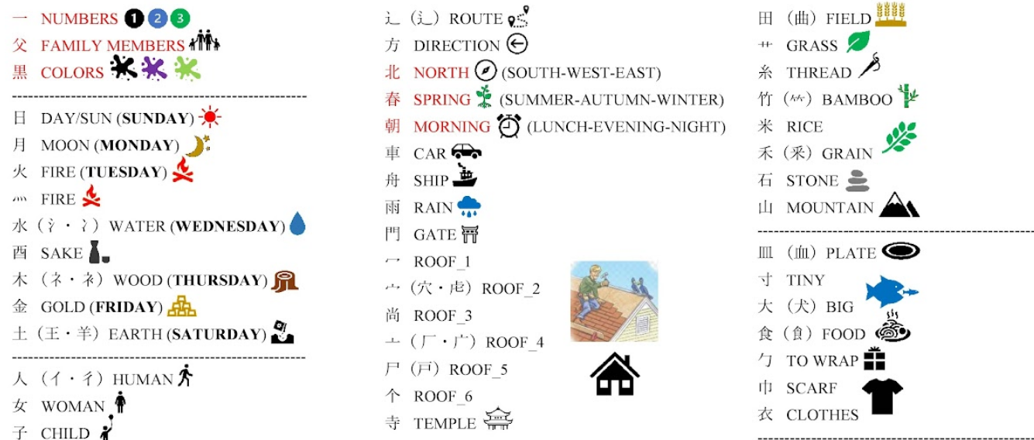
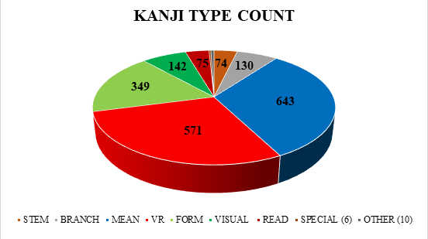
Research on kanji order in Japanese
Paxton (2015) – first mention of importantce of teaching order and rating the difficulty of various orders
Kandrac (2021, 2022) – MBO (multicriteria-based ordering)
So far most comprehensive work on ordering kanji with the goal of optimisation
Based on kanji types and frequency groups; somewhat adaptable

Slide 12
Japanese language corpora
Japanese web corpus 2011 (jaTenTen11) - 8 billion words
Other smaller corpora available on Sketch Engine
Sketch Engine best for word and term research, not kanji research
NINJAL (National Institute for Japanese Language and Linguistics)
Balanced Corpus of Contemporary Written Japanese (104 MW)
NINJAL Web Japanese Corpus (10 BW)
Tsukuba Web corpus (1.1 BW)
Corpus of Modern Japanese
And many more variants (spoken, dialect, old Japanese, historical Japanese)

Slide 13
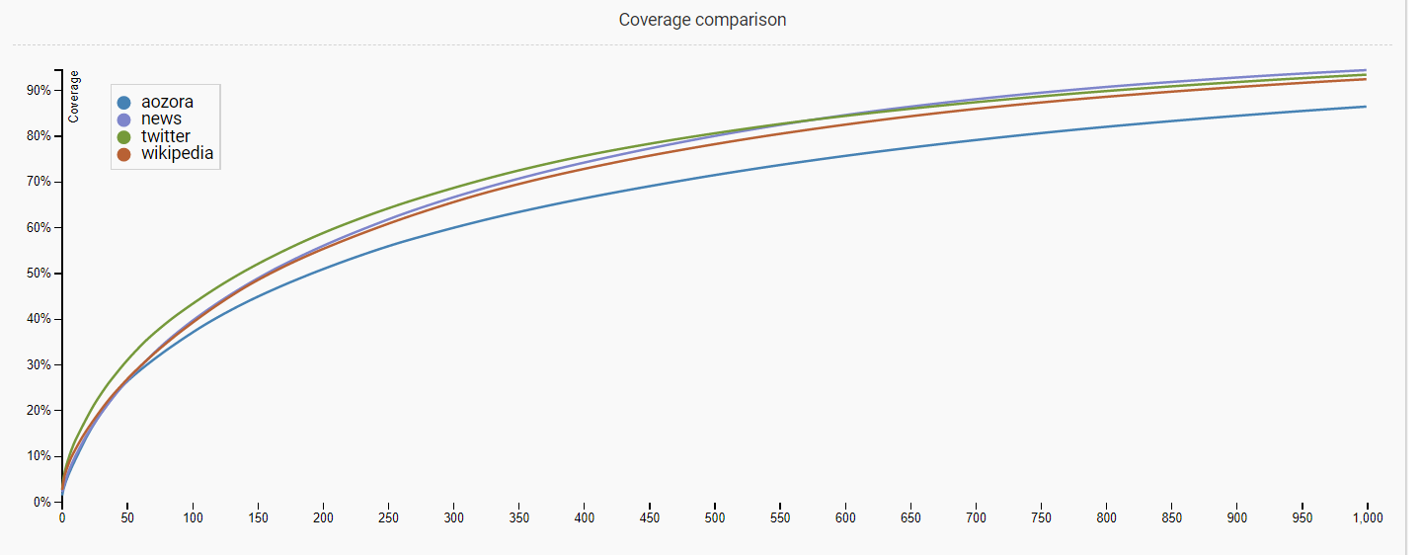
Kanji frequency data in web corpora
Corpora not always open for kanji frequency and statistics
Open web corpora (Shpika, 2016)
Literature (Aozora Bunko) corpus – 51.5 M kanji, 6117 distinct
News Web corpus (Asahi, Mainichi, Saga, Yomiuri) – 10 M kanji, 3639 distinct
Twitter (2015) – 10 M kanji, 4516 distinct
Wikipedia (2015) – 784 M kanji, 20932 distinct
Also by Yatskov (2010)
First 150 characters learned = 50% of all characters in text!
It matters which characters are taught first.

Slide 14
Differences in various databases
From Kandrač (2022) Kanji frequency comparison table v.1.1
Differences in frequency throughout databases -> frequency is relative
Can’t be used as the only criteria to determine order
Different purposes require different kanji
This supports goal-based optimisation vs. absolute optimisation

Slide 15
Proposed solution for optimising
There is no single solution for the best kanji order, but some are better than other
Step 1: Design an algorithm for optimisation based on:
Kanji frequency, components and topological sort
Step 2: Modify the order based on chosen goals
Relative weight modified by chosen textbook, JLPT level, learning goal (e.g. travel, literature, news)
Possible removal of already known characters – adaptable for continuing learners and not just beginners

Slide 16
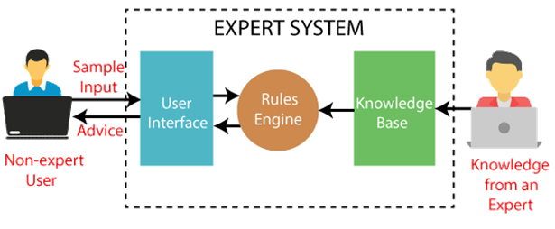
Model based on an Expert system
An expert system is the type of AI popular in the 1980s, not typically used in education (medicine, business)
Knowledge base and Rules engine (finite number of facts and rules) make it applicable for kanji ordering

Slide 17
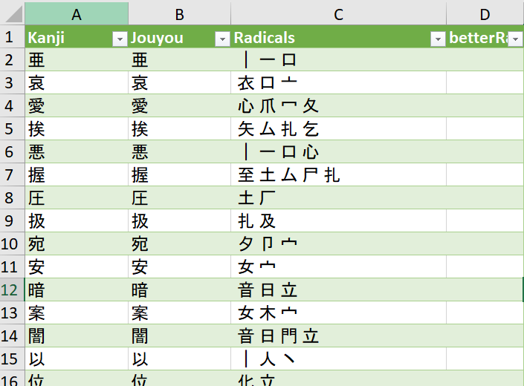
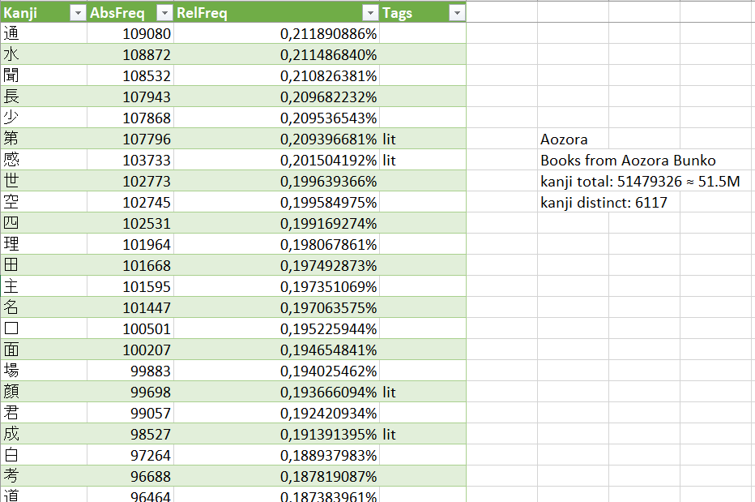
Model of an algorithm for a goal-based kanji ordering
Knowledge base consists of a set of tables:
Main table (list of kanji, their readings, components, meanings)
Frequency tables
Common goals tables
Textbooks, JLPT, School grades, reading, travel
Used to calculate the basic weights, subsequently modified by user choices in the Rules engine

Slide 18
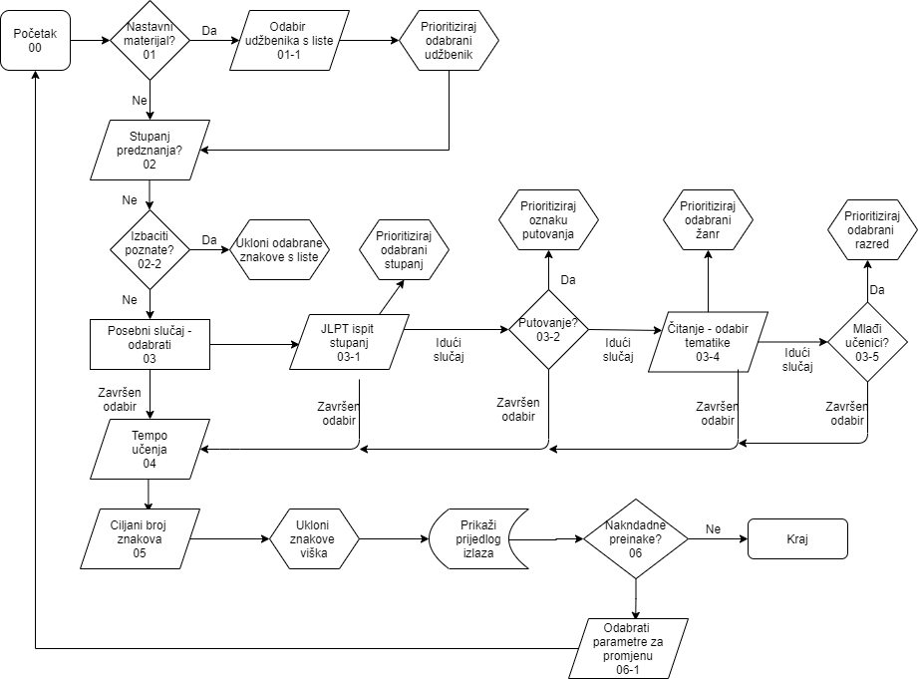
Model of an algorithm for a goal-based kanji ordering
Rule engine diagram

Slide 19
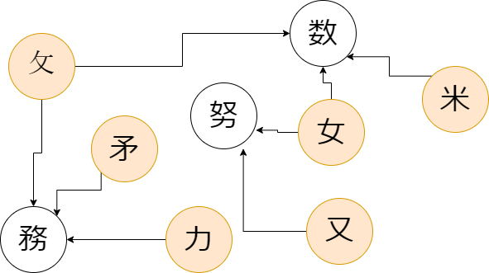
Model of an algorithm for a goal-based kanji ordering
The order of operations
START
Load characters
Load initial weights
Start TopoSort function
Example output (Minna no Nihongo 1 kanji in 10 units)
Unit |  | Count | Cumulative count
1 | 一二三四五六七八九十 | 10 | 10
2 | 人日月明口田山川 | 9 | 19
3 | 生先火水木本金土中円 | 10 | 29
4 | 白百目自半千午牛年 | 9 | 38
5 | 行来見元万方分出寺時 | 10 | 48
6 | 大犬天父文小少子字学 | 10 | 58
7 | 女母毎海安男兄弟妹姉 | 10 | 68
8 | 今会心思社休体仕食飲 | 10 | 78
9 | 上止正下不林校森楽 | 9 | 87
10 | 車帰気刀切前糸後 | 8 | 95
OUTPUT
Start DivideByGroups function

Slide 20
Application and evaluation
Tested over two semesters at Juraj Dobrila University of Pula, Croatia
Module open for students of Japanese Language and Culture from years 1-3
After completing the module, students (N=43) answered the survey and compared the new learning order to Minna no Nihongo 1 learning order they used before
Students were all using the textbook Minna no Nihongo in other classes, so the order aimed to optimise for the textbook users
Second criteria – optimisation for JLPT N5/4 takers

Slide 21
Proposed optimised order and Minna no Nihongo 1 order
Week | Taught characters list | Count
1 | 一二三四五六七八九十 | 10
2 | 人亻木本口月夕名日目自大太犬 | 14
3 | 子学字可何同向土士王玉ネ社会今全金 | 17
4 | ハル貝見員買生先彳行米来𠦝車東国 | 16
5 | 百白千万方円月火水曜翟羽隹半刀刃分力丸 | 19
6 | 父兄母⽏毎寸寺時待持手扌𦘒⺻書今会合 | 18
7 | Review | 0
8 | Test 1 | 0
9 | 𠂇又友右工左午牛年休体門問間聞耳 | 16
10 | 吉𠮷周週刖刂前糸後夂夊攵交校巾帚帰 | 17
11 | 言舌話売読語良食飲欠女好 | 12
12 | 𠦝朝尺昼免晩田男町丁山出入 | 13
13 | 上下中外小少多安高元気天夫 | 13
14 | Review | 0
15 | Test 2 | 0
Total |  | 165

Slide 22
Semester 2 kanji teaching order
Week | Goal characters | Count
1 | 不文川明有色角用内肉星青晴 | 13
2 | 止正歩兄足走起立音暗春 | 11
3 | 村林森公私秋冬夏毛彡毎海 | 12
4 | 早草古占点店勉重動切豚家 | 12
5 | 衣旅氏長族世也地市姉首道 | 12
6 | Test 1 | 0
7 | 未味妹台始弓引弟弱虫強 | 11
8 | 主注住矢知医計記式試画界番 | 13
9 | 馬駅験仕代作親斤新反飯 | 12
10 | 事業乗集建貸質赤変空 | 10
11 | 宮官館去至室屋羊南病雨電 | 11
12 | 心思急悪意楽習北化花西酒 | 11
13 | 使便昔借働石岩研開閉与写死 | 13
14 | Review | 0
15 | Test 2 | 0
Total |  | 141
Coverage:
Minna no Nihongo 1 – 80,27%
JLPT N5 – 100%
JLPT N4 – 65,74%
Grades 1 - 100%, Grade 2 - 63%
Grade 3 - 25%, Grade 4 - 10%

Slide 23
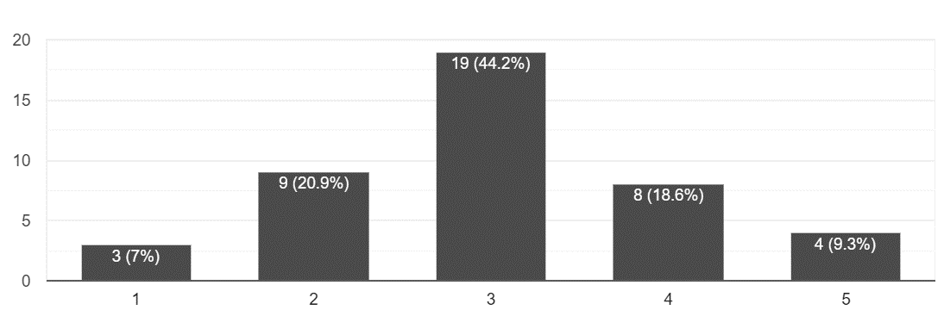
Evaluation
How would you rate the learning order in Minna no Nihongo?
Did the kanji order taught in this module make it easier to study kanji?
Average 3.02 / 5
Average 4.04 / 5

Slide 24
Evaluation
Majority of participants left positive qualitative comments
Suggestions for improvement:
Semantic / thematic grouping
No kanji in other Japanese class should be taught
Sort them by the stroke count -> probably not a good idea (unless for review)
Even more grouping by components and visual similarity
Suggestions were varied
No agreement on the group level

Slide 25
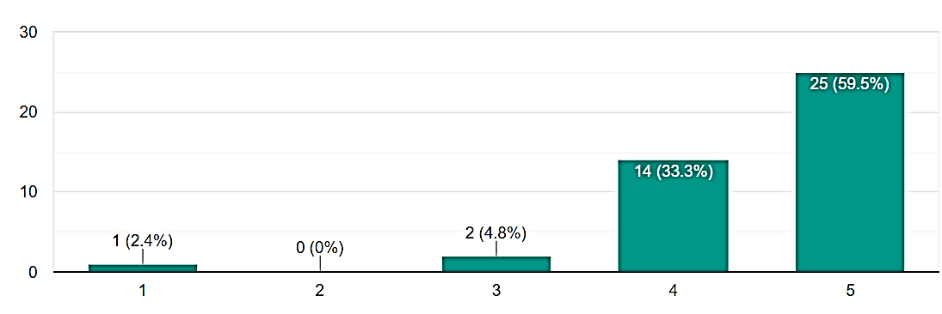
Evaluation
Did this module improve your kanji knowledge? (1 = not at all, 5 = very much)
Did this module affect your attitude towards kanji difficulty?
Did this module make you consider kanji more interesting?
4,47 / 5
4,35 / 5
4,46 / 5

Slide 26
Conclusions
There is no one optimal order for teaching kanji
It needs to be tailored to the students’ needs
We can improve the attitudes and satisfaction of students with the effort of optimising the order
Self-evaluated: Their knowledge improved as well
Goal-based, weight-relative, topological sort algorithm can help ☺

Slide 27
References
Banno, E., Ohno, Y., Sakane, Y. & Shinagawa, C. (2020). Genki Vol. 1. An integrated course in elementary Japanese: 3rd edition. Tokyo: The Japan Times.
Kandrac, Patrick. (2021). Multicriteria-Based Ordering of Kanji. 10.13140/RG.2.2.28227.73762.
RADKFILE/KRADFILE. EDRDG. http://www.edrdg.org/krad/kradinf.html Accessed 07/2022
Loach JC, Wang J (2016) Optimizing the Learning Order of Chinese Characters Using a Novel Topological Sort Algorithm. PLoS ONE 11(10): e0163623. https://doi.org/10.1371/journal.pone.0163623
Paxton. S. (2015) Tackling the kanji hurdle: an investigation of kanji order and its role in facilitating the kanji learning process.. http://hdl.handle.net/1959.14/1067946
Rose, H. (2010). Kanji learning: Strategies, Motivation control and self-regulation. Doctoral Dissertation. The University of Sydney.
Shpika, D. (2016.) Kanji frequency lists. https://github.com/scriptin/kanji-frequency Accessed 07/2022
Yan X, Fan Y, Di Z, Havlin S, Wu J. Efficient Learning Strategy of Chinese Characters Based on Network Approach. PLoS ONE. 2013; 8: e69745. pmid:23990887
Yencken, L. (2010). Orthographic support for passing the reading hurdle in Japanese. PhD thesis , Department of Computer Science and Software Engineering, The University of Melbourne.

